Slide 1

Lesson 57
Grammar

Slide 2

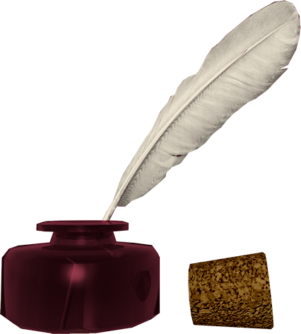
Don’t know much about history
Don’t know much biology
Don’t know much about a science book
Don’t know much about the French I took
But I do know that I love you
And I know that if you love me, too
What a wonderful world this would be
Sam Cooke – Wonderful World
Now, I don’t claim to be an A student
But I’m trying to be
For maybe by being an A student, baby
I can win your love for me
Don’t know much about history
Don’t know much biology
Don’t know much about a science book
Don’t know much about the French I took
But I do know that I love you
And I know that if you love me, too
What a wonderful world this would be
La ta ta ta ta ta ta (History)
Hmm-mm-mm (Biology)
La ta ta ta ta ta ta (Science book)
Hmm-mm-mm (French I took)
Yeah, but I do know that I love you
And I know that if you love me, too
What a wonderful world this would be
Don’t know much about geography
Don’t know much trigonometry
Don’t know much about algebra
Don’t know what a slide rule is for
But I do know one and one is two
And if this one could be with you
What a wonderful world this would be

Slide 3
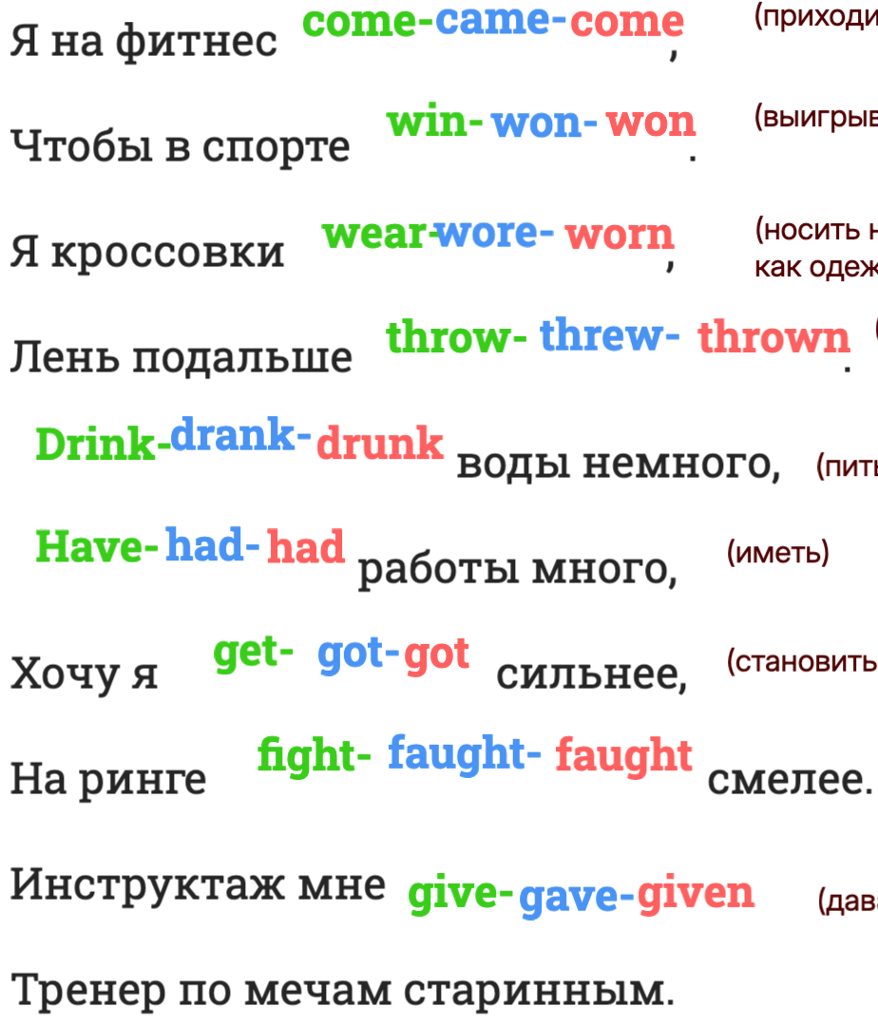
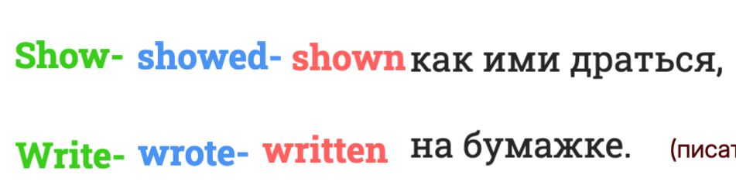
1. Present Simple.
2. Past Simple.
3. Future Simple
4. Present Continious
5. Present Perfect

Slide 4
Put the verbs in the correct form (Past Simple)
A) The Forgetful Professor
Professor Brown 1______ (be) a very clever but very forgetful man. One morning he 2______ (wake) up and 3______ (look) at the clock. It 4______ (be) already 9 o'clock! He 5______ (be) late for his lecture at the university.
He quickly 6______ (get) dressed, 7______ (take) his bag and 8______ (run) to the door. But he 9______ (not can) find his glasses. He 10______ (look) for them everywhere — on the desk, under the bed, in the bathroom. Finally, he 11______ (find) them in the refrigerator next to a jar of milk!
He 12______ (put) on his glasses and 13______ (leave) the house. He 14______ (run) to the bus stop but the bus 15______ (already leave). So he 16______ (decide) to take a taxi.
When he 17______ (arrive) at the university, his students 18______ (wait) for him. He 19______ (begin) his lecture, but after five minutes he 20______ (stop) and 21______ (say), "Oh no! I 22______ (forget) my notes at home!"
The students 23______ (laugh) and one of them 24______ (say), "Don't worry, Professor. You always forget your notes. We 25______ (bring) extra copies for you yesterday!"
Professor Brown 26______ (smile) and 27______ (thank) his students. "You 28______ (be) very kind," he 29______ (say). "Now let's begin our lesson about... hmm... what is the topic today?"

Slide 5
B) The Clever Parrot
Mr. Johnson 1______ (love) birds. He 2______ (have) a parrot named Charlie. Charlie 3______ (can) talk and he 4______ (know) more than fifty words.
One day Mr. Johnson 5______ (go) to work and 6______ (forget) to close the window. Charlie 7______ (see) the open window and 8______ (decide) to fly outside.
Charlie 9______ (fly) to a nearby park and 10______ (sit) on a tree. He 11______ (watch) children playing, dogs running and people eating lunch.
Suddenly a big black cat 12______ (appear) under the tree. Charlie 13______ (be) very scared. He 14______ (not can) fly away because the cat 15______ (be) too quick.
Charlie 16______ (think) for a moment and then he 17______ (shout) in a loud voice, "HELP! FIRE! HELP!"
People in the park 18______ (hear) the noise and 19______ (run) to the tree. The cat 20______ (be) scared of the people and 21______ (run) away.
A little girl 22______ (look) up at the tree and 23______ (say), "Look, Mummy! A parrot! And he 24______ (talk)!"
Charlie 25______ (fly) down to the girl's shoulder. Mr. Johnson 26______ (be) very happy when he 27______ (find) his clever parrot at the police station that evening.

Slide 6
Bonus Activity for Fast Finishers
Ask students to write 5 questions about either story for their partner to answer.
Example:
Why did Professor Brown run to the bus stop?
Where did Charlie sit after he flew away?

