Slide 1

Lesson 56
Audio: A Day in Bath

Slide 2

Big Ben song
700 species in London Zoo
Reptiles*, Amphibians, Invertebrates too *[1st time only]
Penguins waddle, crocodiles snap
No you can't stroke a crocodile on your lap! (^2)
Round and round goes The London Eye
It's 130 meters high
Buckingham Palace is where The Queen sleeps
And The Prime Minister at Downing Street. (^2)
If you're tired, and need to eat
get fish n chips and a cup of tea.
Big Ben is not a person
Big Ben is not a clock
Big Ben is not a tower
It's a bell: ding dong (^2)
A Science museum, to learn about space
Astronauts, rockets, awesome place
At the British Museum you can see
Egyptian mummies; it's free! (^2)

Slide 3
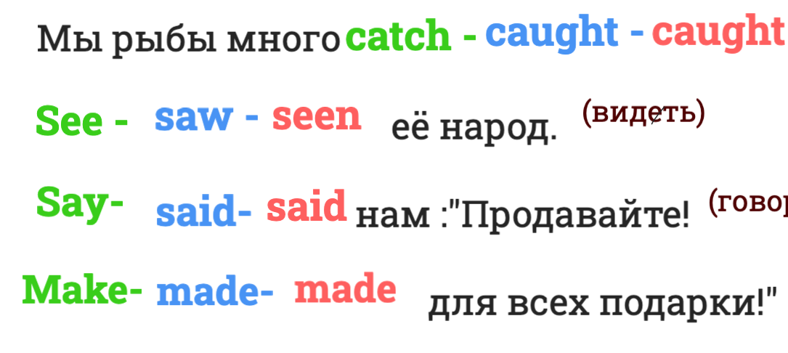
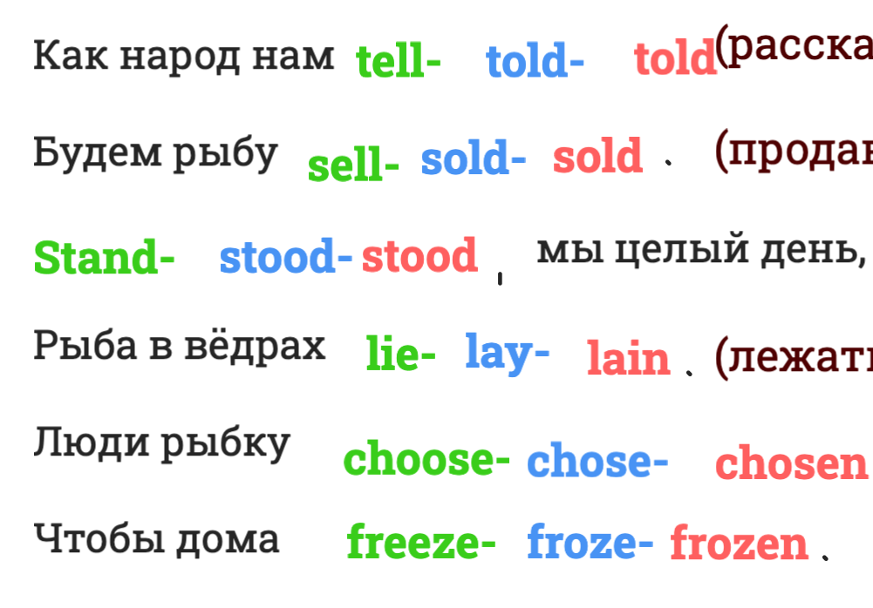
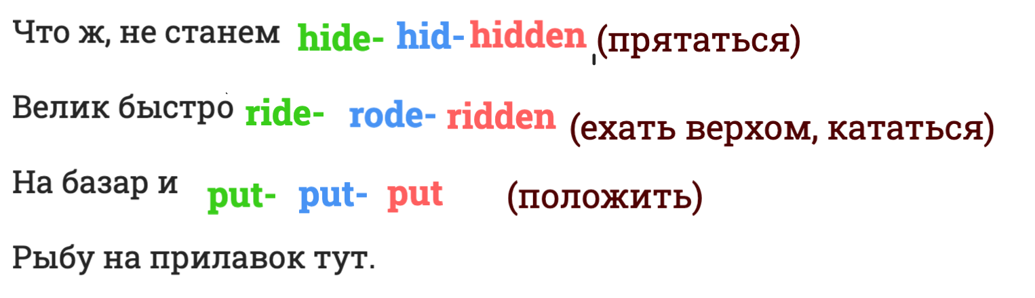
1. Present Simple
2. Past simple
3. Future Simple
4. Present Continious
5. Present Perfect

Slide 4
a tour guide
weather forecast
a coach
an abbey
a row
arrive
Roman baths
a pub
Royal Crescent
Georgian architecture
Yorkshire pudding
A day in Bath (audio)

Slide 5
Tasks for "A Day in Bath"
1. What is the tour guide's name?
A) Daniel B) David C) Denis D) Douglas
2. What does the weather forecast say?
A) It will be rainy and cold.
B) The sun is shining with a light warm wind.
C) There will be a storm in the afternoon.
D) It will be cloudy with no rain.
3. What do the tourists NOT need to take with them?
A) Jackets and umbrellas
B) Cameras and phones
C) Money and maps
D) Water and snacks
4. When does the coach arrive?
A) In about ten minutes
B) In about twenty minutes
C) In about half an hour
D) In about an hour
5. What is the city of Bath famous for?
A) Its modern skyscrapers and shopping centres
B) Its Roman baths and Georgian architecture
C) Its famous university and libraries
D) Its large airport and stadium
6. Where do the tourists have lunch?
A) At a traditional English pub
B) At the Roman Baths Museum
C) At a nice little cafe near the river
D) At the Royal Crescent
7. What can tourists do on the old streets near the Abbey?
A) Visit Shakespeare's house
B) Swim in the river
C) Watch street musicians and artists
D) See a play at the theatre
8. What is the Royal Crescent?
A) A museum with ancient baths
B) A row of beautiful Georgian houses built in a half-circle
C) A famous restaurant in the city centre
D) A large park with swans and boats
9. Where do the tourists meet at half past five?
A) Near the Roman Baths
B) Near the Royal Crescent
C) Near the river Avon
D) Near the Bath Abbey
10. When do the tourists leave Bath?
A) At half past five
B) At eight o'clock
C) At ten o'clock in the evening
D) No later than eight o'clock

Slide 6
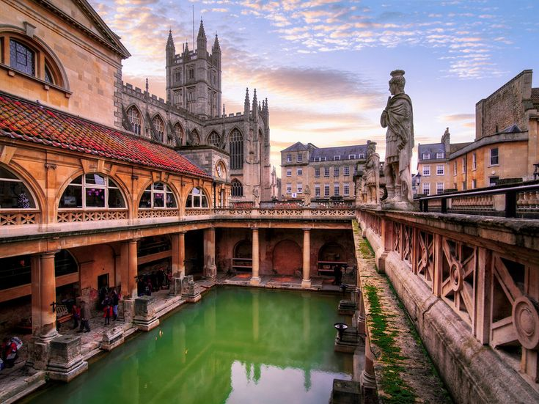
Roman baths
(reconstruction of the 18 century )

Slide 7
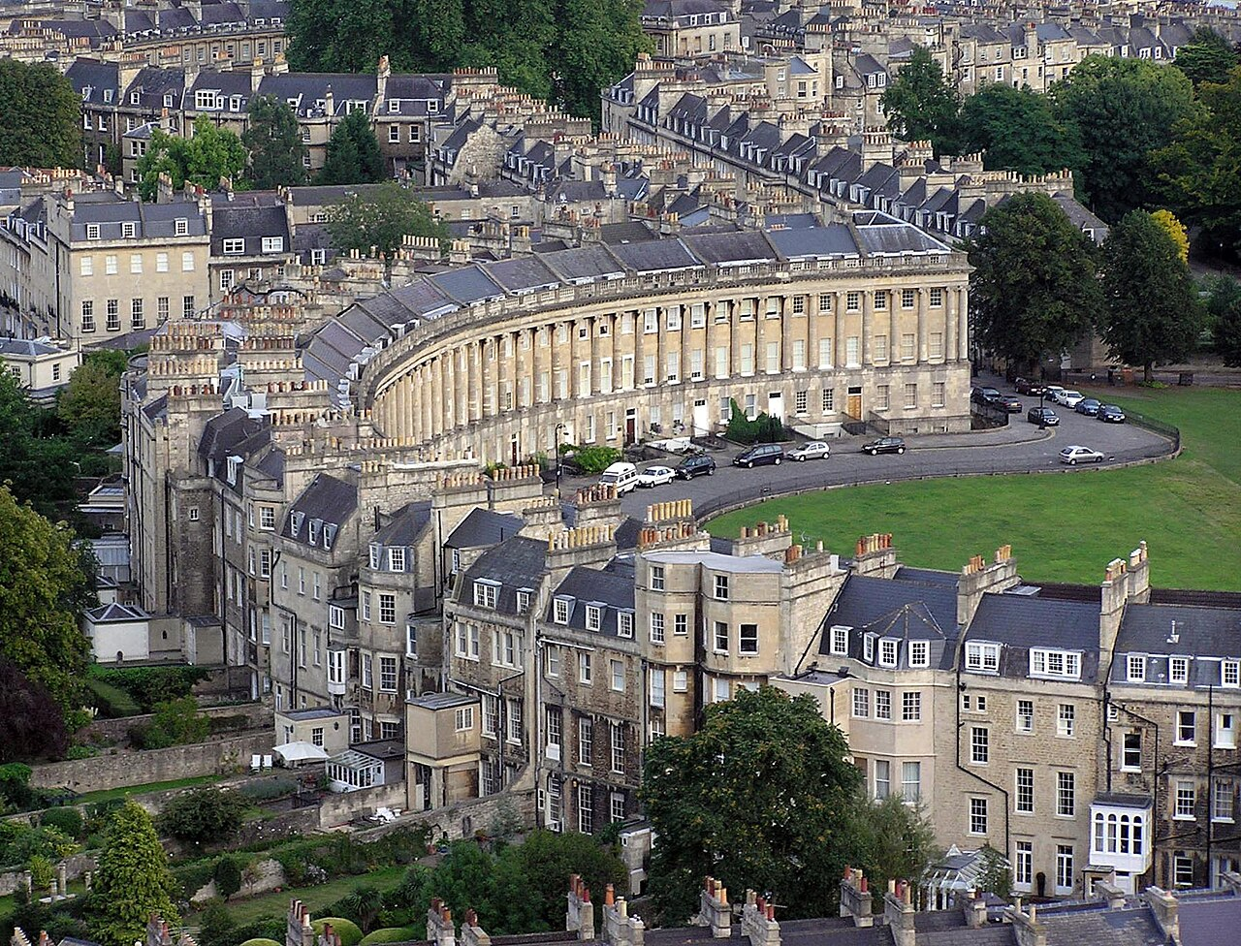
Royal
Crescent/
Georgian architecture

Slide 8
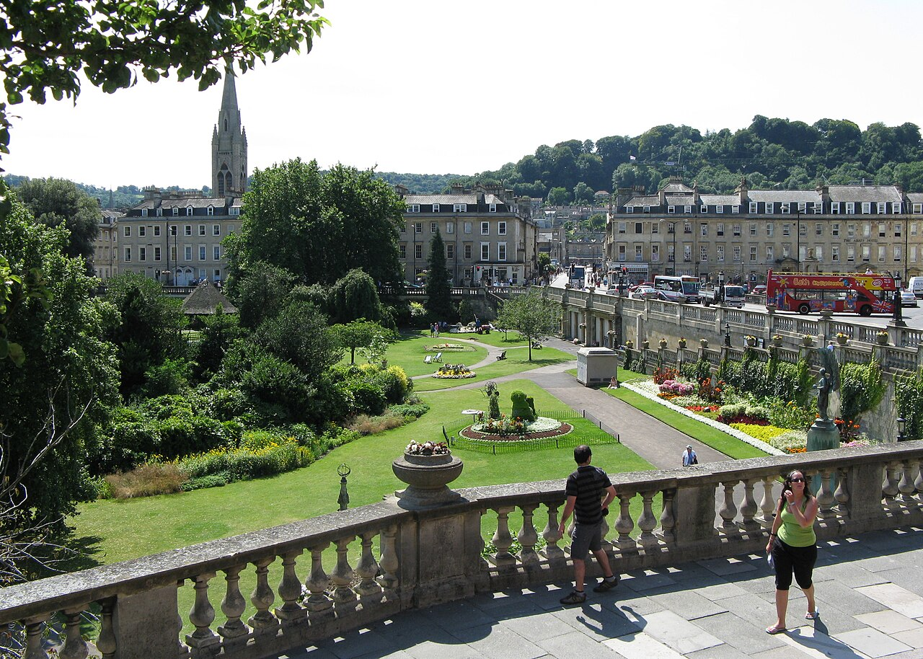
A park in Bath

