Slide 1


Lesson 55
reading

Slide 2
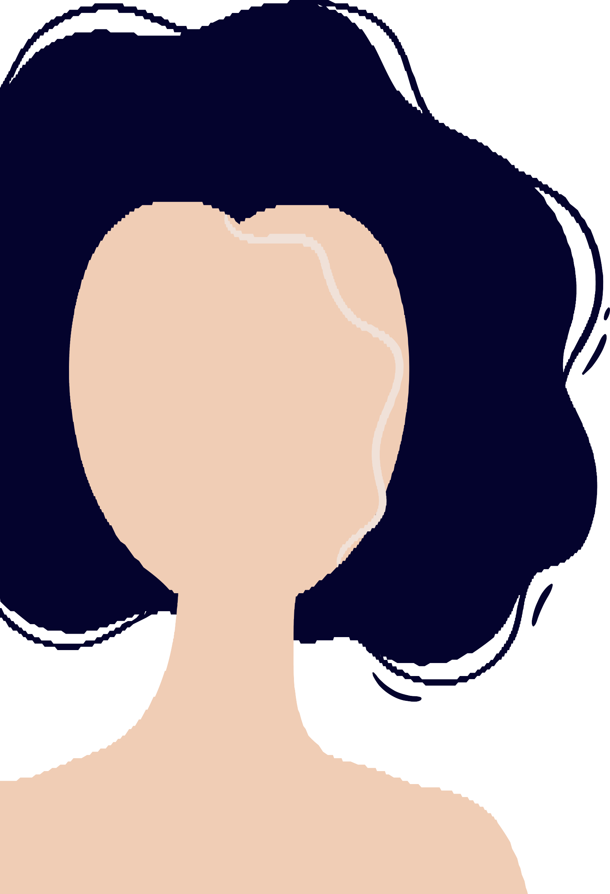



Everything at once
All I wanna be
Oh-oh-oh, all I wanna be
Oh-oh-oh, all I wanna be is everything
Everything at once
Everything at once
Oh-oh-oh, everything at once
As warm as the sun, as silly as fun
As cool as a tree, as scary as the sea
As hot as fire, cold as ice
Sweet as sugar and everything nice
As old as time, as straight as a line
As royal as a queen, as buzzed as a bee
As stealth as a tiger, smooth as a glider
Pure as a melody, pure as I wanna be
All I wanna be
Oh-oh-oh, all I wanna be
Oh-oh-oh, all I wanna be is everything
Everything at once
As sly as a fox, as strong as an ox
As fast as a hare, as brave as a bear
As free as a bird, as neat as a word
As quiet as a mouse, as big as a house
All I wanna be
All I wanna be
Oh-oh-oh, all I wanna be is everything
As mean as a wolf, as sharp as a tooth
As deep as a bite, as dark as the night
As sweet as a song, as right as a wrong
As long as a road, as ugly as a toad
As pretty as a picture hanging from a fixture
Strong like a family, strong as I wanna be
Bright as day, as light as play
As hard as nails, as grand as a whale

Slide 3

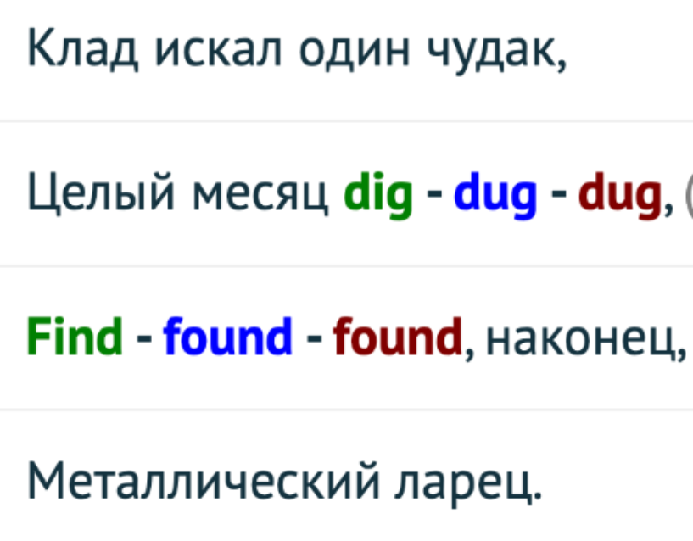
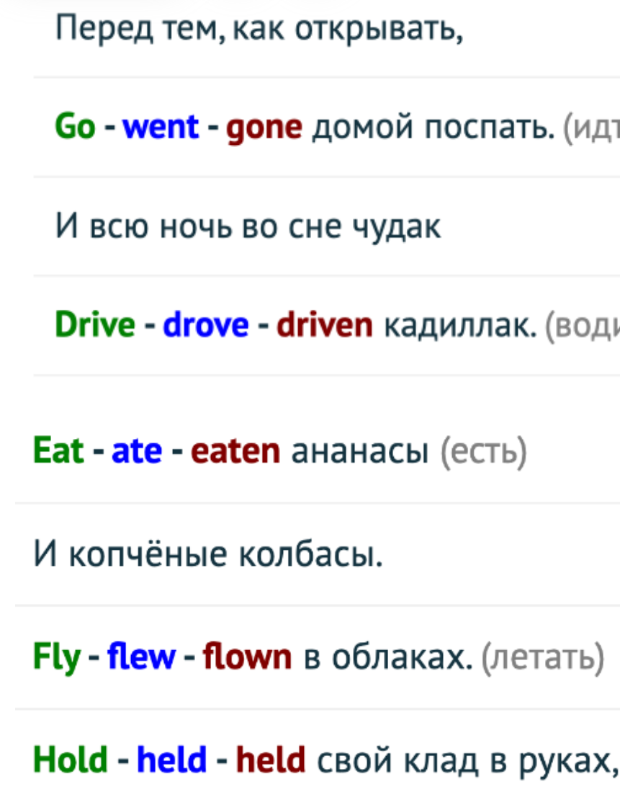
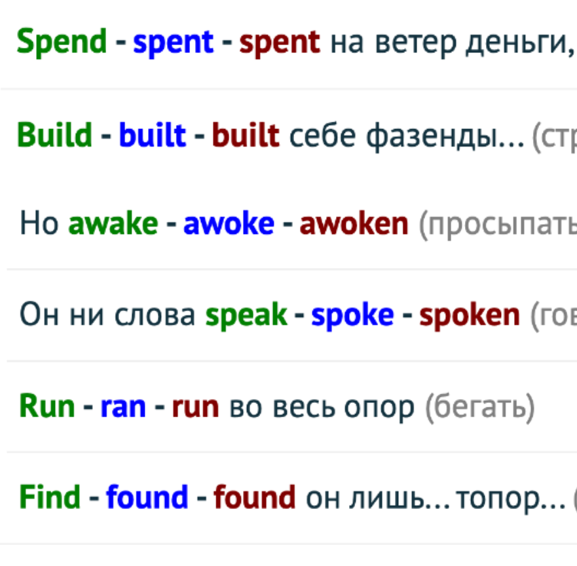
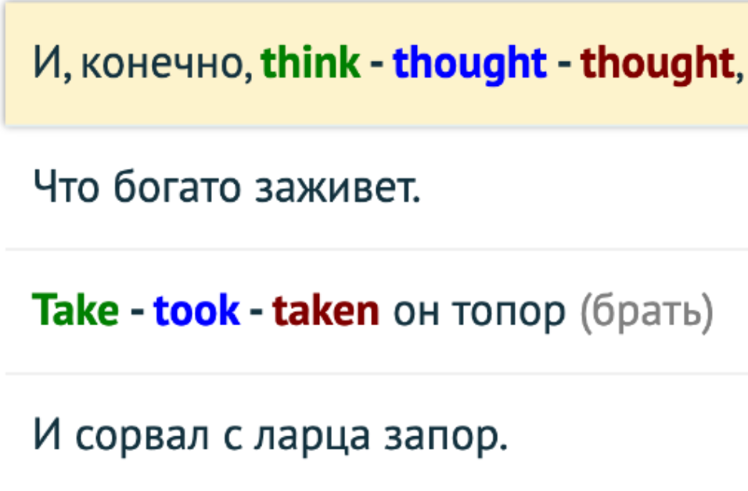














+/-/?
1. Present Simple
2. Past simple
3. Future Simple
4. Present Continious
5. Present Perfect

Slide 4
The Clever Farmer
Many years ago there lived a farmer in a small village whose name was Thomas. A lot of people knew him because he could predict (предсказывать) the weather better than anyone else (кто-либо ещё). He never used books or almanacs (календарь, альманах)— he just watched the sky, the wind, and the animals.
One summer, a young man from the city came to visit the village. His name was Henry, and he worked as a clerk (клерк, офисный работник) in London. He did not believe (верить) that a simple (простой) farmer could know more about weather than scientists with their instruments.
One morning, Thomas was working in his field (поле) when Henry approached (приближаться)him. "Good morning, farmer," said Henry. "I heard you can predict (предсказывать) the weather. Tell me, will it rain today?"
Thomas looked at the sky, then at the cows in the distance (на расстоянии, вдали) and said, "No, it will not rain today. But tomorrow morning, there will be a heavy storm."(сильная гроза)
Henry laughed. "A storm in July? I don't believe (верить) you. Look at the sky — it is clear and blue!"

Slide 5
Thomas smiled and continued (продолжать) his work. Henry decided to stay in the village for another day to see if the farmer was wrong. (неправ)
That day was indeed (действительно) sunny and warm. Henry felt proud (гордый). "This farmer knows nothing," he thought.
But the next morning, when Henry woke up, he heard thunder (гром). He looked out of the window and saw dark clouds in the sky. Soon a heavy storm began. Rain fell for hours, and the wind was so strong that it broke (ломать) a few branches (ветви) from the trees.
Henry could not understand how the farmer had known. He went to Thomas's house and asked, "How did you predict (предсказать) the storm so well? You were right!"
Thomas smiled again. "It was simple, (просто)" he said. "Yesterday morning, the cows lay down (ложиться) in the field. They always do that before a storm. Also, the birds flew very low, (низко) and I felt a change (перемена) in the wind. Nature always tells us the weather if we know how to listen."
Henry returned to London with a new respect (уважение) for farmers and for nature. From that day on, he never laughed at simple wisdom (простая мудрость)again.

Slide 6
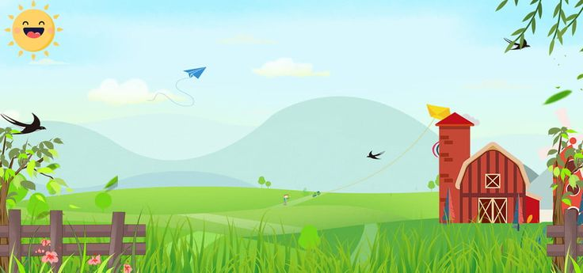
A – True or False
Thomas was known because he wrote almanacs about weather.
Henry worked as a clerk in London.
Thomas predicted rain on the same day he spoke with Henry.
Henry believed Thomas's prediction immediately.
Thomas used nature signs to predict the storm.
After the storm, Henry still did not believe the farmer.
B – Answer the following questions
Why did many people know Thomas?
Why did Henry come to the village?
What did Thomas predict about the weather?
How did Thomas know that a storm was coming?
What did Henry learn at the end of the story?

