Slide 1


Lesson 54
Talking

Slide 2
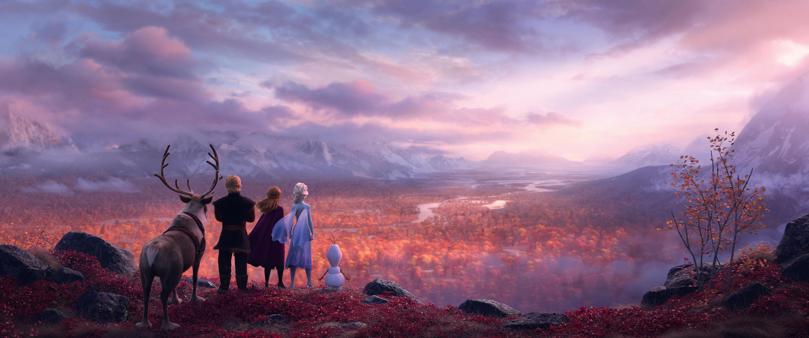
All Is Found
1. Where the north wind meets the sea
There's a river full of memory
Sleep, my darling, safe and sound
For in this river, all is found
3.Yes, she will sing to those who'll hear
And in her song, all magic flows
But can you brave what you most fear?
Can you face what the river knows?
2. In her waters, deep and true
Lie the answers and a path for you
Dive down deep into her sound
But not too far or you'll be drowned
4. Where the north wind meets the sea
There's a mother full of memory
Come, my darling, homeward bound
When all is lost, then all is found

Slide 3
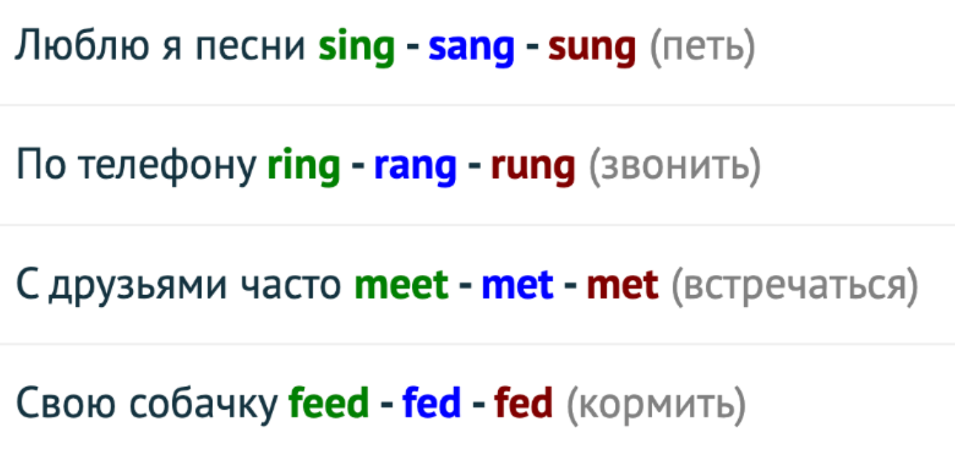
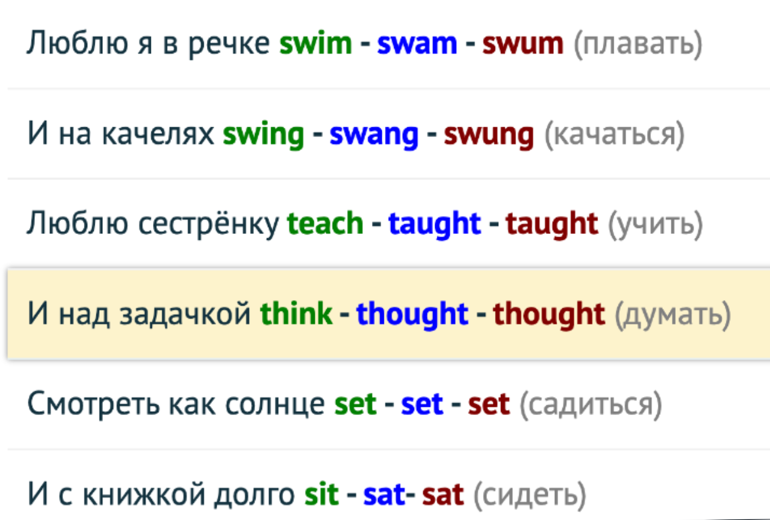
! повтор предыдущего
sing - sang - sung
ring - rang - rung
meet - met - met
feed - fed - fed
swim - swam - swum
swing - swang - swung
teach - taught - taught
think - thought - thought
set - set - set
sit - sat - sat
+/-/?
1. Present Simple
2. Past simple
3. Future Simple
4. Present Continious
5. Present Perfect

Slide 4

I think =
Talk game
https://wordwall.net/resource/3441333/speaking-cards-all-about-me-b1-school

