Slide 1



hello
о
LESSON 53
Dialogues

Slide 2
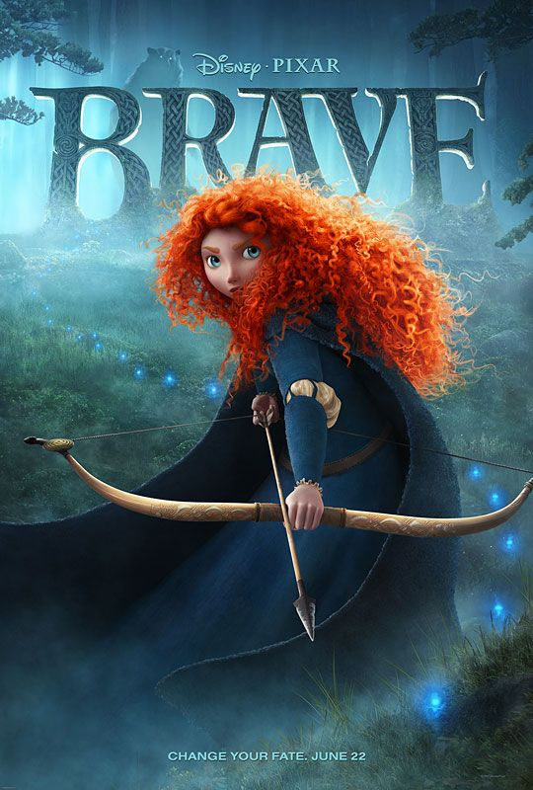
Touch the sky
When cold winds are calling
And the sky is clear and bright,
Misty mountains sing and beckon,
Lead me out into the light.
I will ride, I will fly,
Chase the wind and touch the sky,
I will fly,
Chase the wind and touch the sky.
Where dark woods hide secrets,
And mountains are fierce and bold,
Deep waters hold reflections,
Of times lost long ago.
I will hear their every story,
Take hold of my own dream,
Be as strong as the seas are stormy,
And proud as an eagle’s scream.

Slide 3
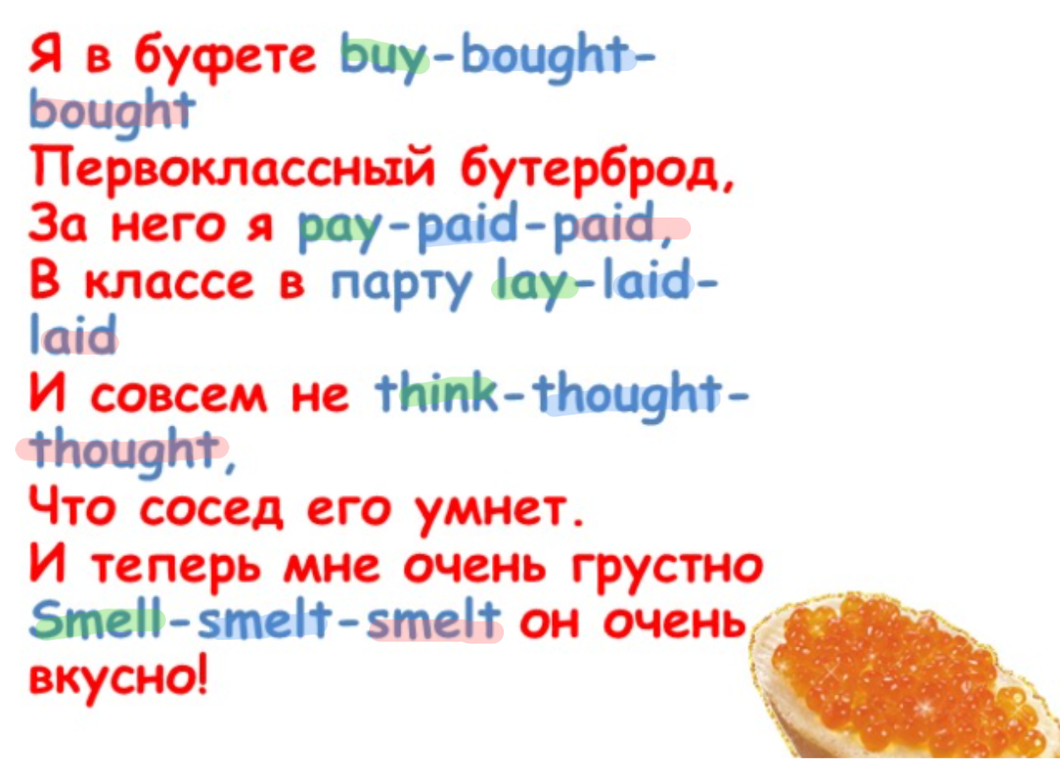
buy - bought - bought
pay - paid - paid
lay - laid - laid
think - thought - thought
smell - smelt - smelt
1. Present Simple
2. Past simple
3. Future Simple
4. Present Continious
5. Present Perfect
+/-/?

Slide 4

shopping
1. A: I like that shirt!
B: So do I. (И я)
A: How much is it?
B: I don't know. The tag (ярлык, ценник)is missing.
A: Ask the clerk (продавец).
B: I will.
A: Oh, look! Here's another (другую) shirt just like it.
B: Does it have a price tag?
A: Yes, it does. It's only $20.
B: That's a great price.
A: I think I'll buy both of (обе) them!
B: You'd better (Ты лучше) try them on first.

Slide 5
Предложите другу пойти за покупками. Определитесь с магазином, посмотрите товары и выберите что-нибудь. Используйте образец и разговорные фразы для опоры.
1. A: I like that shirt!
B: So do I. (И я)
A: How much is it?
B: I don't know. The tag (ярлык, ценник)is missing.
A: Ask the clerk (продавец).
B: I will.
A: Oh, look! Here's another (другую) shirt just like it.
B: Does it have a price tag?
A: Yes, it does. It's only $20.
B: That's a great price.
A: I think I'll buy both of (обе) them!
B: You'd better (Ты лучше) try them on first.
You’re right. – Ты прав.
I don’t mind. – Я не против.
It doesn’t matter. – Это не важно.
I’m just kidding. – Я просто шучу.
What’s going on? – Что происходит?
Sure. - Конечно.
Sounds like a good idea. - Звучит здорово!

