Slide 1

Lesson 52
Writing letters

Slide 2

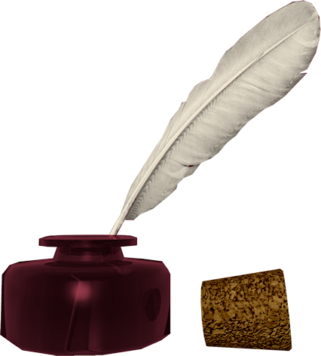
Don’t know much about history
Don’t know much biology
Don’t know much about a science book
Don’t know much about the French I took
But I do know that I love you
And I know that if you love me, too
What a wonderful world this would be
Sam Cooke – Wonderful World
Now, I don’t claim to be an A student
But I’m trying to be
For maybe by being an A student, baby
I can win your love for me
Don’t know much about history
Don’t know much biology
Don’t know much about a science book
Don’t know much about the French I took
But I do know that I love you
And I know that if you love me, too
What a wonderful world this would be
La ta ta ta ta ta ta (History)
Hmm-mm-mm (Biology)
La ta ta ta ta ta ta (Science book)
Hmm-mm-mm (French I took)
Yeah, but I do know that I love you
And I know that if you love me, too
What a wonderful world this would be
Don’t know much about geography
Don’t know much trigonometry
Don’t know much about algebra
Don’t know what a slide rule is for
But I do know one and one is two
And if this one could be with you
What a wonderful world this would be

Slide 3
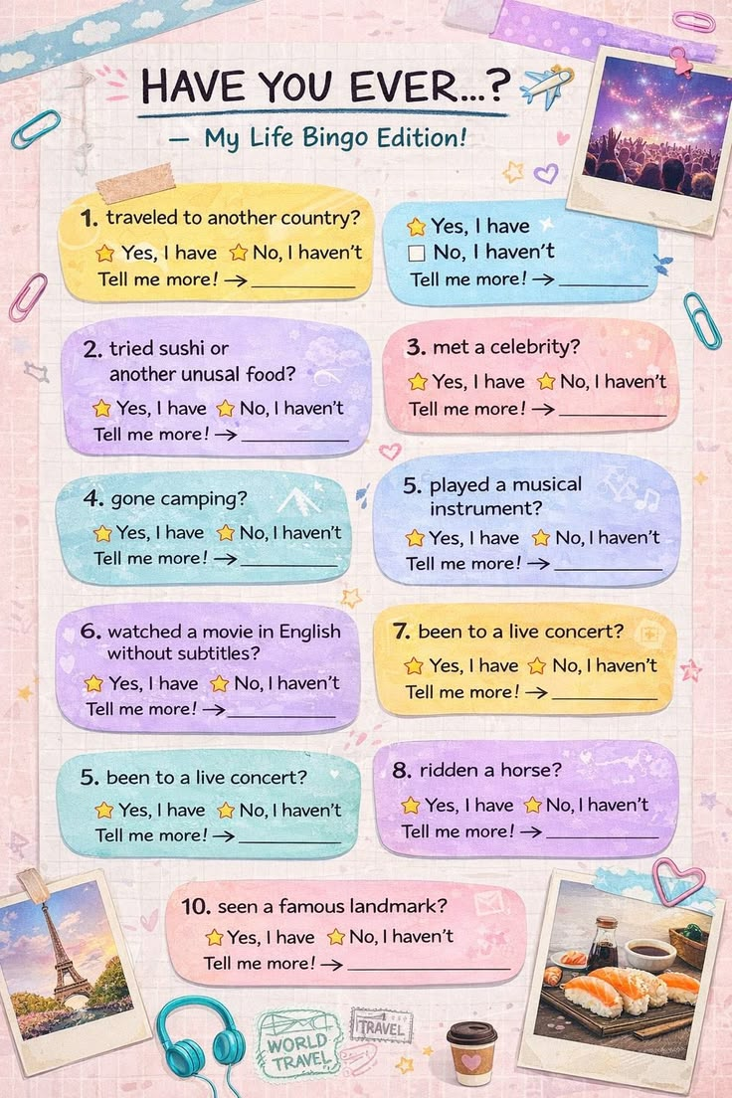
Present perfect
unusual - необычный
live concert - живой концерт
celebrity - знаменитость
go camping - поход с палатками
landmark - достпримечательность
ask proper questions!

Slide 4
Writing letters
03
4. Complete the sentences with the correct linking words below.
and because but or so
1) I’m tired ________ I want to go to bed.
2) I’d like to go out this evening, ________ I can’t.
3) I can speak English ________ mum’s from France.
4) Let’s go to the newsagent’s ________ buy a newspaper.
5) Do you want to eat at home ________ go to a restaurant?
6) My name’s Lisa ________ I’m your new penfriend.

Slide 5
Writing letters
– talk about a future arrangement.
– suggest an activity to do together.
– say what you are doing now.
From: holly13@mail.ru
To: james@email.com
Hi James,
How are things? I hope you and your family are well. What are you doing at the moment? I’m trying to finish homework, but it’s taking a long time!
How about meeting in town one day soon? I want to try the new café on Market Street because mum says it’s very good. We can go there after school or meet for lunch one Saturday.
I’m going to Ava’s barbecue next Saturday. Are you going too? It’s at her house. I’m helping her with the preparations so I’m arriving early. I hope I see you there!
That’s all for me. I have to get things ready for tomorrow morning. Please write soon!
Best wishes,
Holly
04

Slide 6
Writing letters
Writing Guide
Plan an email. Make notes about:
From:
To:
1) Thank your friend for his/her email or ask about his/her life.
2) your current activity
3) a suggestion for an activity
4) a future arrangement.
5) An appropriate ending.
04
Dear...,
I hope you are well.
That is all from me.
Can you call me next week?
Goodbye for now.
Give love to your parents.
Thanks for your email.
Best wishes,
How are things?
Lots of love,
Say ‘Hi’ to your ....
I hope to see you soon.
social phrases

Slide 7
Homework
1. Write the e-mail using the guide on Slide 6.
(about 50 words)
2. decide - decided - decided - решать(ся)
explain -explained - explained - объяснять
hope- hoped - hoped - надеяться

