Slide 1

Lesson 51
Writing letters

Slide 2
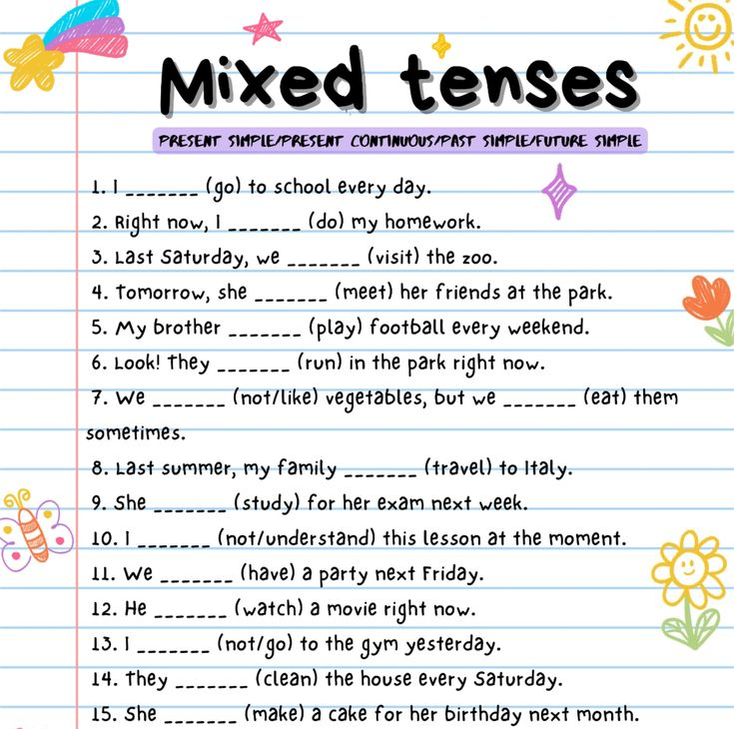
Tenses Revision

Slide 3
Writing letters
01
for from of soon things to (x2) wishes
1) Give love ____________ your parents.
2) Thanks ____________ your email.
3) That’s all ____________ me.
4) Best ____________,
5) How are ____________?
6) Lots ____________ love,
7) Say ‘Hi’ ____________ your sister.
8) I hope to see you ____________
social phrases

Slide 4
Writing letters
From: holly13@mail.ru
To: james@email.com
Hi James,
1) _____ I hope you and your family are well. What are you doing at the moment? I’m trying to finish homework, but it’s taking a long time!
How about meeting in town one day soon? I want to try the new café on Market Street because mum says it’s very good. We can go there after school or meet for lunch one Saturday.
I’m going to Ava’s barbecue next Saturday. Are you going too? It’s at her house. I’m helping her with the preparations so I’m arriving early. I hope I see you there!
2) _____ I have to get things ready for tomorrow morning. Please write soon!
3) _____
Holly
02

Slide 5
Homework
1. Copy the e-mail from Slide 5 inserting the missing words and translate it.
2. Write out the social phrases from Slide 3 to your Vocabularies.
3. reach - reached - reached - достигать
raise - raised - raised - поднимать
sell - sold - sold - продавать

