Slide 1
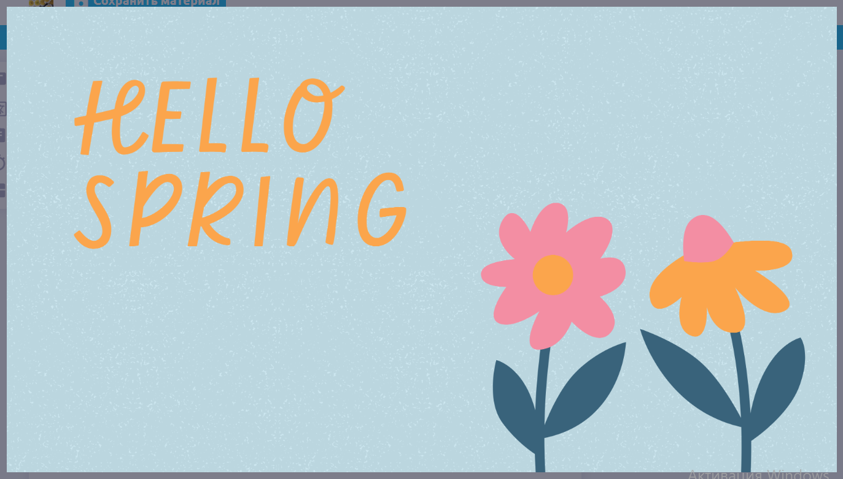
Lesson 49

Slide 2

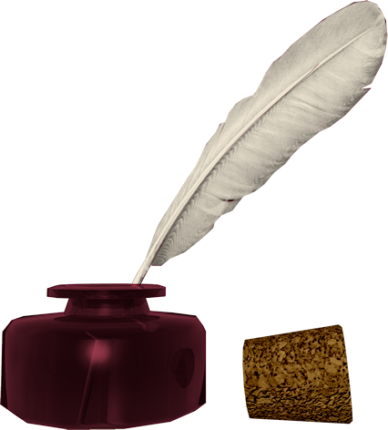
Don’t know much about history
Don’t know much biology
Don’t know much about a science book
Don’t know much about the French I took
But I do know that I love you
And I know that if you love me, too
What a wonderful world this would be
Sam Cooke – Wonderful World
Now, I don’t claim to be an A student
But I’m trying to be
For maybe by being an A student, baby
I can win your love for me
Don’t know much about history
Don’t know much biology
Don’t know much about a science book
Don’t know much about the French I took
But I do know that I love you
And I know that if you love me, too
What a wonderful world this would be
La ta ta ta ta ta ta (History)
Hmm-mm-mm (Biology)
La ta ta ta ta ta ta (Science book)
Hmm-mm-mm (French I took)
Yeah, but I do know that I love you
And I know that if you love me, too
What a wonderful world this would be
Don’t know much about geography
Don’t know much trigonometry
Don’t know much about algebra
Don’t know what a slide rule is for
But I do know one and one is two
And if this one could be with you
What a wonderful world this would be

Slide 3
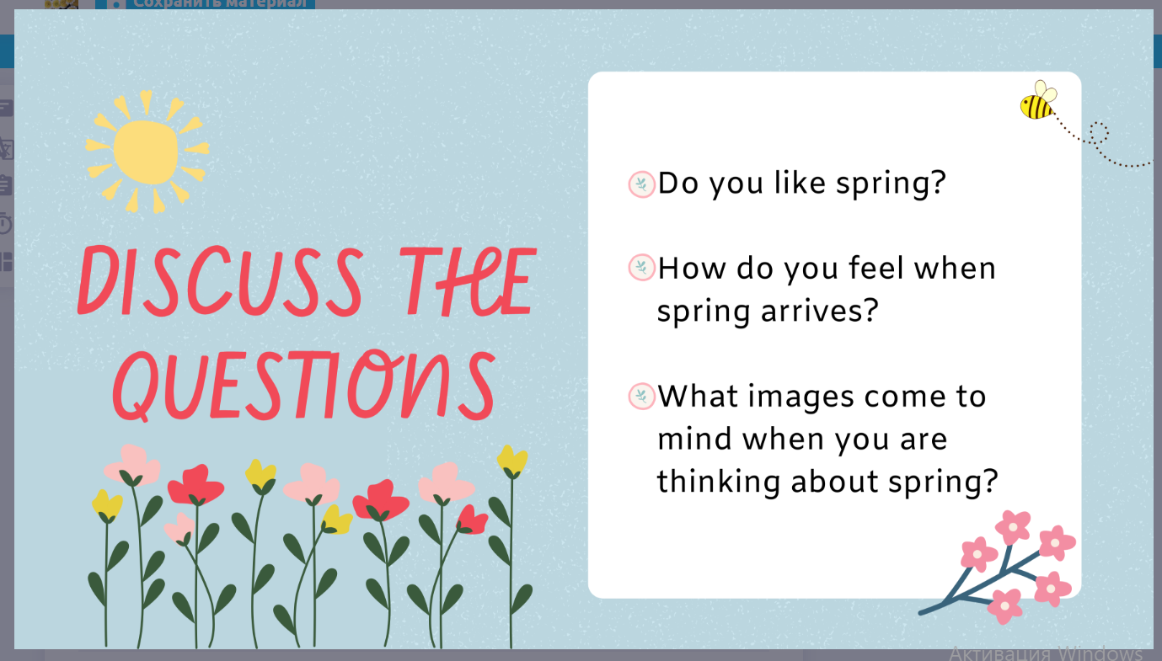

Slide 4
(Audio)

Slide 5

Spring
Spring is a time for things. It seems everyone is full of energy. The days become warmer so everyone spends more time . Winter is finishing, so the becomes greener. I love watching the new flowers in my
in spring. I watch the tulips grow and then I know winter is over. I wonder what it’s like to live in countries that don’t have . They miss out on what it’s like to welcome spring and see everything come alive. Spring has to be the
season. It definitely makes you feel very about life. It’s a good time to clean your house from top to bottom. We call this . Spring also means the weather gets warmer and you can do more things outside.

Slide 6
stay - stayed - stayed - оставаться
fall - fell - fallen - падать
cut - cut - cut - резать, рубить

Slide 7
HOMEWORK
Copy and translate the text “Spring” inserting the missing words.

