Slide 1

Lesson 48
Uncountables

Slide 2

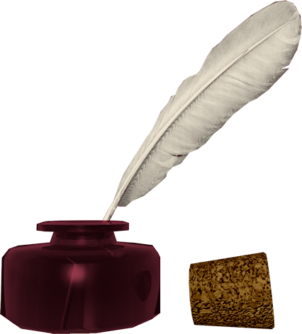
Don’t know much about history
Don’t know much biology
Don’t know much about a science book
Don’t know much about the French I took
But I do know that I love you
And I know that if you love me, too
What a wonderful world this would be
Sam Cooke – Wonderful World
Now, I don’t claim to be an A student
But I’m trying to be
For maybe by being an A student, baby
I can win your love for me
Don’t know much about history
Don’t know much biology
Don’t know much about a science book
Don’t know much about the French I took
But I do know that I love you
And I know that if you love me, too
What a wonderful world this would be
La ta ta ta ta ta ta (History)
Hmm-mm-mm (Biology)
La ta ta ta ta ta ta (Science book)
Hmm-mm-mm (French I took)
Yeah, but I do know that I love you
And I know that if you love me, too
What a wonderful world this would be
Don’t know much about geography
Don’t know much trigonometry
Don’t know much about algebra
Don’t know what a slide rule is for
But I do know one and one is two
And if this one could be with you
What a wonderful world this would be

Slide 3
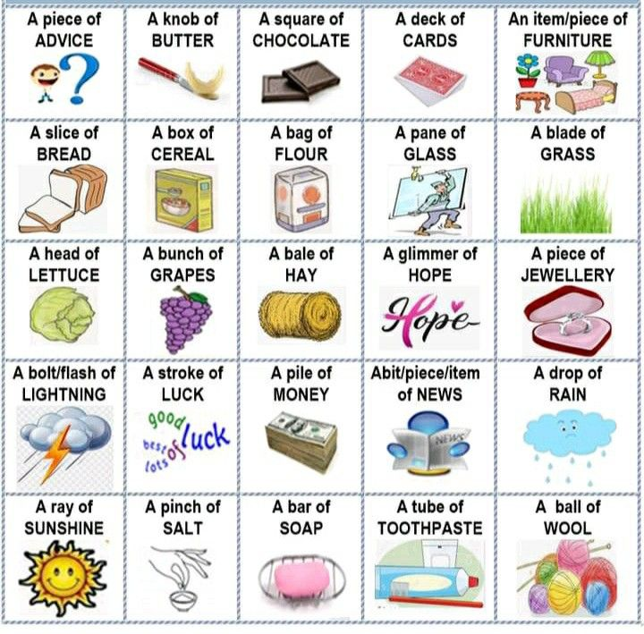
give
buy
see
enjoy
take
eat
hate
hear
have
offer
use
can
Will you...?
Could you...?

Slide 4

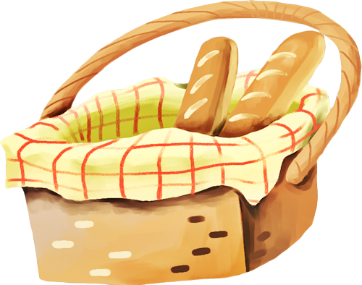
A Perfect Picnic Day
Last Sunday, my friends and I decided to have a picnic in the park. The weather was sunny and warm, perfect for outdoor fun.
We brought a few sandwiches with chicken and cheese. They were delicious! We also had a little lemonade in a big bottle – just enough for everyone to have one glass. Unfortunately, we had few cookies – only six for seven girls! But Milana said, "It's okay, we can share."
I checked the fruit basket. We had a few apples and a little grapes. Dasha brought a little chocolate, and we all got one small piece. It was so sweet!
There was little juice left after lunch, but we didn't mind because we had fun playing games. Zlata noticed we had few spoons for the fruit salad, so we used our hands – it was even funnier!
We spent a few hours talking, laughing, and taking photos. When it was time to go home, we had little energy left, but our hearts were full of joy.
It wasn't a perfect picnic with lots of food, but we had a few great moments and a little sunshine – and that was enough!

Slide 5
VERBS
die - died - died - умирать
send - sent - sent - посылать
build - built - built - строить
picnic

Slide 6
Homework:
write down and translate the text from Slide 5

