Slide 1

Lesson 47
Video about zebras

Slide 2

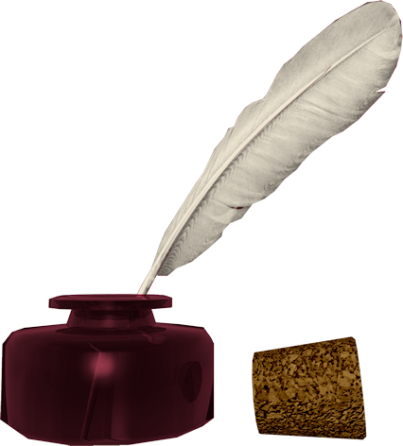
Don’t know much about history
Don’t know much biology
Don’t know much about a science book
Don’t know much about the French I took
But I do know that I love you
And I know that if you love me, too
What a wonderful world this would be
Sam Cooke – Wonderful World
Now, I don’t claim to be an A student
But I’m trying to be
For maybe by being an A student, baby
I can win your love for me
Don’t know much about history
Don’t know much biology
Don’t know much about a science book
Don’t know much about the French I took
But I do know that I love you
And I know that if you love me, too
What a wonderful world this would be
La ta ta ta ta ta ta (History)
Hmm-mm-mm (Biology)
La ta ta ta ta ta ta (Science book)
Hmm-mm-mm (French I took)
Yeah, but I do know that I love you
And I know that if you love me, too
What a wonderful world this would be
Don’t know much about geography
Don’t know much trigonometry
Don’t know much about algebra
Don’t know what a slide rule is for
But I do know one and one is two
And if this one could be with you
What a wonderful world this would be

Slide 3
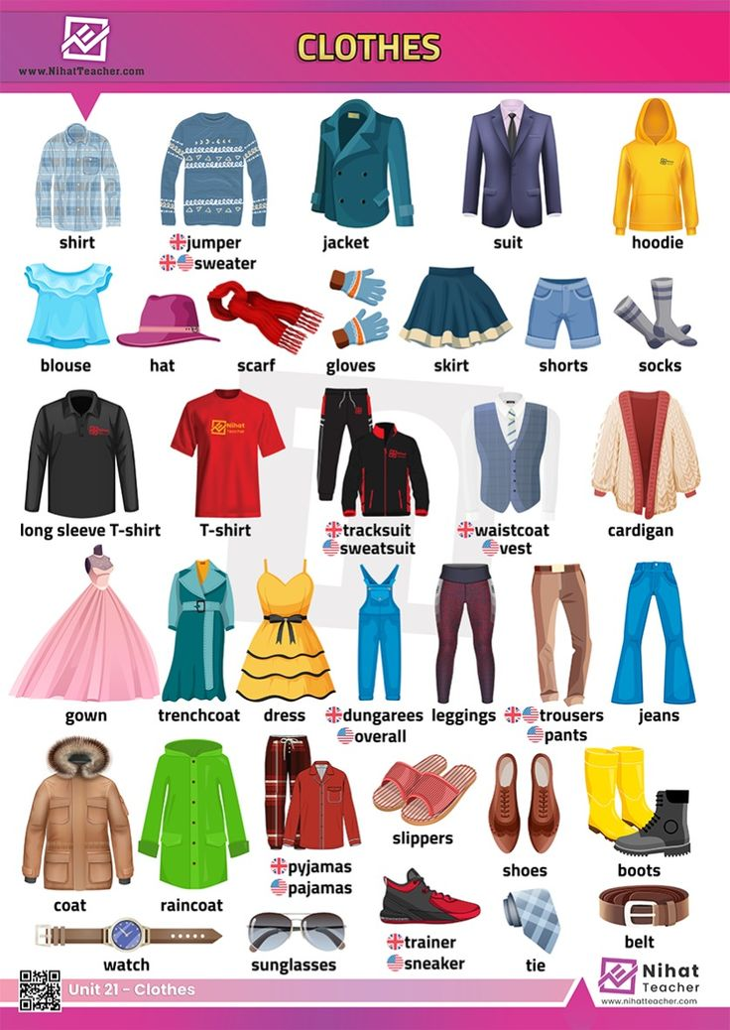
Do you have many/much... ?
Uncountables
underwear - нижнее бельё
cotton/linen - хлопок/лён
jewelry - бижутерия
cosmetics - косметика
money - деньги
(school/handmade/girlish) stuff - школьные/рукодельные/девчачьи мелочи

Slide 4
Video

Slide 5
VERBS
appear - appeared - appeared - появляться
buy - bought - bought - покупать
serve - served - served - служить
zebras

Slide 6
Homework:
write down and translate the text from the video

