Slide 1

Lesson 46
LITTLE/A LITTLE /A FEW/FEW

Slide 2

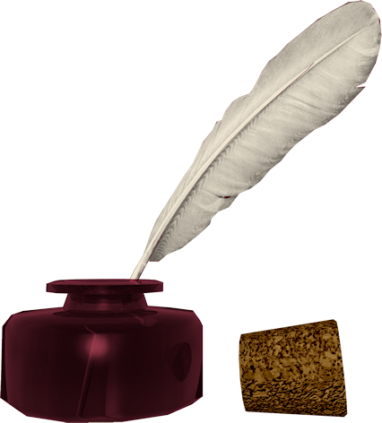
Don’t know much about history
Don’t know much biology
Don’t know much about a science book
Don’t know much about the French I took
But I do know that I love you
And I know that if you love me, too
What a wonderful world this would be
Sam Cooke – Wonderful World
Now, I don’t claim to be an A student
But I’m trying to be
For maybe by being an A student, baby
I can win your love for me
Don’t know much about history
Don’t know much biology
Don’t know much about a science book
Don’t know much about the French I took
But I do know that I love you
And I know that if you love me, too
What a wonderful world this would be
La ta ta ta ta ta ta (History)
Hmm-mm-mm (Biology)
La ta ta ta ta ta ta (Science book)
Hmm-mm-mm (French I took)
Yeah, but I do know that I love you
And I know that if you love me, too
What a wonderful world this would be
Don’t know much about geography
Don’t know much trigonometry
Don’t know much about algebra
Don’t know what a slide rule is for
But I do know one and one is two
And if this one could be with you
What a wonderful world this would be

Slide 3
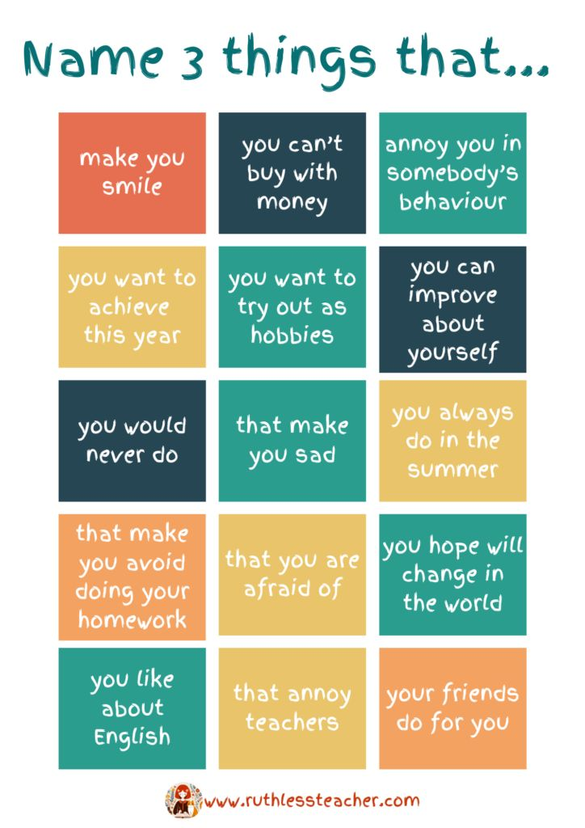

Slide 4
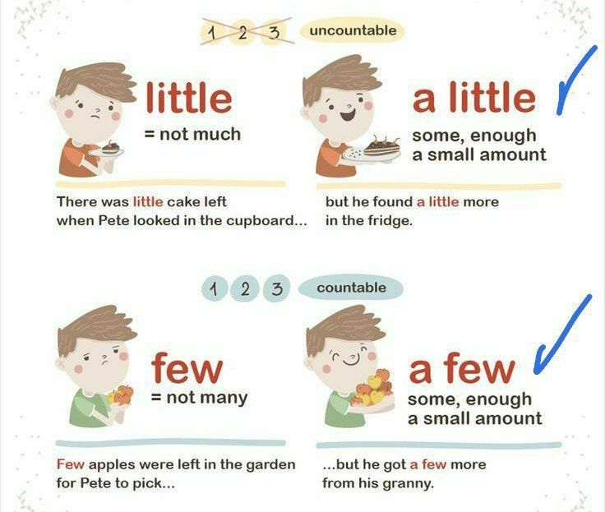
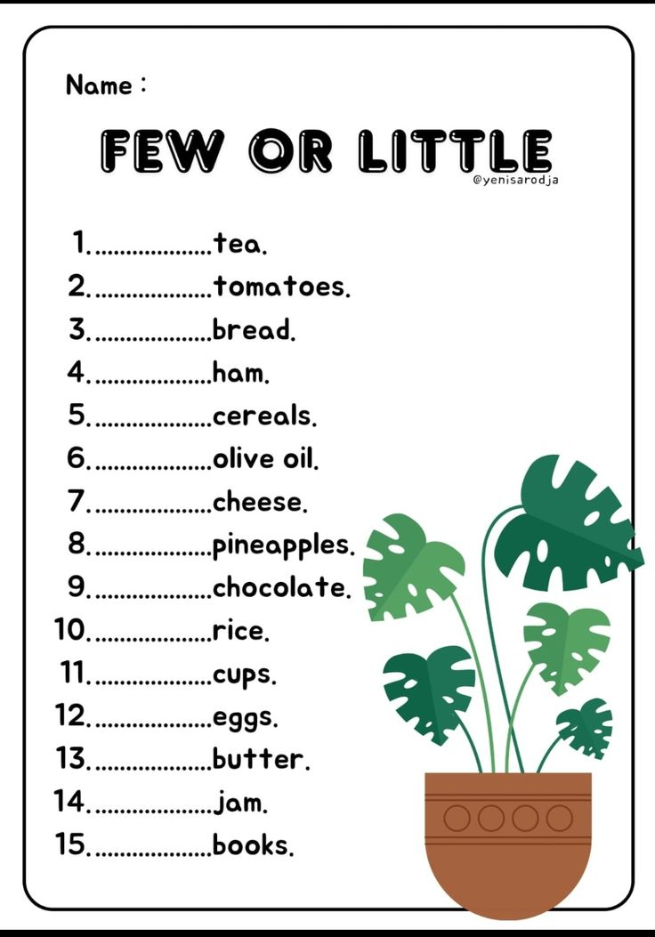

Slide 5
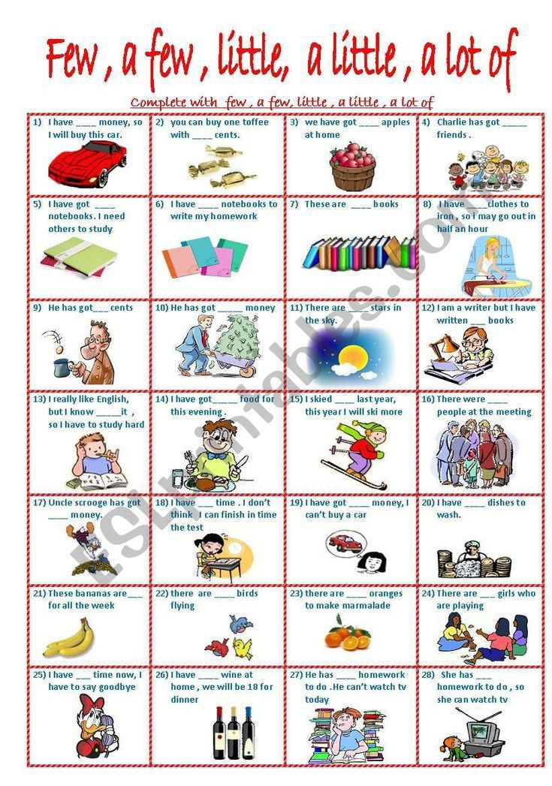

Slide 6
VERBS
offer - offered - offered - предлагать
remember - remembered - remembered - помнить, вспоминать
consider - considered - considered - считать, принимать во внимание, рассматривать
LITTLE /A LITTLE /A FEW / FEW

Slide 7
HOMEWORK
Take a look in your wadrobe
and
make up
2 sentences with LITTLE
2 sentences with A LITTLE
2 sentences with A FEW
2 sentences with FEW

