Slide 1
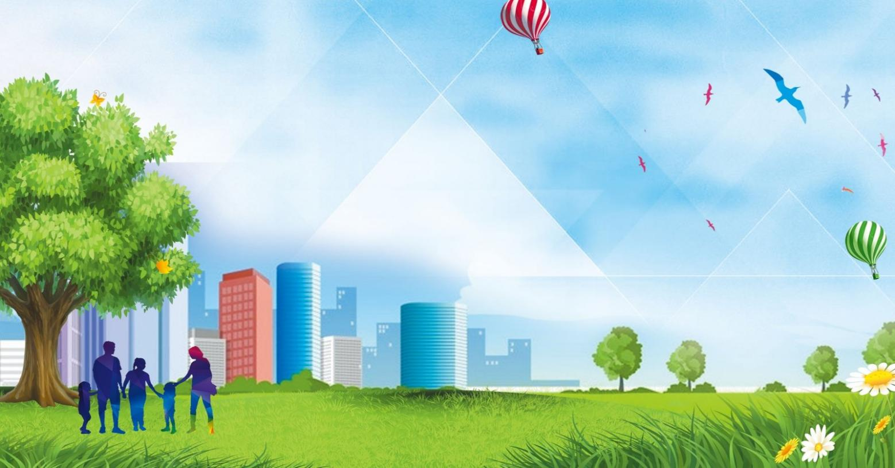
Russian Cities
Lesson 44

Slide 2
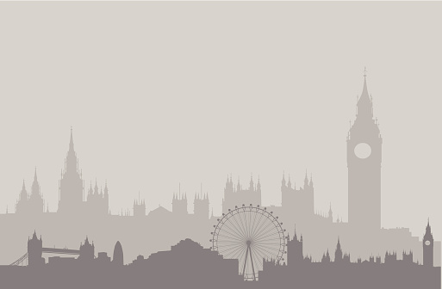
Big Ben song
700 species in London Zoo
Reptiles*, Amphibians, Invertebrates too *[1st time only]
Penguins waddle, crocodiles snap
No you can't stroke a crocodile on your lap! (^2)
Round and round goes The London Eye
It's 130 meters high
Buckingham Palace is where The Queen sleeps
And The Prime Minister at Downing Street. (^2)
If you're tired, and need to eat
get fish n chips and a cup of tea.
Big Ben is not a person
Big Ben is not a clock
Big Ben is not a tower
It's a bell: ding dong (^2)
A Science museum, to learn about space
Astronauts, rockets, awesome place
At the British Museum you can see
Egyptian mummies; it's free! (^2)

Slide 3
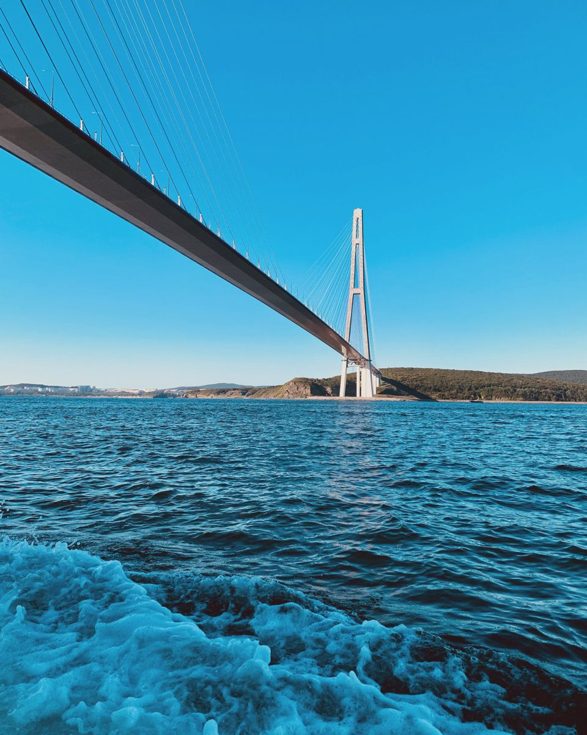
Vladivostok - The Pacific Gates of Russia
major - главный
the Far East - Дальний Восток
the Pacific coast - тихоокеанское побережье
shores - берега
Golden Horn Bay - залив Золотой Рог
Gateway - путевые врата
stunning - потрясающий
pylons - столбы, опоры
incredible structure - невероятное сооружение
connect - связывать, соединять
mainland - материк, большая земля
Island - остров
cable-stayed bridge - вантовый мост
delicious - восхитительный
scallops - гребешки
Harbor - гавань
embankment - набережная
to stroll along - прогуливаться по
marine life - морская жизнь
a must-see - обязательно к просмотру
different - разнообразный
unique - уникальный
vibrant - живой, пульсирующий
growing - растущий

Slide 4
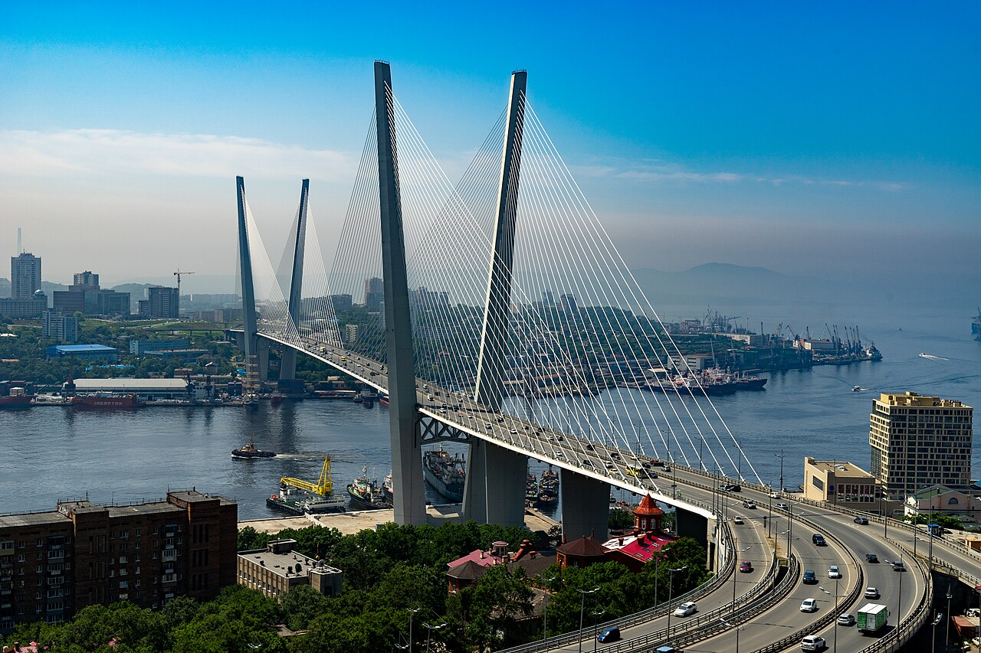
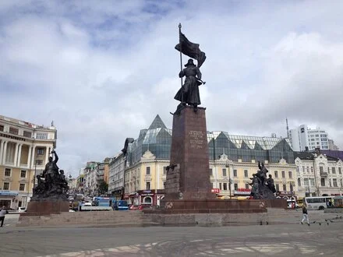
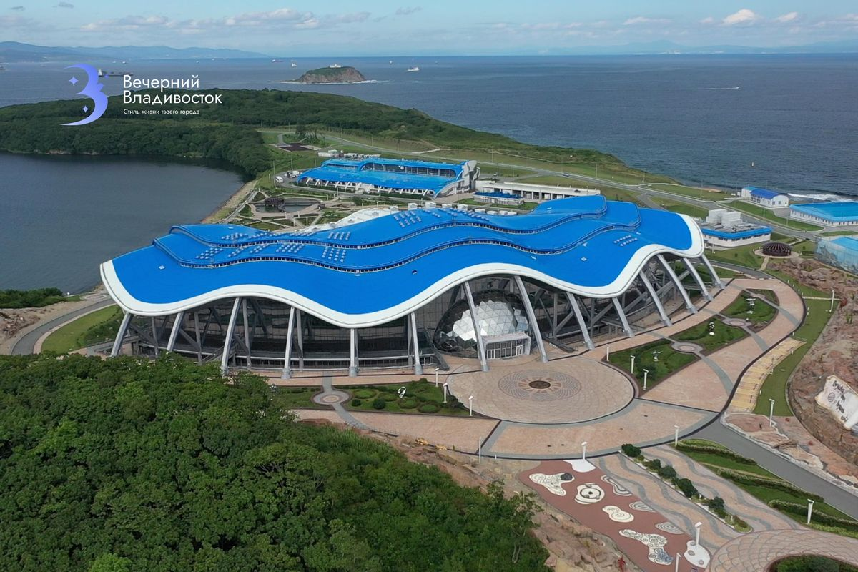
Vladivostok: Russia's Gateway to the Pacific
Vladivostok is a major Russian city in the Far East. It is located on the Pacific coast, on the shores of the beautiful Golden Horn Bay. People often call it "Russia's Gateway to the Pacific" because it is the country's largest Pacific port .
The city is famous for its stunning bridges. The Golden Bridge across the Golden Horn Bay is a modern symbol of Vladivostok. Its tall pylons look like the letter "V" . Another incredible structure is the Russky Bridge, which connects the mainland to Russky Island. It is one of the longest cable-stayed bridges in the world .
The city's location by the sea means fresh seafood is a big part of life. Local restaurants are famous for their delicious king crab, scallops, and other seafood dishes . For a walk, the Sportivnaya Harbor embankment is a great spot. Locals and visitors come here to stroll along the water, visit cafes, and enjoy the sea air . If you are interested in marine life, the Primorsky Oceanarium on Russky Island is a must-see. It is one of the largest aquariums in Russia, with many different sea animals .
Vladivostok is a unique city where European and Asian cultures meet. It is a vibrant place with a busy port, a growing cultural scene, and beautiful nature all around.

Slide 5
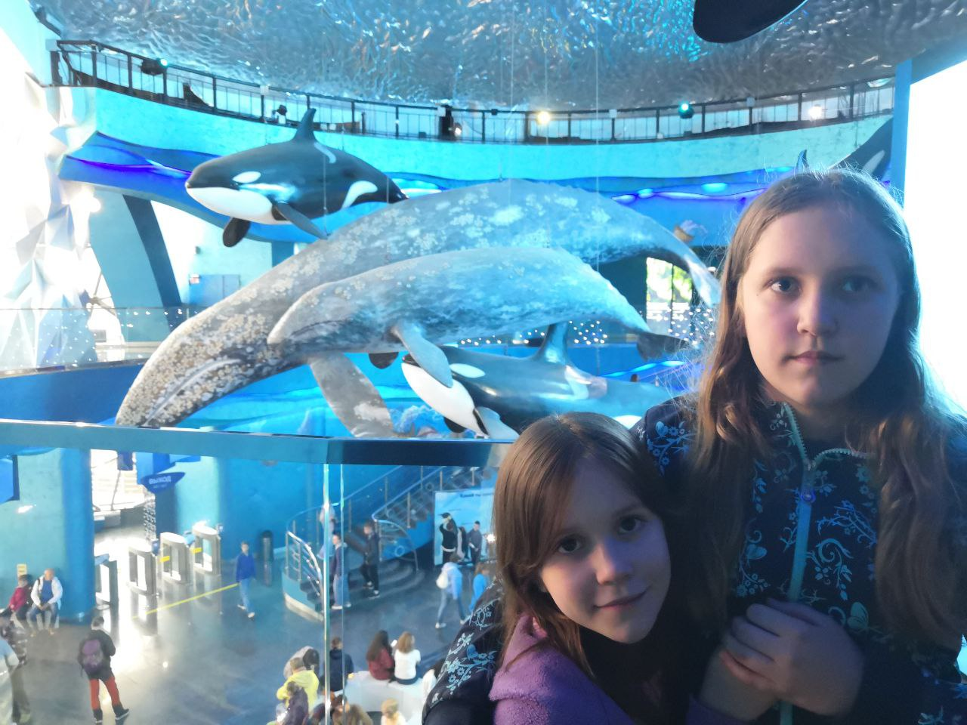
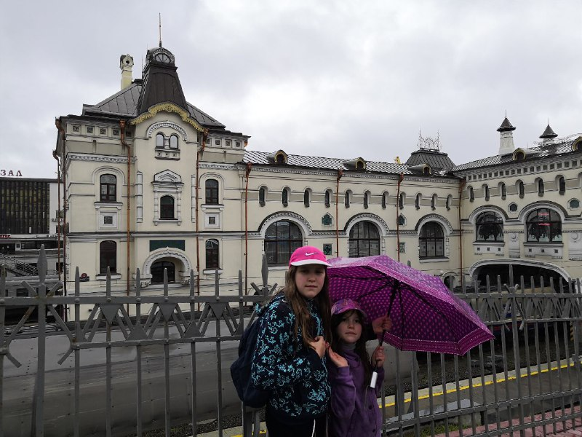
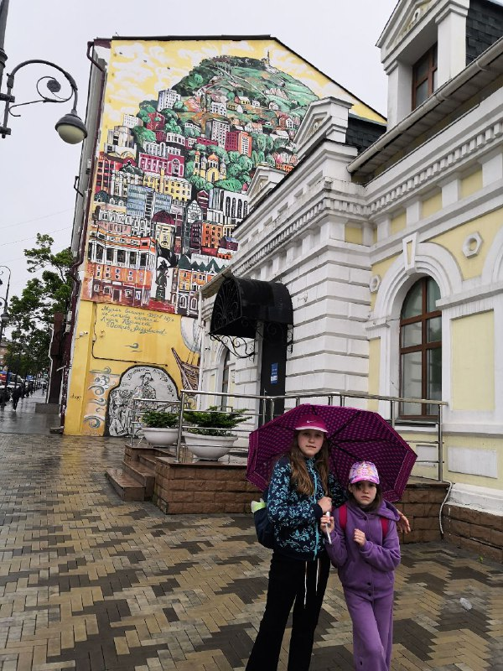
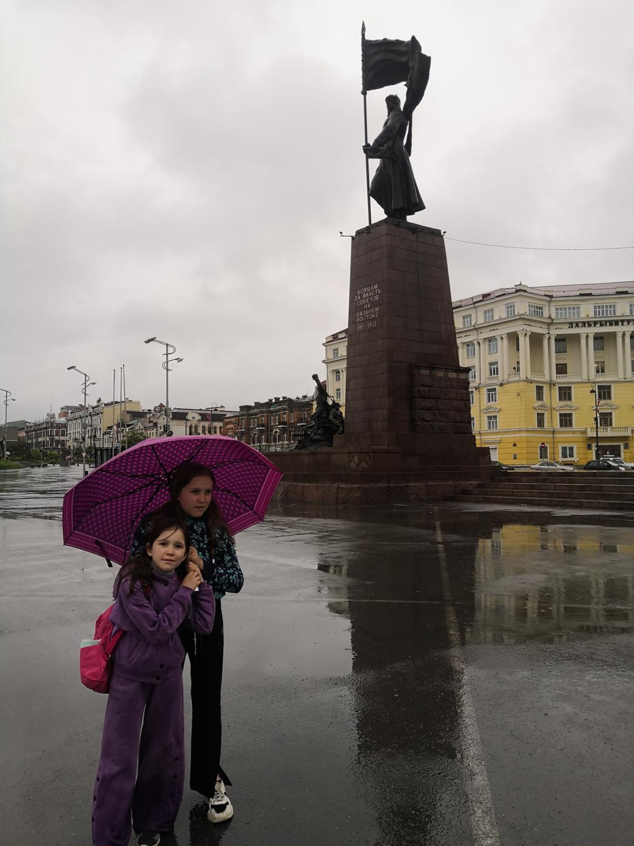
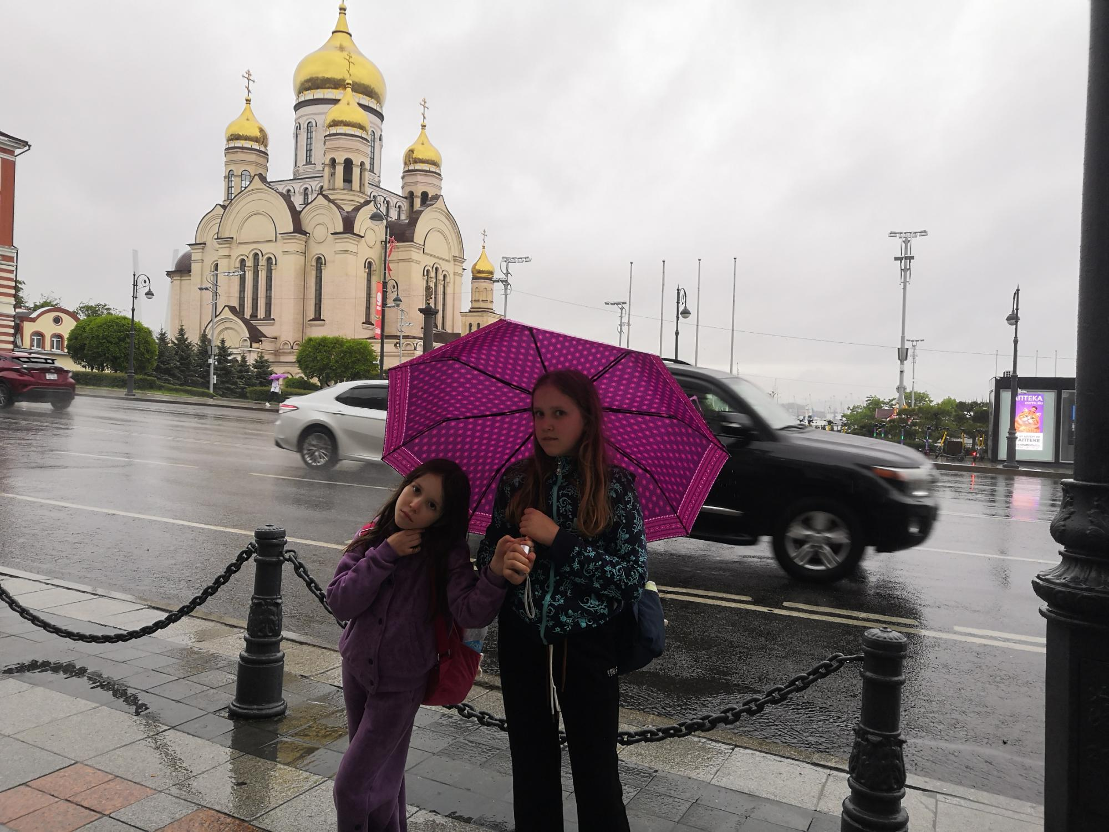
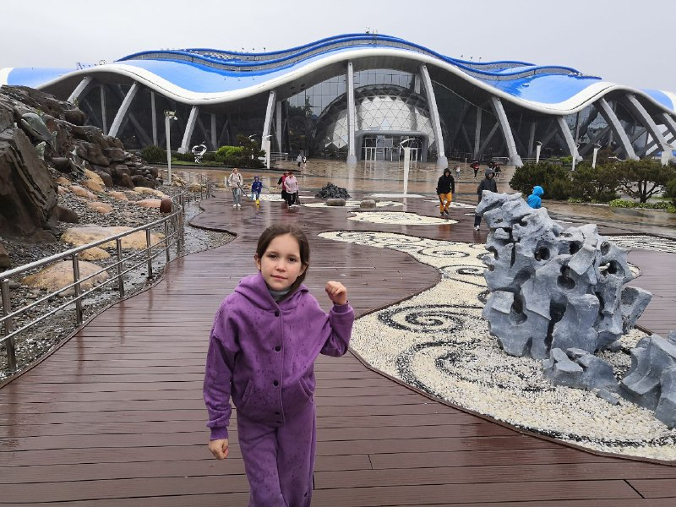






Slide 6

HOMEWORK
1. Where is Vladivostok located?
2. Why is it called the Gateway to the Pacific?
3. What is the city famous for?
4. What places of interest do you know there?
5. What special food can you try in Vladivostok?
5. Would you like to visit Vladivostok? Why?

