Slide 1
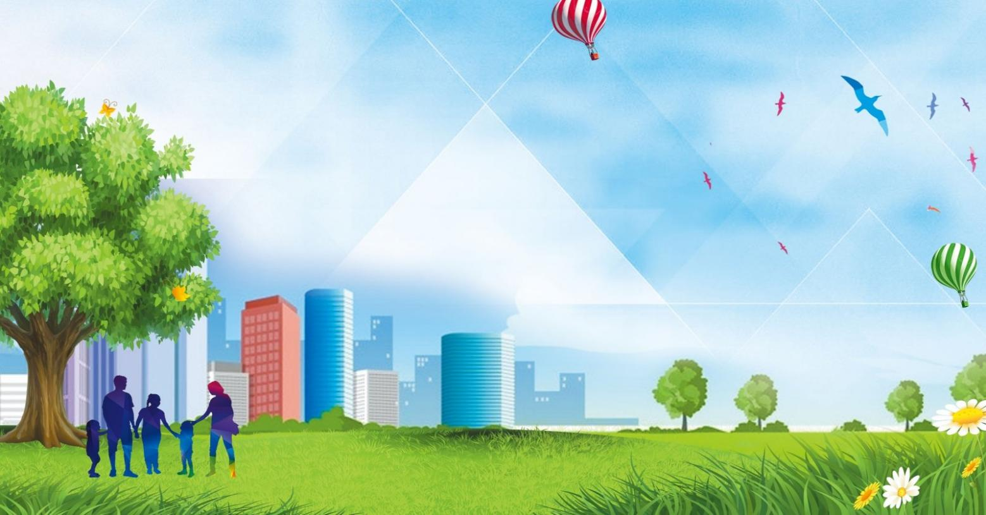
Russian Cities
Lesson 43

Slide 2
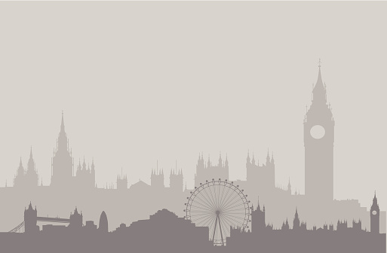
Big Ben song
700 species in London Zoo
Reptiles*, Amphibians, Invertebrates too *[1st time only]
Penguins waddle, crocodiles snap
No you can't stroke a crocodile on your lap! (^2)
Round and round goes The London Eye
It's 130 meters high
Buckingham Palace is where The Queen sleeps
And The Prime Minister at Downing Street. (^2)
If you're tired, and need to eat
get fish n chips and a cup of tea.
Big Ben is not a person
Big Ben is not a clock
Big Ben is not a tower
It's a bell: ding dong (^2)
A Science museum, to learn about space
Astronauts, rockets, awesome place
At the British Museum you can see
Egyptian mummies; it's free! (^2)

Slide 3
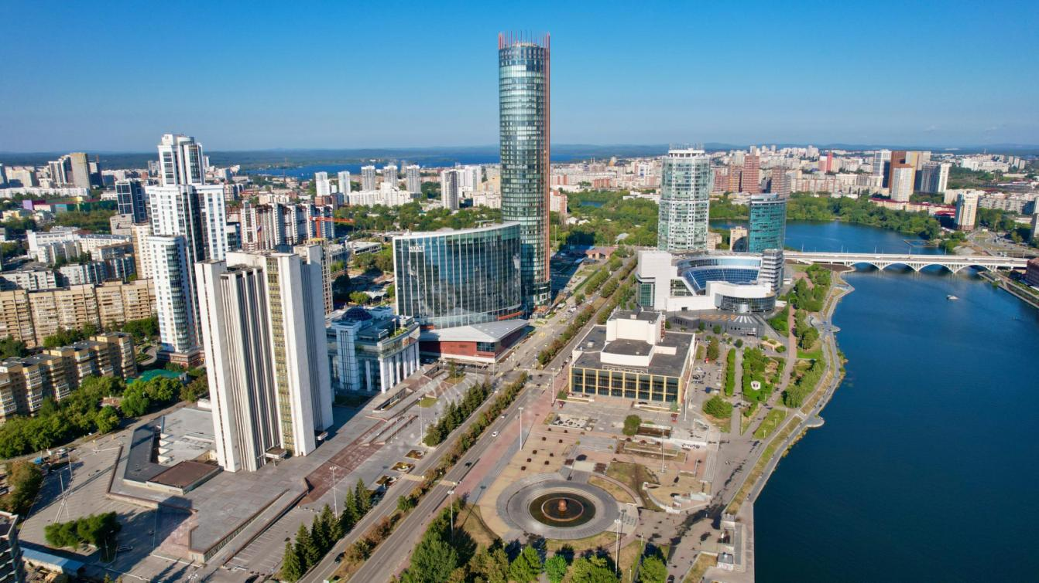

Slide 4
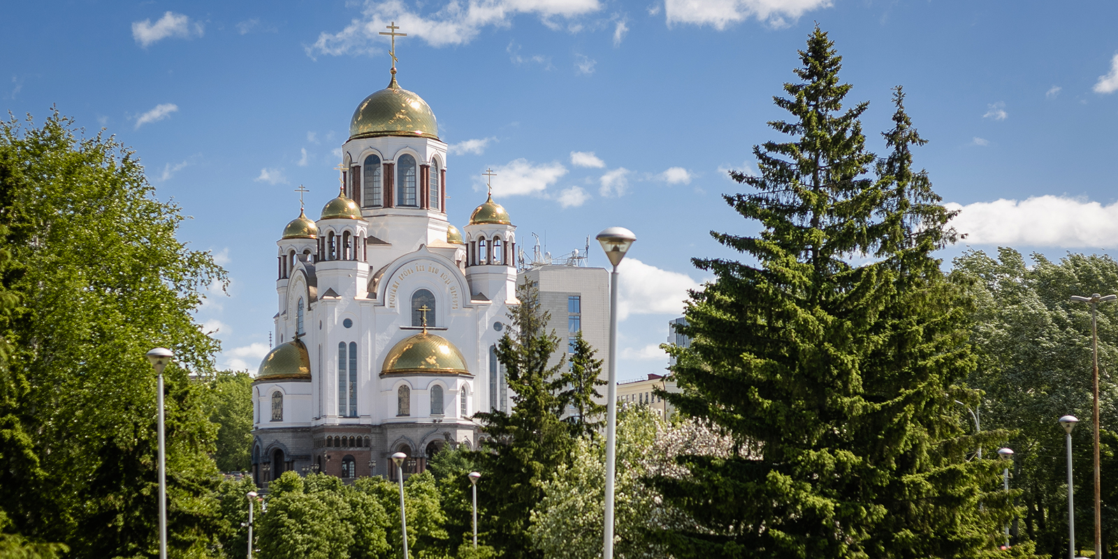

Slide 5
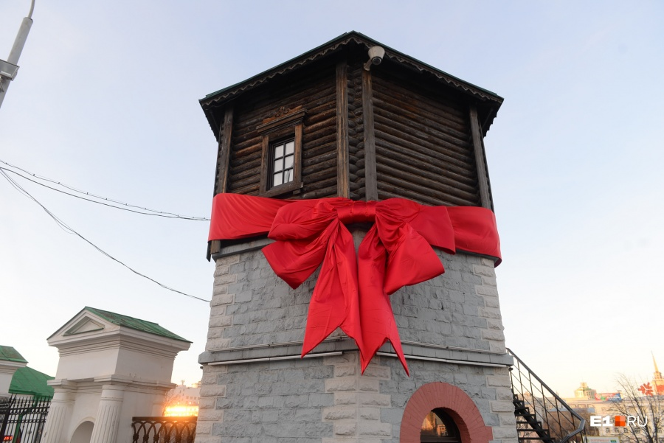

Slide 6
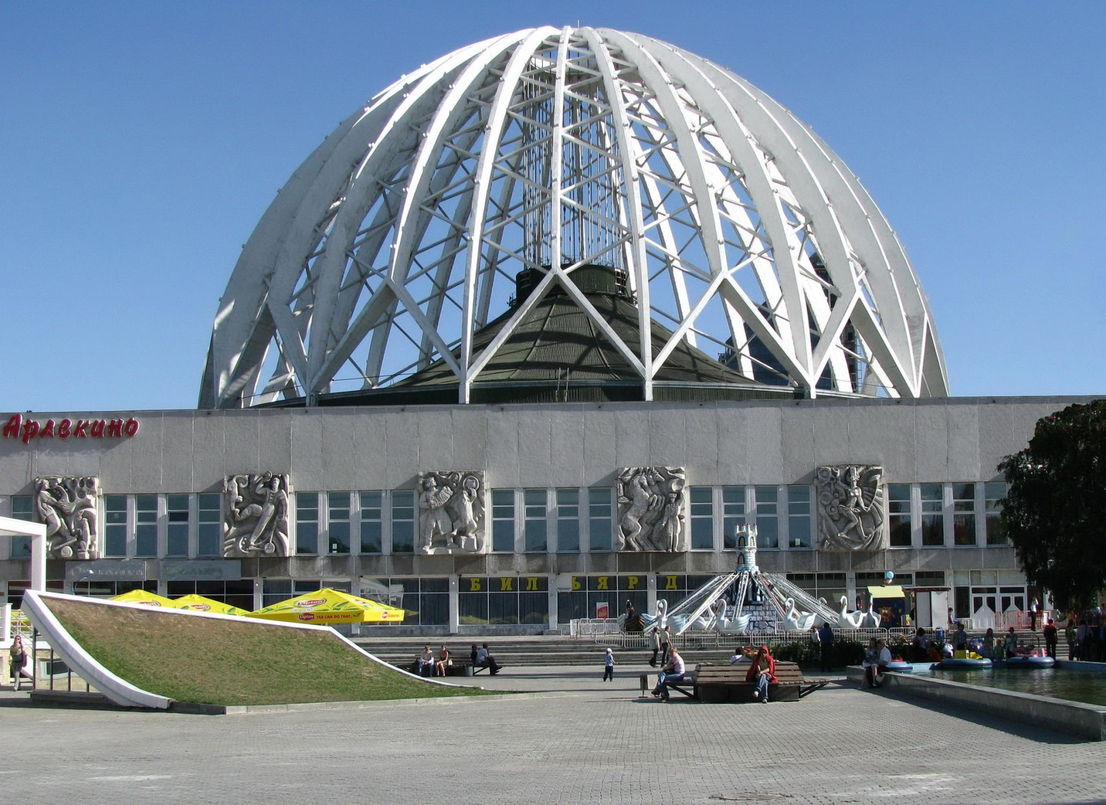

Slide 7
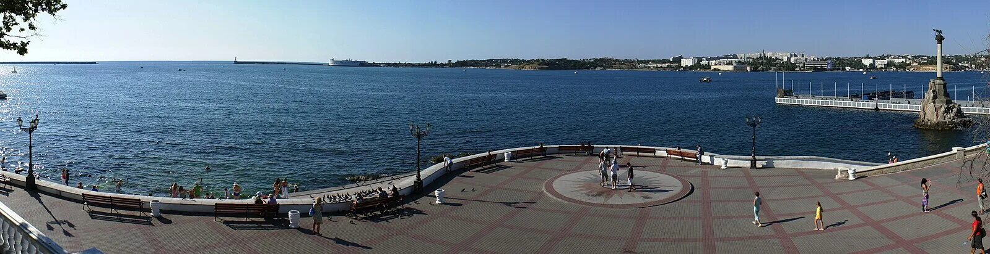
SEVASTOPOL - A hero city on the Black Sea
embankment - набережная
beach - пляж
jasper - яшма
down the stairs - вниз по лестнице
ancient - древний
Greek - греческий
Prince Vladimir - князь Владимир
Tauric Chersonese - Херсонес Таврический
baptize - крестить
sunken - затонувший
victory - победа
bay - бухта, залив
harbor - гавань
sea port - морской порт

Slide 8
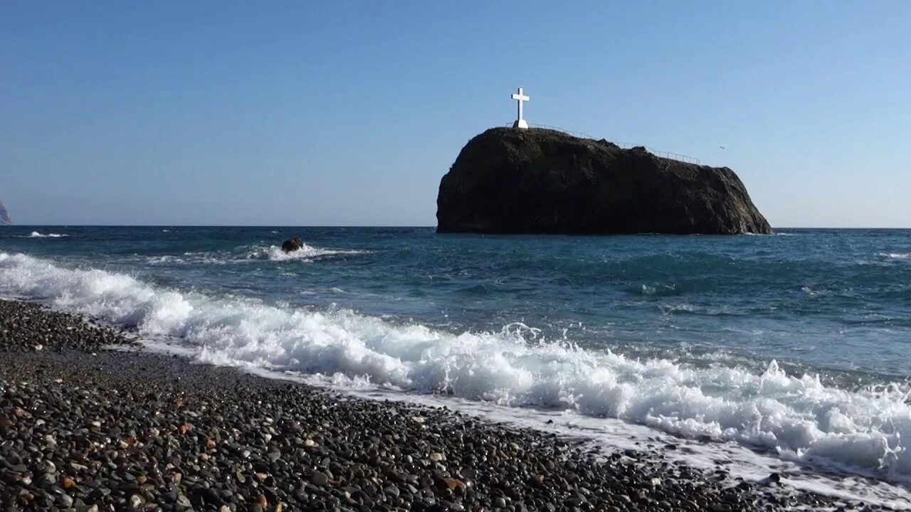
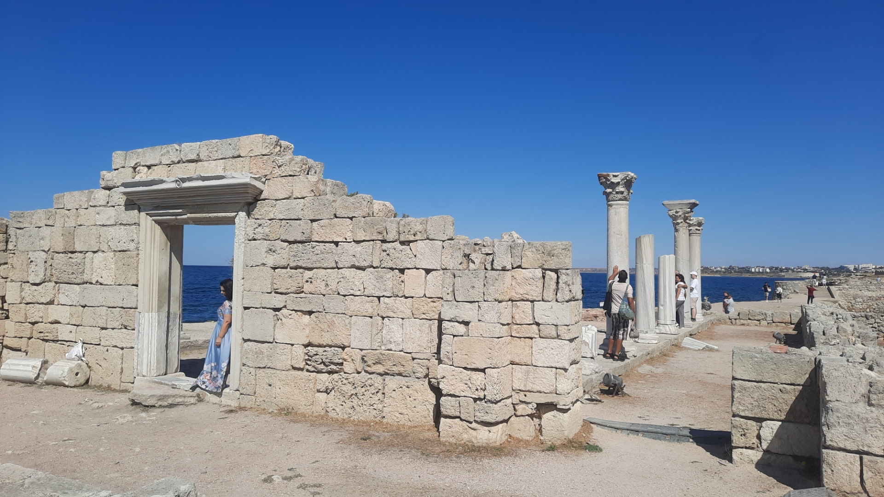
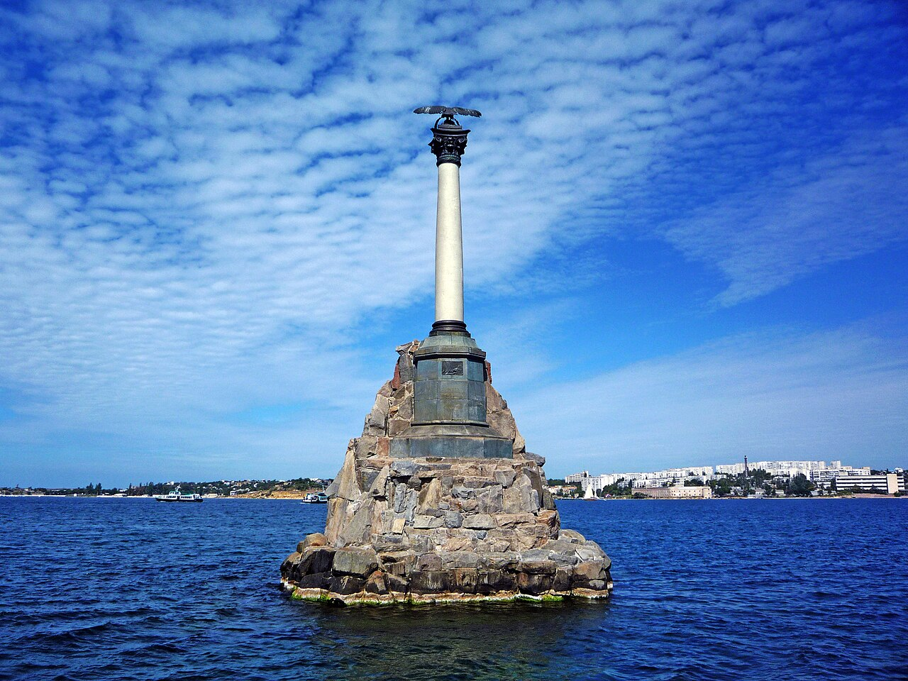
Sevastopol is a famous hero city located on the Black Sea. It has many beautiful beaches, museums, monuments and parks. The most beautiful beach is called Jasper beach. If you want to visit this beach, you will have to go down the stairs with 800 steps. The most famous museum is Tauric Chersonesos where you can see the riuins of an ancient Greek city. In this place Prince Vladimir was baptized. Another interesting place is a Monument to the Sunken Ships. The biggest park in my city is the Park of Victory. It is 2 kilometers long. There are 14 fountains in this park. Today Sevastopol is an important historical and cultural city.

Slide 9
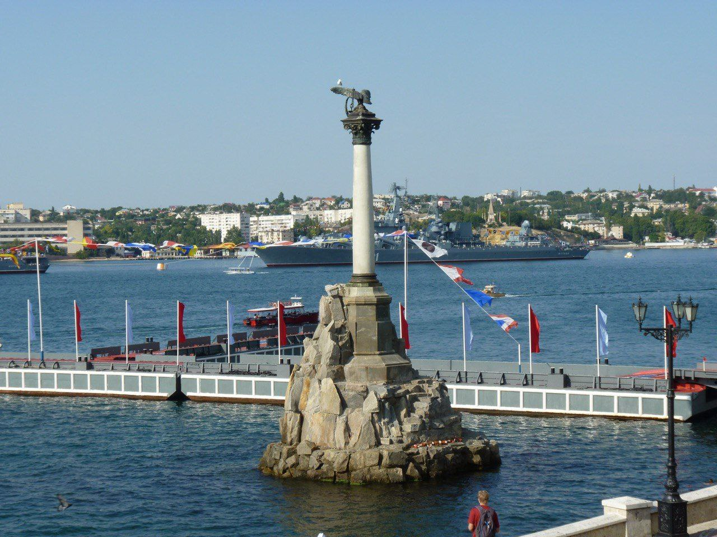
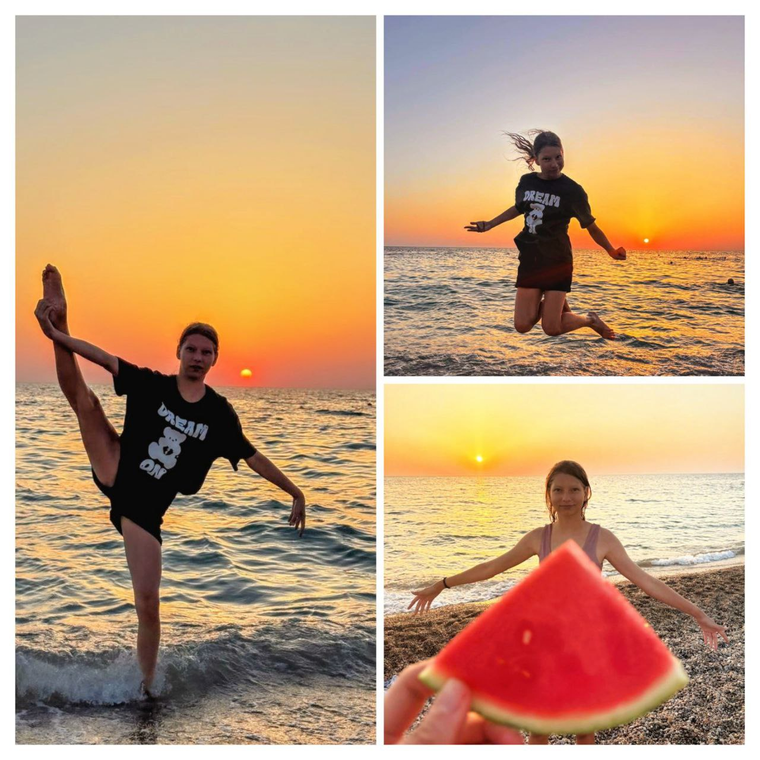
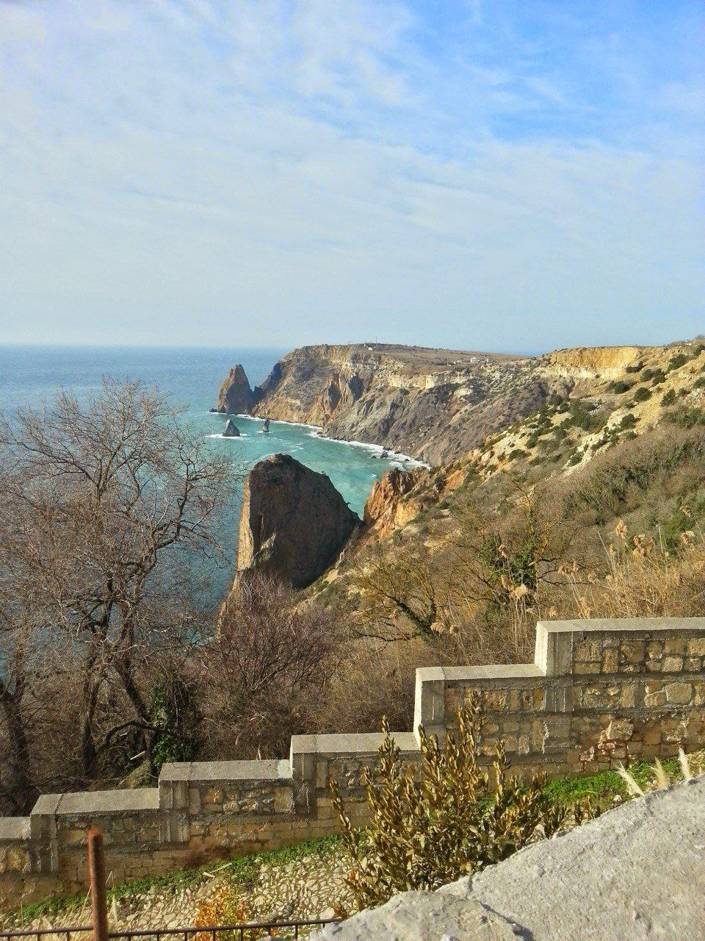
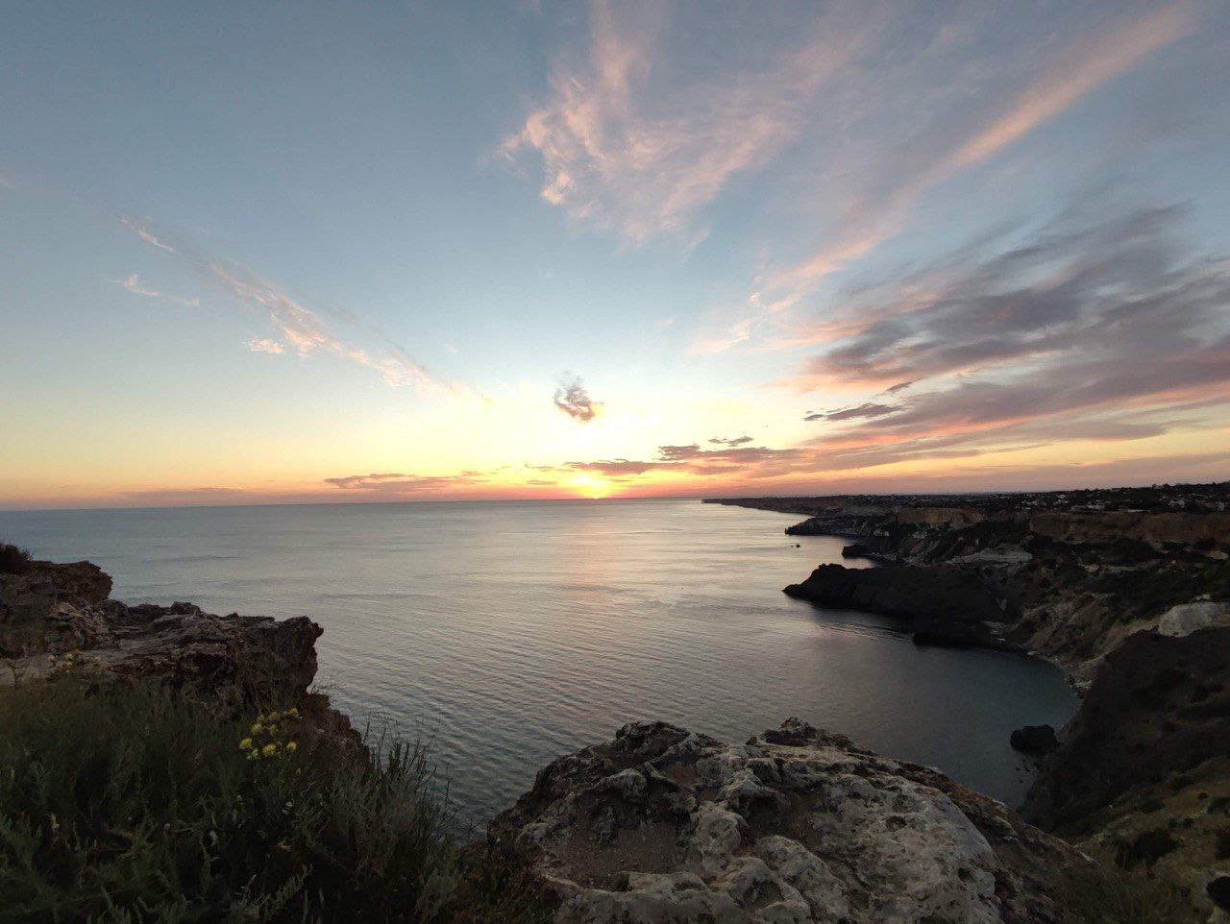
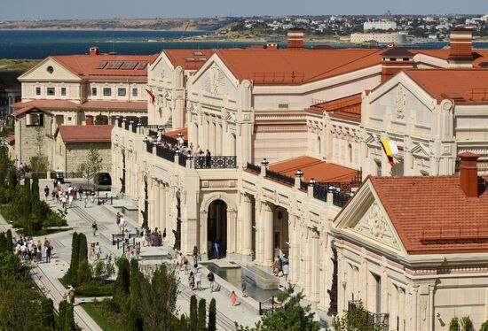
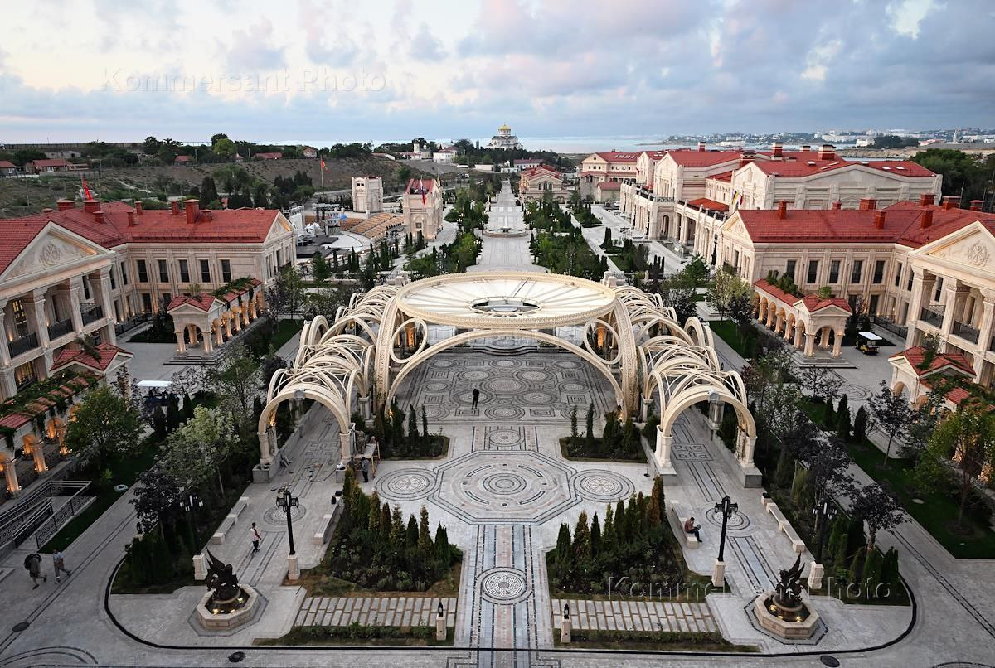
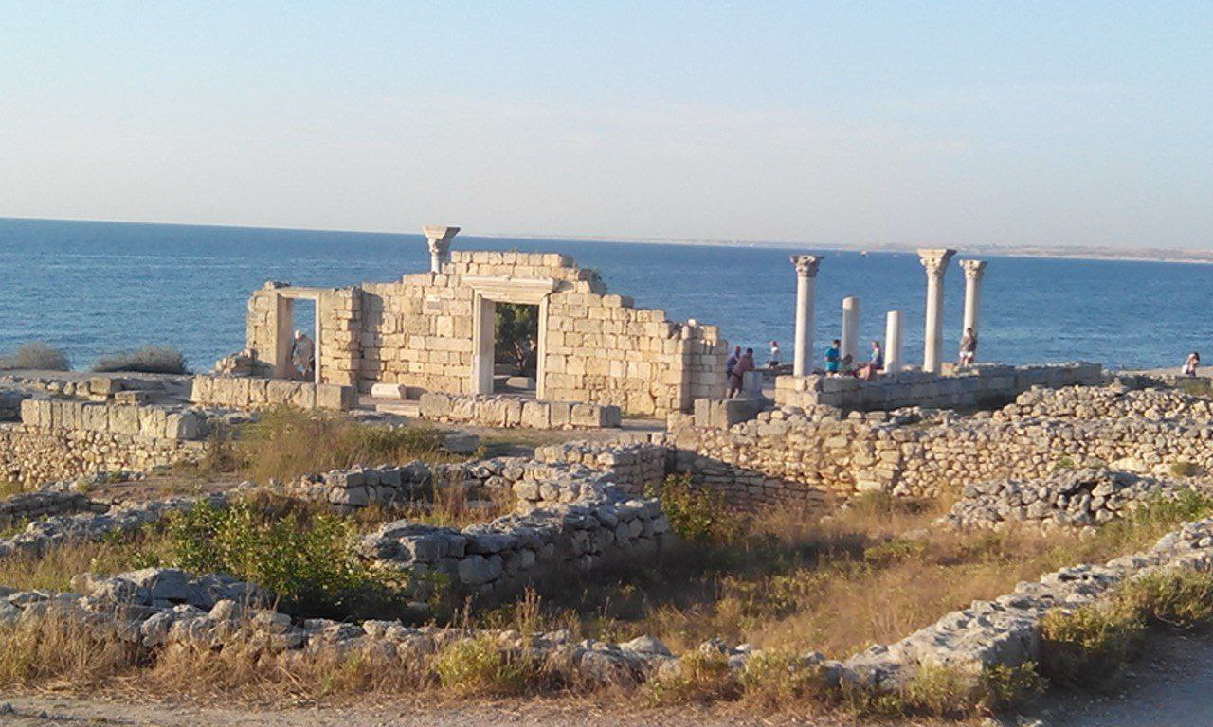



Slide 10

HOMEWORK
1. Where is Sevastopol located?
2. Why is it called a hero city?
3. What is the symbol of the city?
4. What places of interest do you know there?
5. Would you like to visit Sevastopol? Why?

