Slide 1
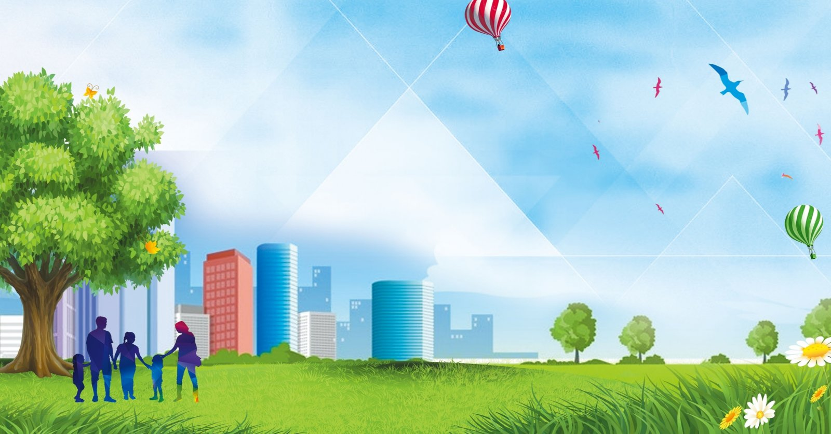
Russian Cities
Lesson 40

Slide 2
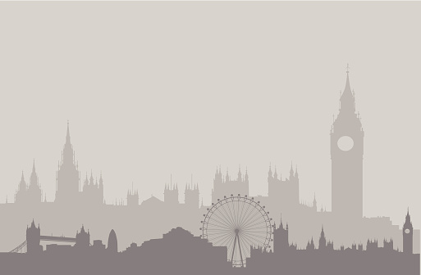
Big Ben song
700 species in London Zoo
Reptiles*, Amphibians, Invertebrates too *[1st time only]
Penguins waddle, crocodiles snap
No you can't stroke a crocodile on your lap! (^2)
Round and round goes The London Eye
It's 130 meters high
Buckingham Palace is where The Queen sleeps
And The Prime Minister at Downing Street. (^2)
If you're tired, and need to eat
get fish n chips and a cup of tea.
Big Ben is not a person
Big Ben is not a clock
Big Ben is not a tower
It's a bell: ding dong (^2)
A Science museum, to learn about space
Astronauts, rockets, awesome place
At the British Museum you can see
Egyptian mummies; it's free! (^2)

Slide 3
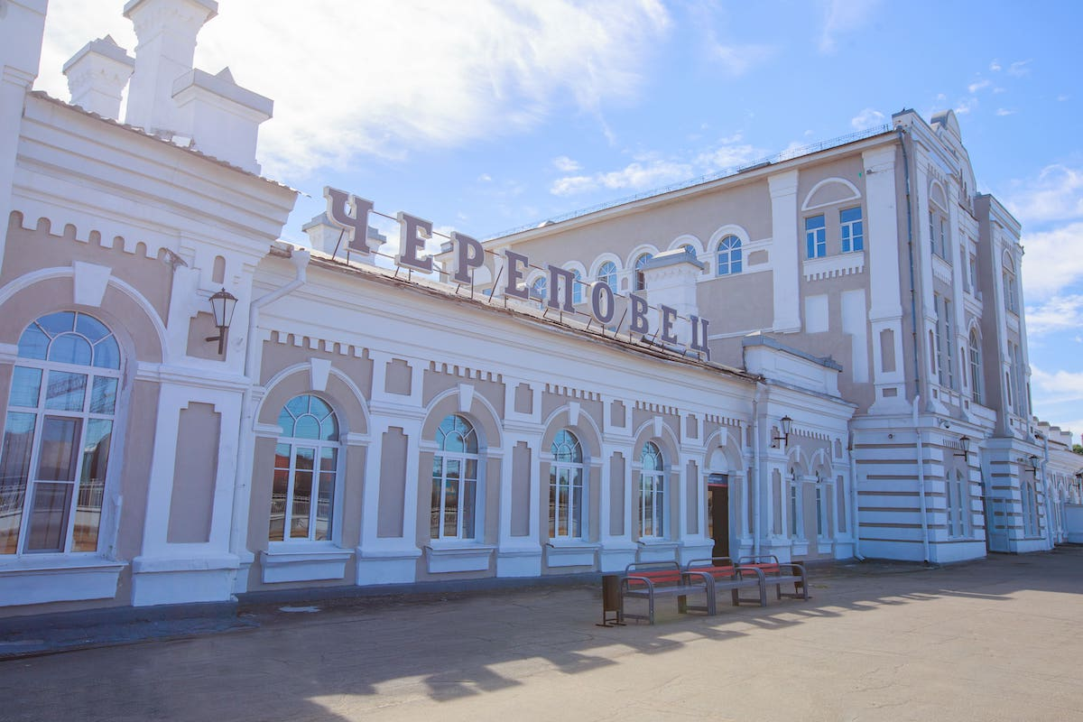

Slide 4
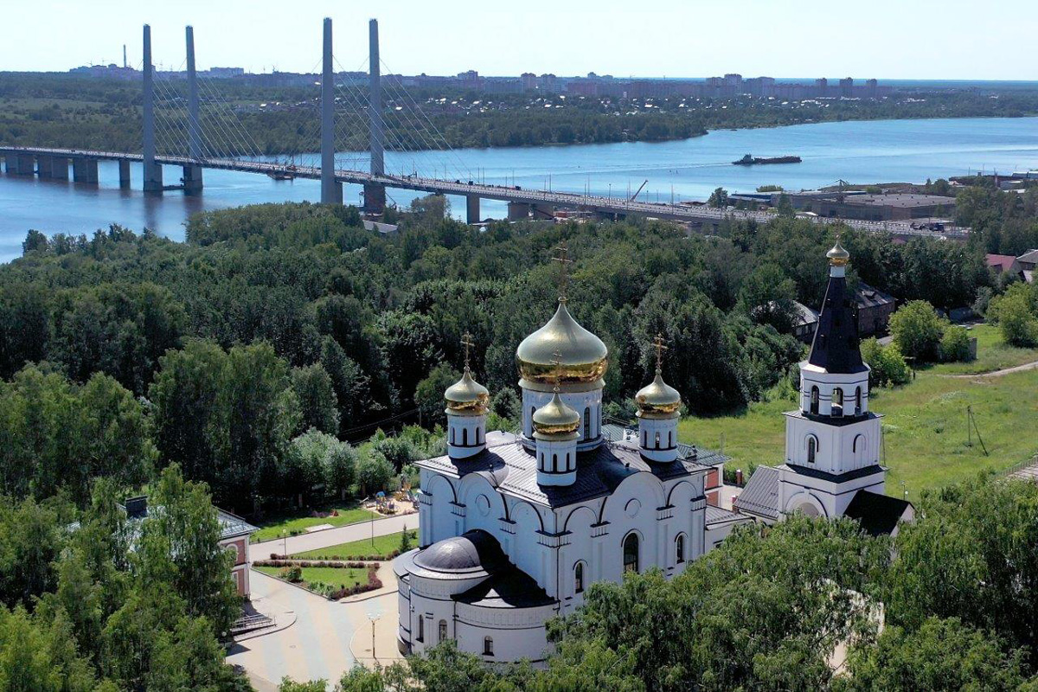

Slide 5
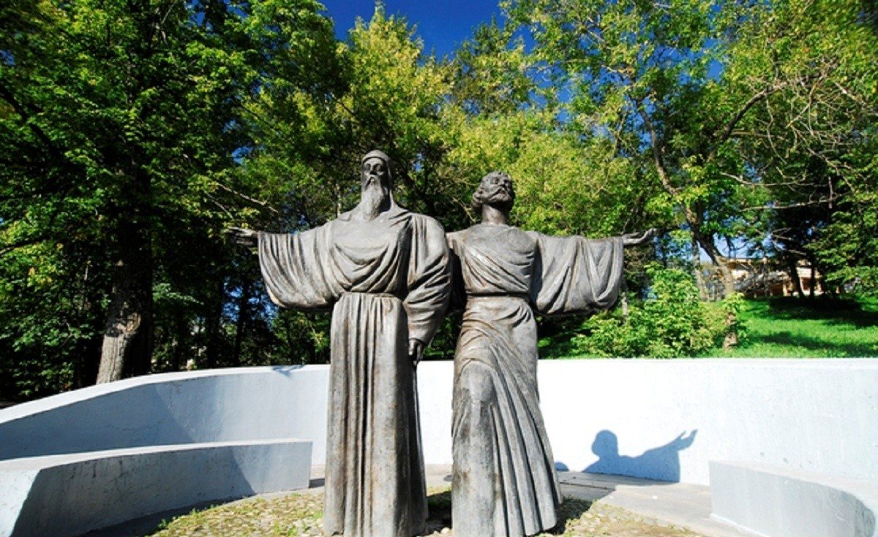

Slide 6
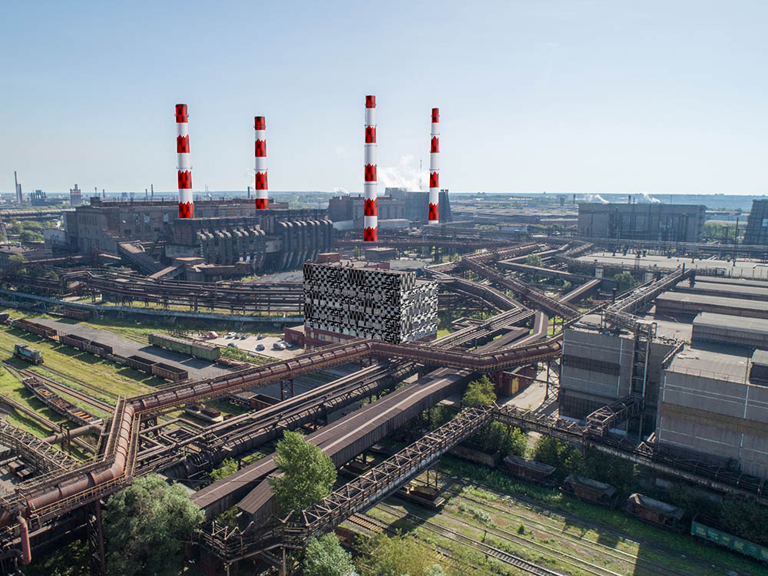

Slide 7
Yekaterinburg: The City on the Border of Two Continents
Yekaterinburg is one of the largest cities in Russia. It is often called the "capital of the Urals" because it is located on the border (на границе) between Europe and Asia. This makes the city very special.(особенным)
The heart of the city is the beautiful pond near the city dam(плотины). Here you can walk along the embankment (набережная)and see the old Water Tower, a symbol of Yekaterinburg. Not far away is Vaynera Street, a pedestrian street (пешеходная улица) full of shops, cafes, and street musicians. Locals (местные) call it "Ural Arbat."
Yekaterinburg is also a city of modern architecture (архитектура).The "Vysotsky" skyscraper (небоскрёб) is the tallest building in the city. From its observation deck, (видовая площадка) you can see the whole city.
The city has many green parks. The Green Grove (роща) park is perfect for walks, and in winter, it turns into (превращается) a popular ice-skating rink.
Yekaterinburg is also known for its tragic history. The Church on the Blood (храм-на-крови)was built on the spot where the last Russian emperor, (император) Nicholas II, and his family were killed. This place is now a memorial and an important spiritual center (духовный центр).
Near the city, there is a monument to the border between Europe and Asia. Tourists love to take photos with one foot in Europe and the other in Asia.
Yekaterinburg is a city of contrasts (контрастов): here you can see old factories (заводы)next to modern business centers, and quiet parks next to noisy avenues(шумные проспекты). It is a city that preserves (сохраняет) history while looking to the future.

Slide 8
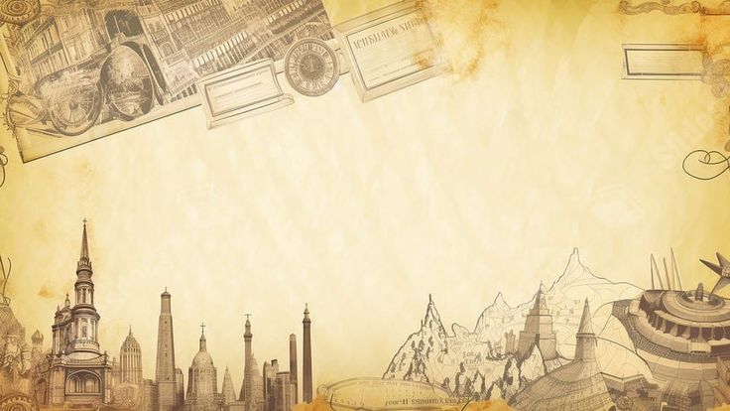
Homework
1. Where is Yekaterinburg located?
2. When is it founded? By whom?
3. What is the symbol of the city?
4. What places of interest do you know there?
5. Why is the city known for its tragic history ?
6. Would you like to visit Yekaterinburg? Why?

