Slide 1

Russian Cities
Lesson 40

Slide 2

Big Ben song
700 species in London Zoo
Reptiles*, Amphibians, Invertebrates too *[1st time only]
Penguins waddle, crocodiles snap
No you can't stroke a crocodile on your lap! (^2)
Round and round goes The London Eye
It's 130 meters high
Buckingham Palace is where The Queen sleeps
And The Prime Minister at Downing Street. (^2)
If you're tired, and need to eat
get fish n chips and a cup of tea.
Big Ben is not a person
Big Ben is not a clock
Big Ben is not a tower
It's a bell: ding dong (^2)
A Science museum, to learn about space
Astronauts, rockets, awesome place
At the British Museum you can see
Egyptian mummies; it's free! (^2)

Slide 3
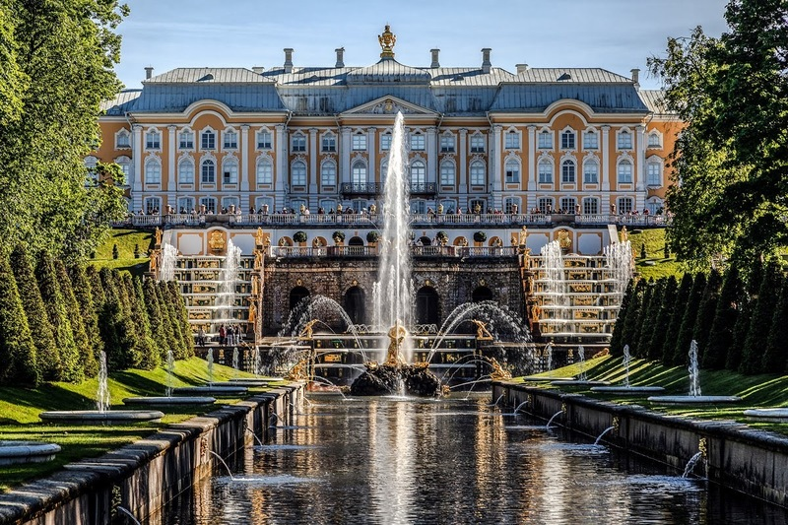

Slide 4
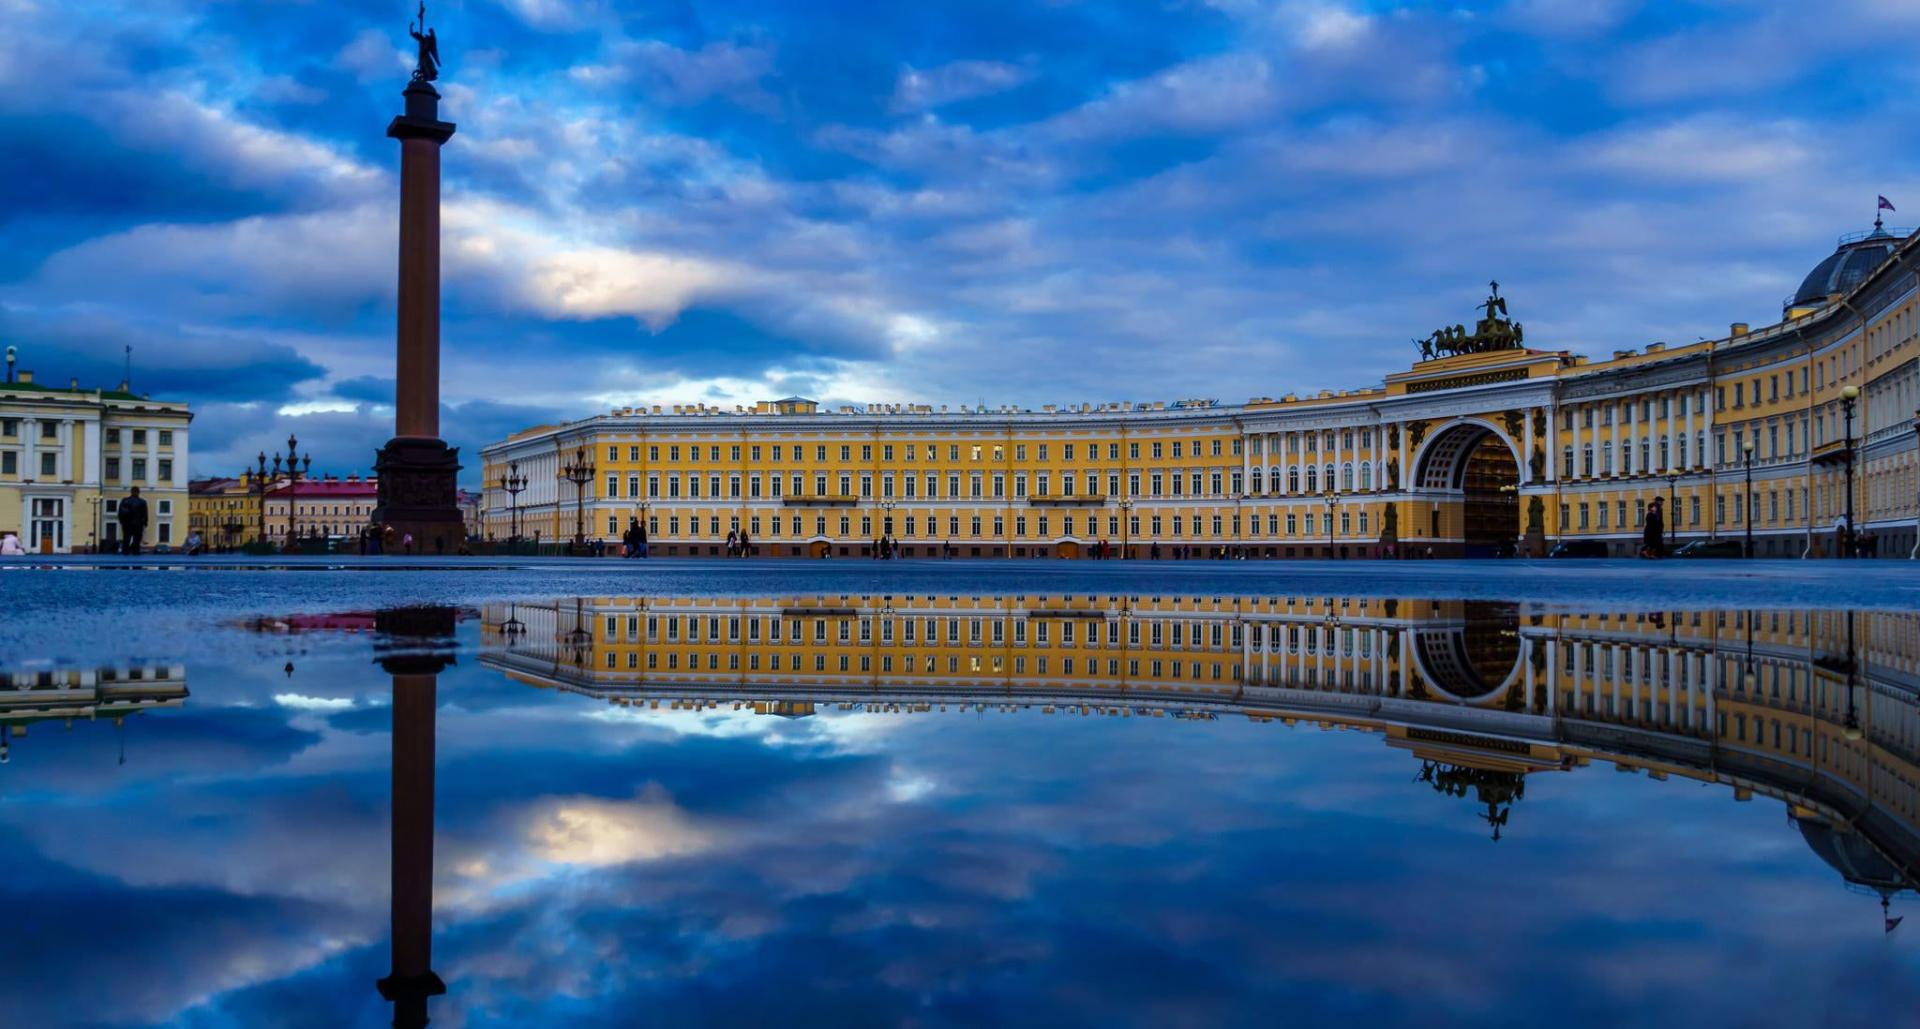

Slide 5
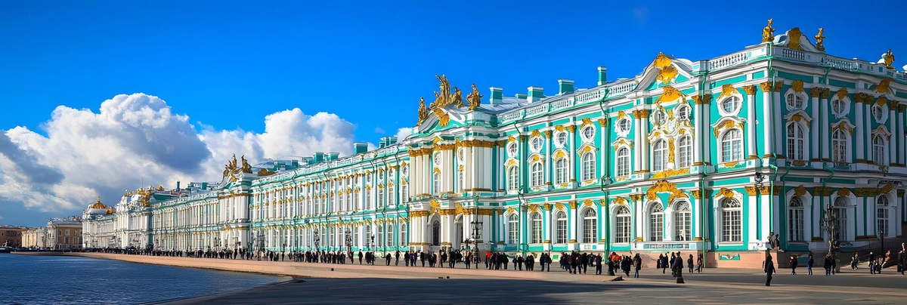

Slide 6
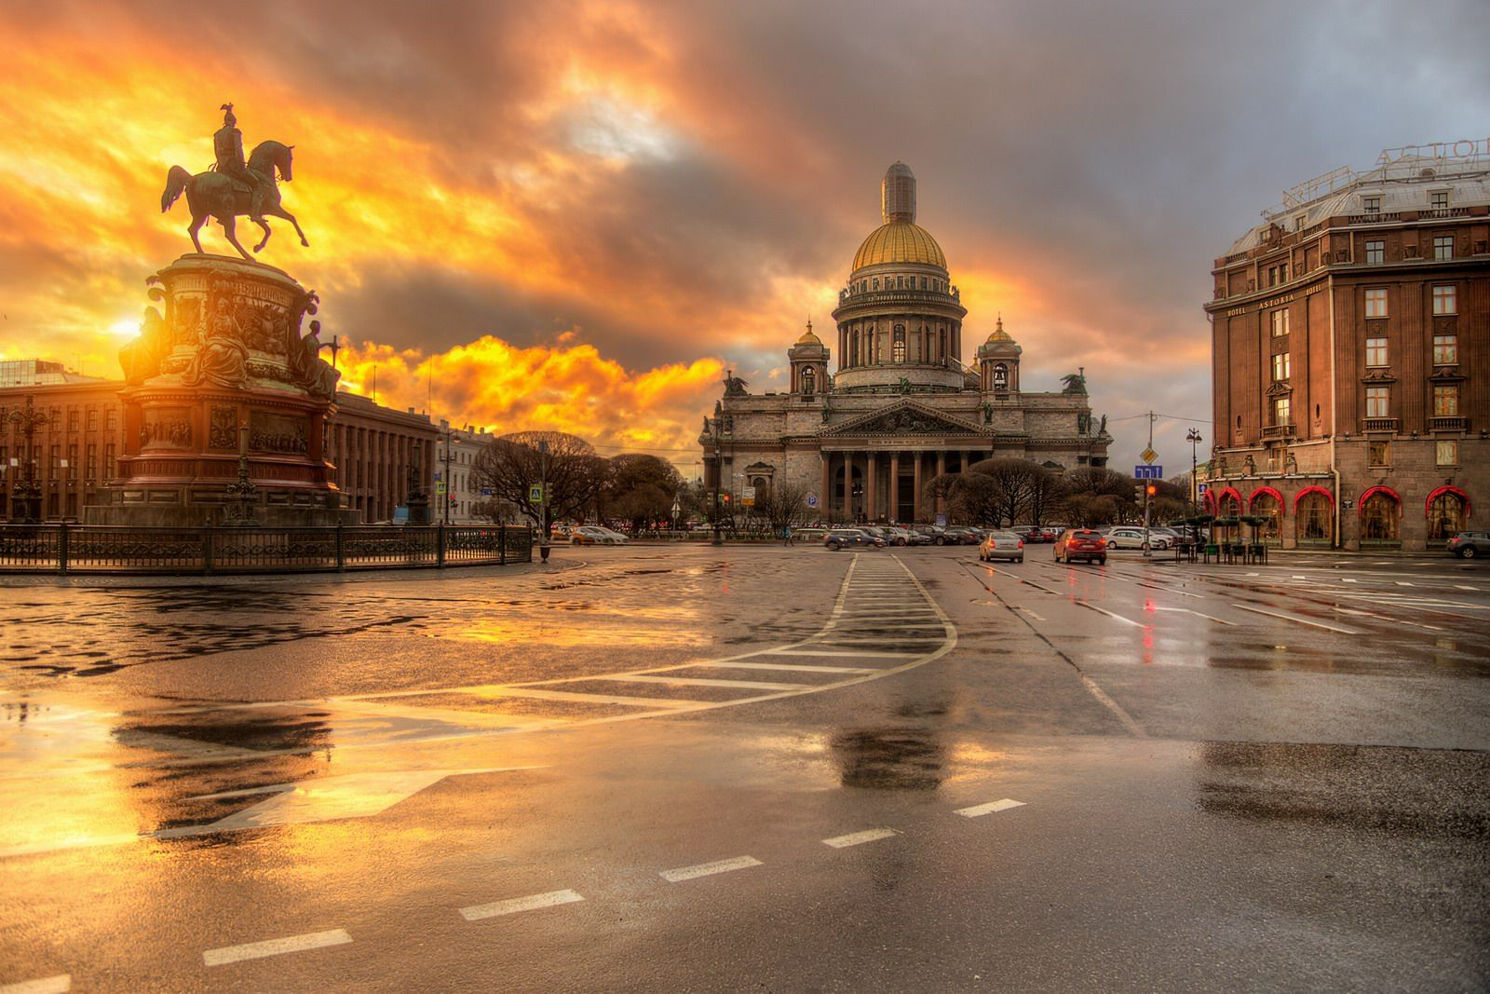
St. Isaac's Cathedral

Slide 7
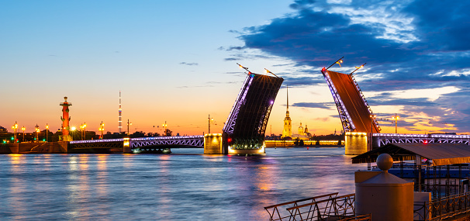
The Palace Bridge

Slide 8
Girls in Cherepovets walking in the park on the embankment
Zlata (guest): Cherepovets is such a green city! And how wide the Sheksninsky Bridge is!
Anya (guest): Yes, and so many parks! Where can we go for a walk in the evening here?
Milana (local): Be sure to go to Oktyabrsky Prospekt — there are beautiful fountains there!
Dasha (local): And we also have a Children's Park with rides and a Ferris wheel.
Yasenia (guest): Interesting! What can we buy as a souvenir from Cherepovets?
Vasilisa (local): Souvenirs with the city symbol — the polar bear! Or a magnet with the metallurgical plant.
Sonya (local): Have you tried local sweets? Our Cherepovets "Ferrero" is very tasty!
Milana: And be sure to try the pies at the cafe "Uyut" — they are legendary here!
Zlata: Where can we go if we want some culture?
Dasha: To the Art Museum or the Drama Theatre — we often have interesting plays there.
Anya: Is there nature nearby?
Vasilisa: Of course! The Rybinsk Reservoir and the surrounding forests — it's great there in summer!
Yasenia: Now I understand why you love your city so much!
Sonya: Come in winter — we'll go ice skating at the Metallurg stadium

Slide 9

Homework
1. Where is Cherepovets located?
2. When is it founded? By whom?
3. How many people live there?
4. What places of interest do you know there?
5. What is the city famous for?
6. Would you like to visit Cherepovets? Why? (for guests)
6. Your information (for locals).

