Slide 1

Russian Cities
Lesson 40

Slide 2

Big Ben song
700 species in London Zoo
Reptiles*, Amphibians, Invertebrates too *[1st time only]
Penguins waddle, crocodiles snap
No you can't stroke a crocodile on your lap! (^2)
Round and round goes The London Eye
It's 130 meters high
Buckingham Palace is where The Queen sleeps
And The Prime Minister at Downing Street. (^2)
If you're tired, and need to eat
get fish n chips and a cup of tea.
Big Ben is not a person
Big Ben is not a clock
Big Ben is not a tower
It's a bell: ding dong (^2)
A Science museum, to learn about space
Astronauts, rockets, awesome place
At the British Museum you can see
Egyptian mummies; it's free! (^2)

Slide 3
capital - столица
modern- современный
famous - известный
square - площадь
cathedral - собор
domes - купола
power - власть
performances - спектакли
skyscrapers - небоскрёбы
a boat trip - лодочная прогулка
palace - дворец
marble - мрамор
chandeliers - канделябры
mosaics - мозаика
guests - гости
Warm-up
Have you ever been to Moscow?
Would you like to go there (again)?
What places have you visited/would you like to visit?
Why?

Slide 4
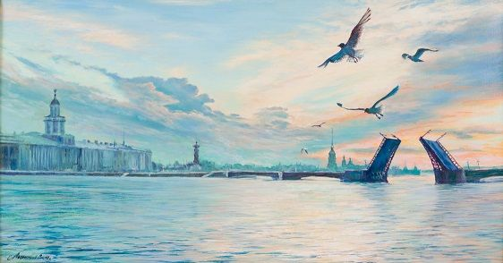
Saint Petersburg
currently - в настоящий момент
famous for - знаменит (чем-то)
canals - каналы
the Hermitage Museum - Эрмитаж
art collections - коллекции предметов искусства
incredible - невероятный
was amazed - был изумлён
paintings - живописные полотна
stunning views - потрясающие виды
local pastries - местная выпечка
Peterhof - Петергоф
A. Dmitry is in St. Petersburg.
B. Dmitry is on holiday with his family.
C. Dmitry visited the Hermitage Museum.
D. The pirozhki were filled with fruit.
E. Dmitry enjoyed visiting Peterhof.
known for - известен (чем-то)
gardens and fountains - сады и фонтаны
sharing adventures - делиться приключениями

Slide 5
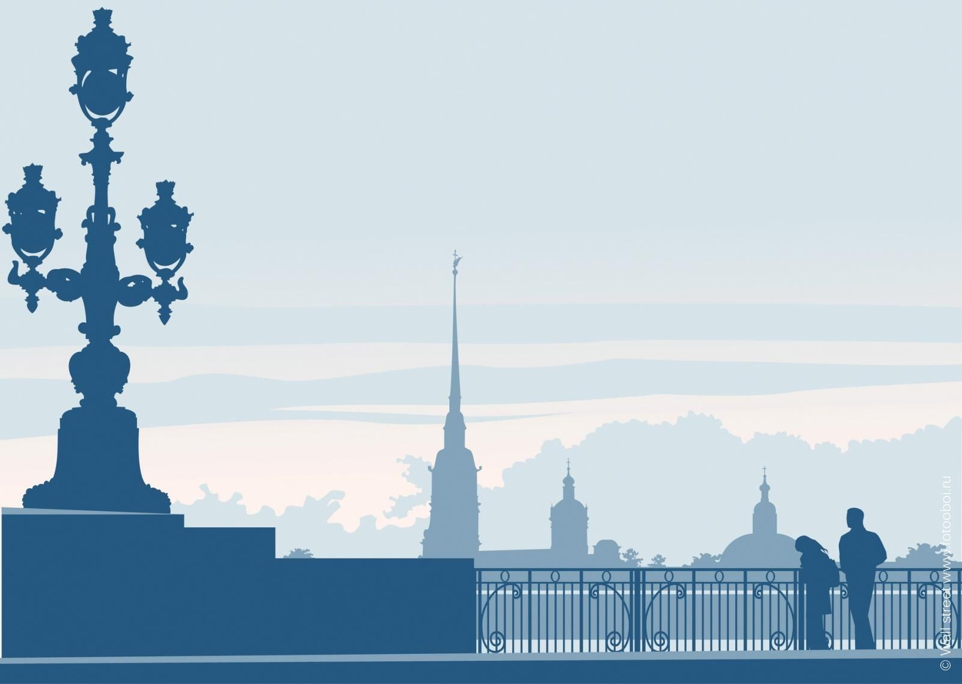
«Собери фразу» (соедини начало и конец предложения)
St. Petersburg is famous for...
a) ...filled with cabbage and meat.
2.The Hermitage Museum is...
b) ...beautiful gardens and fountains.
3. Pirozhki are...
c) ...its canals and historic buildings.
4. Peterhof is known for...
d) ...one of the largest museums in the world.
Заполни пропуски (слова даны в скобках)
Dmitry is in St. Petersburg with his ________ (friends / family). They visited the ________ (Hermitage / Kremlin) Museum. They saw paintings by ________ (Rembrandt / Picasso) and Van Gogh. They walked along the ________ (Neva / Volga) River. They ate delicious ________ (pirozhki / blini). The next day they went to ________ (Peterhof / Moscow) to see the gardens.

Slide 6
HOMEWORK
1. What other places of interest do you know in Saint Petersburg?
2. Which of them would you like to visit (have you visited)?
3. Would you prefer to visit an art museum or a palace with gardens? Why?
4. What local food would you like to try in St. Petersburg?
5. Do you like travelling with friends? What are the advantages?

