Slide 1
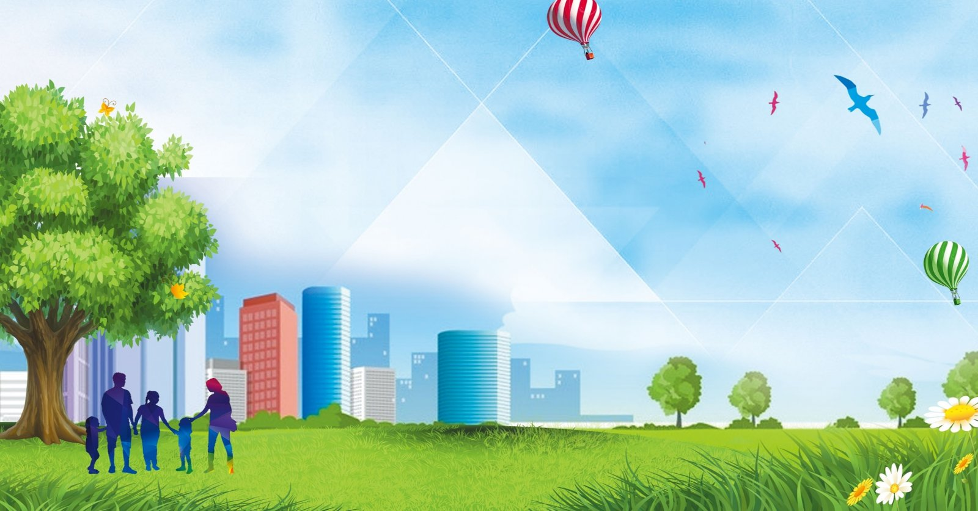
Russian Cities
Lesson 39

Slide 2
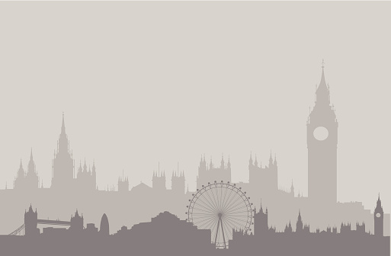
Big Ben song
700 species in London Zoo
Reptiles*, Amphibians, Invertebrates too *[1st time only]
Penguins waddle, crocodiles snap
No you can't stroke a crocodile on your lap! (^2)
Round and round goes The London Eye
It's 130 meters high
Buckingham Palace is where The Queen sleeps
And The Prime Minister at Downing Street. (^2)
If you're tired, and need to eat
get fish n chips and a cup of tea.
Big Ben is not a person
Big Ben is not a clock
Big Ben is not a tower
It's a bell: ding dong (^2)
A Science museum, to learn about space
Astronauts, rockets, awesome place
At the British Museum you can see
Egyptian mummies; it's free! (^2)

Slide 3
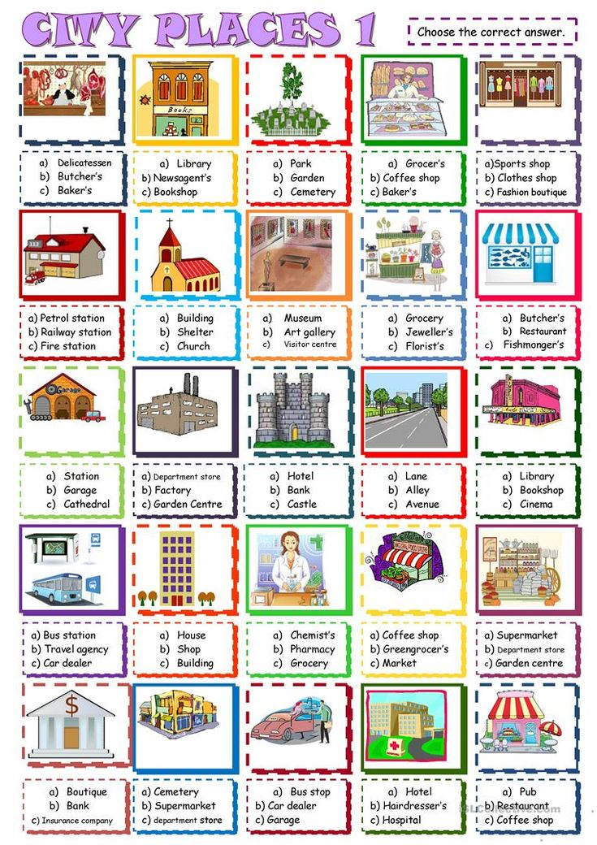
CITY PLACES

Slide 4
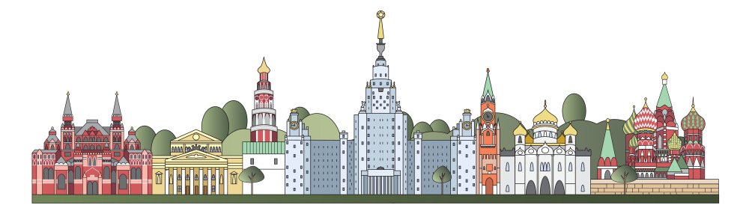
Moscow: The Heart of Russia
Moscow is the capital of Russia and one of the largest cities in the world. It is a city where history and modern life meet. The most famous place in Moscow is Red Square. Here you can see the beautiful St. Basil's Cathedral with its colorful domes. It looks like a fairy-tale building!
Next to Red Square is the Kremlin, the historical center of power. The Kremlin walls are red and very old. Inside, there are museums, churches, and the President's office. Another important place is the Bolshoi Theatre. It is famous for ballet and opera. People from all over the world come here to see performances.
Moscow has many modern parts too. The Moscow City district has very tall, shiny skyscrapers. The city is also green – there are many parks like Gorky Park where people walk, cycle, and relax. In winter, you can skate on the ice rinks.
The Moskva River flows through the city. You can take a boat trip to see Moscow from the water. The metro in Moscow is not just transport; it is like an underground palace with marble, chandeliers, and mosaics.
Moscow is always busy, day and night. It is a city of students, businesspeople, artists, and tourists. It can be very cold in winter, but very warm and sunny in summer. Moscow is a city that never sleeps and always welcomes its guests.
capital - столица
modern- современный
famous - известный
square - площадь
cathedral - собор
domes - купола
power - власть
performances - спектакли
skyscrapers - небоскрёбы
a boat trip - лодочная прогулка
palace - дворец
marble - мрамор
chandeliers - канделябры
mosaics - мозаика
guests - гости

Slide 5
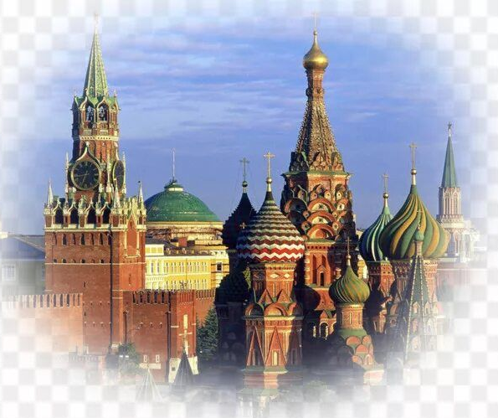
Верно/Неверно (True/False)
Moscow is the capital of Russia.
St. Basil's Cathedral is located inside the Kremlin walls.
The Moscow metro looks like an ordinary underground.
Moscow City is an area with old historical buildings.
You can skate in Moscow parks in winter.
The Moskva River does not flow through the city.
Заполни пропуски (слова даны в скобках)
Moscow is the ______ (capital / city) of Russia. The most famous ______ (square / street) is Red Square. St. Basil's Cathedral looks like a ______ (fairy-tale / modern) building. The Moscow metro is very ______ (beautiful / simple) with chandeliers and mosaics. In ______ (winter / autumn), you can skate in the parks.

Slide 6
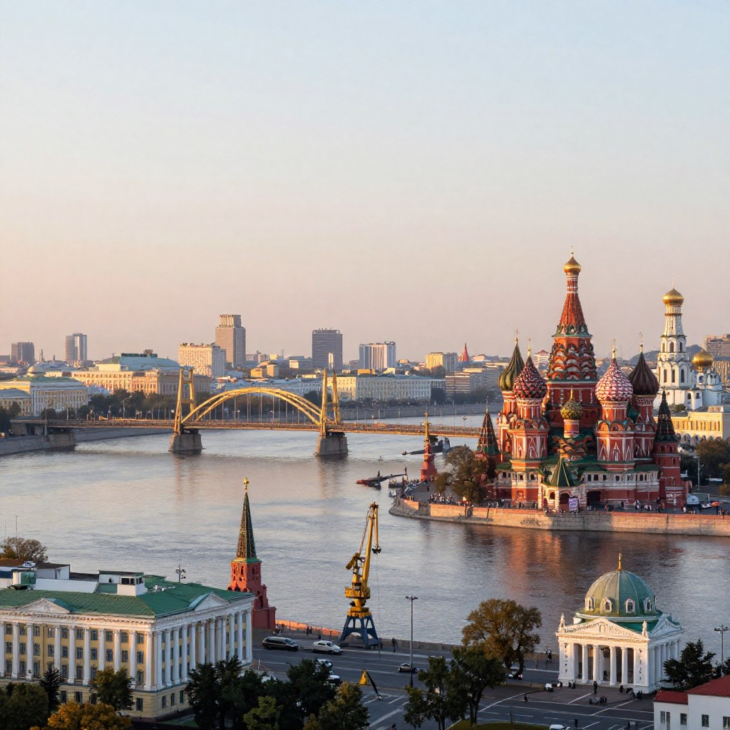
Homework
1.What is the most famous square in Moscow?
2.How would you describe St. Basil's Cathedral?
3. What can you find inside the Kremlin?
4. Why is the Bolshoi Theatre famous?
5. What can people do in Gorky Park?
6. What is special about the Moscow metro?
7. Would you like to visit Moscow? Why or why not?
8. What place in Moscow sounds the most interesting to you?
9.Do you prefer historical places (like the Kremlin) or modern places (like Moscow City)? Why?

