Slide 1





LESSON 38
Appearance & Character

Slide 2
Everything at once
All I wanna be
Oh-oh-oh, all I wanna be
Oh-oh-oh, all I wanna be is everything
Everything at once
Everything at once
Oh-oh-oh, everything at once
As warm as the sun, as silly as fun
As cool as a tree, as scary as the sea
As hot as fire, cold as ice
Sweet as sugar and everything nice
As old as time, as straight as a line
As royal as a queen, as buzzed as a bee
As stealth as a tiger, smooth as a glider
Pure as a melody, pure as I wanna be
All I wanna be
Oh-oh-oh, all I wanna be
Oh-oh-oh, all I wanna be is everything
Everything at once
As sly as a fox, as strong as an ox
As fast as a hare, as brave as a bear
As free as a bird, as neat as a word
As quiet as a mouse, as big as a house
All I wanna be
All I wanna be
Oh-oh-oh, all I wanna be is everything
As mean as a wolf, as sharp as a tooth
As deep as a bite, as dark as the night
As sweet as a song, as right as a wrong
As long as a road, as ugly as a toad
As pretty as a picture hanging from a fixture
Strong like a family, strong as I wanna be
Bright as day, as light as play
As hard as nails, as grand as a whale

Slide 3

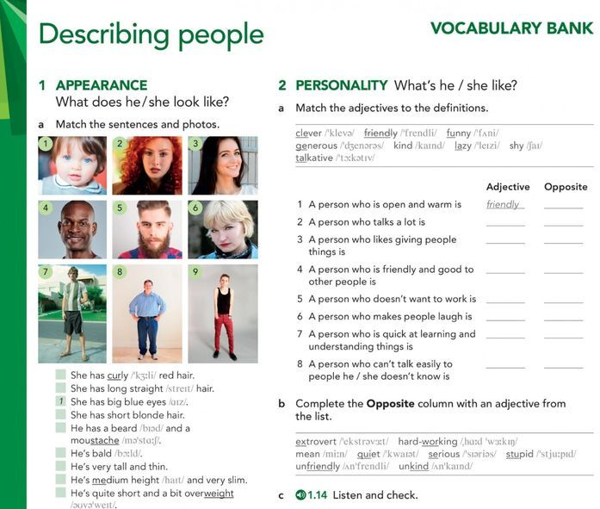
2. Practice listening
(закладка в браузере)

Slide 4
My baby brother always laughs when I make funny faces. He's so ______ and happy!
a) scary b) cheerful c) strict
2. Sarah always remembers everyone's birthdays and gives small presents. She's very ______.
a) selfish b) sensible c) sweet
3. The mountain climber didn't fear the high peak. She was very ______.
a) shy b) brave c) moody
4. John never shouts or gets angry, even when things go wrong. He's always ______.
a) calm b) mean c) arrogant
5. This old book has stories about ghosts and dark forests. It's really ______ to read at night!
a) intelligent b) scary c) generous
6. My neighbour always gives vegetables from her garden to everyone. She's so ______.
a) careless b) generous c) strict
7. The queen in that fairy tale thinks she's better than everyone. She's very ______.
a) wise b) arrogant c) hardworking
8. I love talking to my aunt because she understands everything and gives good advice. She's so ______.
a) funny b) wise c) selfish
9. Mark always thinks before he acts. He never does silly things. He's very ______.
a) sensible b) moody c) careless
10. Our new teacher tells jokes during lessons and makes learning fun. He's really ______!
a) strict b) shy c) funny

Slide 5

MY CHARACTER CARD:
Today I am: ___________ and_________
In the future I want to be: ___________
To become like that I’m going to... ___________________________________

Slide 6
HOMEWORK
Подставьте подходящее слово и переведите:
1. My friend always tells me the truth. She is a very __________ person.
(wise / honest / scary)
2. The lion in the zoo looked big and __________, but actually he was sleeping peacefully.
(sweet / scary / calm)
3. Don't be __________! Share your chocolates with your sister.
(selfish / brave / intelligent)
4. My grandmother knows many stories about life. She is very __________.
(hardworking / wise / careless)
5/ The student forgot his homework for the third time. He is so __________!
(careless / generous / funny)
2 (Bonus points) Character card Slide 6

