Slide 1





LESSON 34
Appearance & Character

Slide 2
Everything at once
All I wanna be
Oh-oh-oh, all I wanna be
Oh-oh-oh, all I wanna be is everything
Everything at once
Everything at once
Oh-oh-oh, everything at once
As warm as the sun, as silly as fun
As cool as a tree, as scary as the sea
As hot as fire, cold as ice
Sweet as sugar and everything nice
As old as time, as straight as a line
As royal as a queen, as buzzed as a bee
As stealth as a tiger, smooth as a glider
Pure as a melody, pure as I wanna be
All I wanna be
Oh-oh-oh, all I wanna be
Oh-oh-oh, all I wanna be is everything
Everything at once
As sly as a fox, as strong as an ox
As fast as a hare, as brave as a bear
As free as a bird, as neat as a word
As quiet as a mouse, as big as a house
All I wanna be
All I wanna be
Oh-oh-oh, all I wanna be is everything
As mean as a wolf, as sharp as a tooth
As deep as a bite, as dark as the night
As sweet as a song, as right as a wrong
As long as a road, as ugly as a toad
As pretty as a picture hanging from a fixture
Strong like a family, strong as I wanna be
Bright as day, as light as play
As hard as nails, as grand as a whale

Slide 3

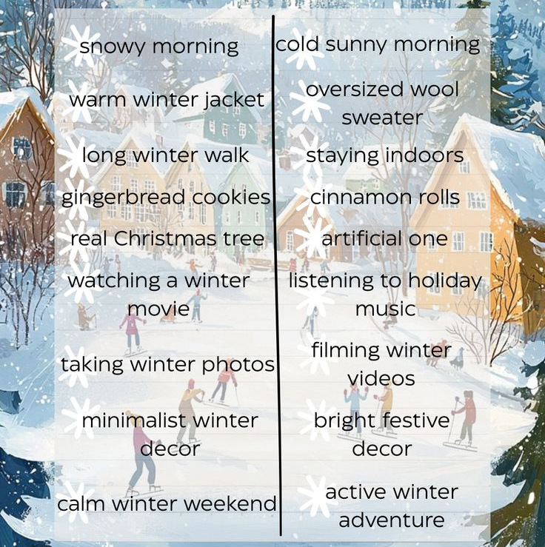
I’d choose... because...
For me... is better.
In my opinion,... is the best option
Personally I’d go for...
Both sound good, but I think...
It depends, but usually I choose...

Slide 4
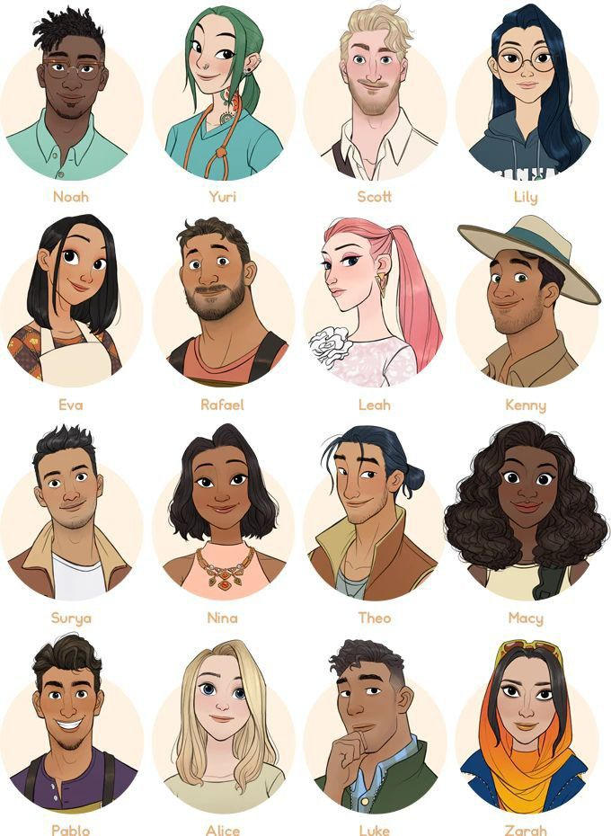
Dialogue with the poster
Anna: Look at this poster! Who is your favourite character?
Yasenia: I like the afro girl with long curly hair. Her smile is so kind.
Dasha: Oh, I prefer the hero in the green jacket. He is tall and has strong arms.
Zlata: Really? I think his face is too serious. The girl with glasses looks smarter.
Milana: Yes! She has big black eyes and long dark hair. Very pretty.
Sofia: But my favourite is the funny one. He isn't very tall, but he has a nice face.
Vasilisa: Which one? The one with the blonde hair and freckles?
Sofia: Exactly! His eyes are very bright.
Anna: Okay, and who is the prettiest? The girl with pink ponytail?
Yasenia: Probably! But my favourite is still the kind one with curly hair. Appearance isn't everything!

Slide 5
HOMEWORK
1. Describe your favourite person (at least 10 sentences )
2.Act out the dialogue by heart

