Slide 1





LESSON 33
Appearance & Character

Slide 2
Everything at once
All I wanna be
Oh-oh-oh, all I wanna be
Oh-oh-oh, all I wanna be is everything
Everything at once
Everything at once
Oh-oh-oh, everything at once
As warm as the sun, as silly as fun
As cool as a tree, as scary as the sea
As hot as fire, cold as ice
Sweet as sugar and everything nice
As old as time, as straight as a line
As royal as a queen, as buzzed as a bee
As stealth as a tiger, smooth as a glider
Pure as a melody, pure as I wanna be
All I wanna be
Oh-oh-oh, all I wanna be
Oh-oh-oh, all I wanna be is everything
Everything at once
As sly as a fox, as strong as an ox
As fast as a hare, as brave as a bear
As free as a bird, as neat as a word
As quiet as a mouse, as big as a house
All I wanna be
All I wanna be
Oh-oh-oh, all I wanna be is everything
As mean as a wolf, as sharp as a tooth
As deep as a bite, as dark as the night
As sweet as a song, as right as a wrong
As long as a road, as ugly as a toad
As pretty as a picture hanging from a fixture
Strong like a family, strong as I wanna be
Bright as day, as light as play
As hard as nails, as grand as a whale

Slide 3
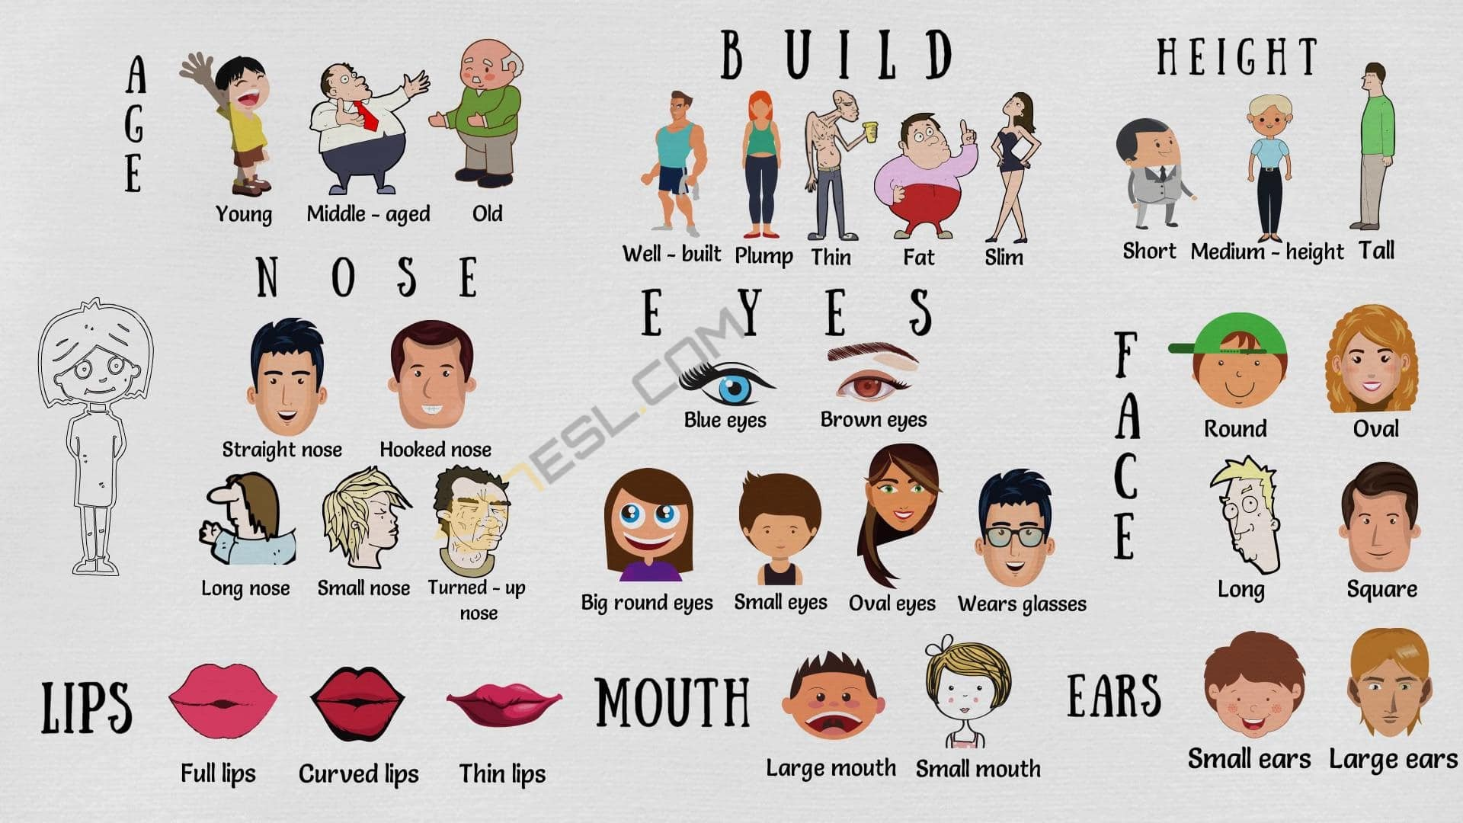

Slide 4
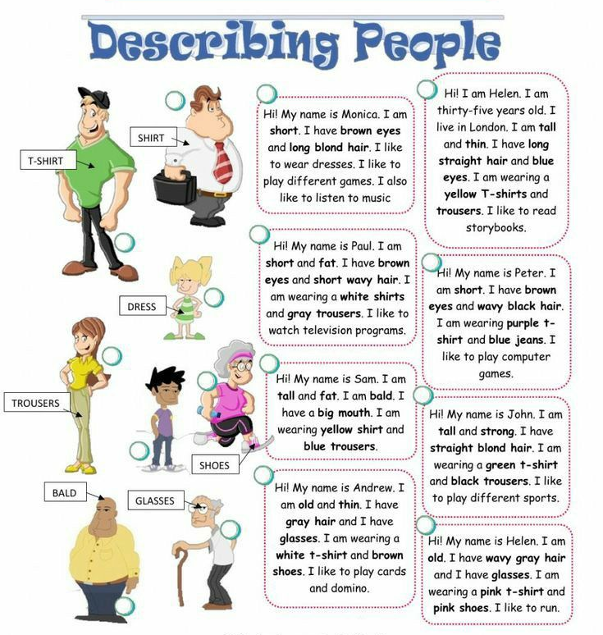
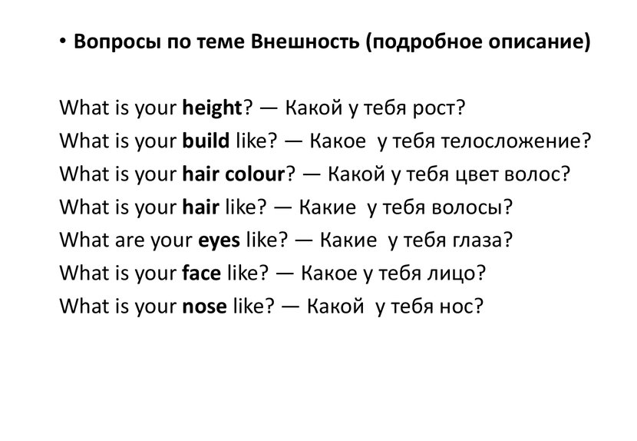

Slide 5
HOMEWORK
1. Copy the appearance words from slide 3 (or print them) - write the transcription
2.Answer the questions from slide 4
Нарисуйте/вклейте портрет

