Slide 1
Lesson 31

Slide 2
You better watch out, you better not cry
You better not pout, I'm telling you why
Santa Claus is coming to town
He's making a list and checking it twice
Gonna find out who's naughty or nice
Santa Claus is coming to town
He sees you when you're sleeping
He knows when you're awake
He knows if you've been bad or good
So be good for goodness sake
You better watch out, you better not cry
You better not pout, I'm telling you why
Santa Claus is coming to town
Santa Claus Is Coming to Town
He sees you when you're sleeping
He knows when you're awake
He knows if you've been bad or good
So be good for goodness sake
Oh, you better watch out, you better not cry
Better not pout, I'm telling you why
Santa Claus is coming to town

Slide 3

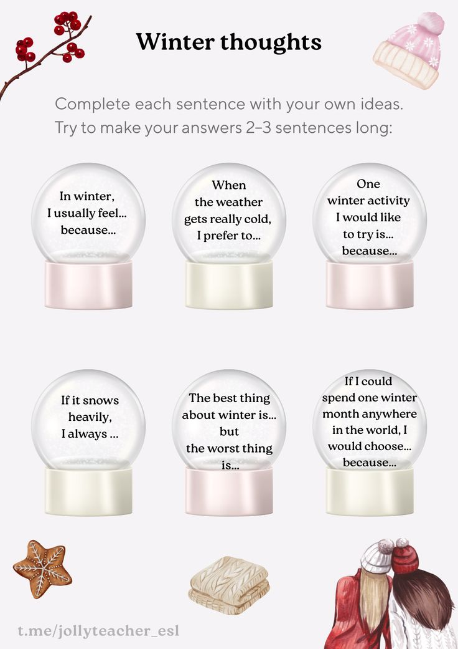

Slide 4
Winter story Part 3

Slide 5
100 verbs
64. walk - walked - walked - гулять, ходить пешком
65. win - won - won - побеждать, выигрывать
66. teach - taught - taught - преподавать, обучать
Modal verbs practice
1. Мы бы погуляли, но (это) было слишком холодно.
2. Мы победим, если сделаем всё возможное.
3. Можете научить этому своих детей.
4. На улице следует ходить пешком.
5. Им придётся выиграть этот раунд.
6. Она не обязана учить вас, ей просто это нравится.

Slide 6
BONUS: SONG
Reporter
Homework
Write the answers to Questions 18-23 in the video

