Slide 1
Lesson 30

Slide 2
You better watch out, you better not cry
You better not pout, I'm telling you why
Santa Claus is coming to town
He's making a list and checking it twice
Gonna find out who's naughty or nice
Santa Claus is coming to town
He sees you when you're sleeping
He knows when you're awake
He knows if you've been bad or good
So be good for goodness sake
You better watch out, you better not cry
You better not pout, I'm telling you why
Santa Claus is coming to town
Santa Claus Is Coming to Town
He sees you when you're sleeping
He knows when you're awake
He knows if you've been bad or good
So be good for goodness sake
Oh, you better watch out, you better not cry
Better not pout, I'm telling you why
Santa Claus is coming to town

Slide 3

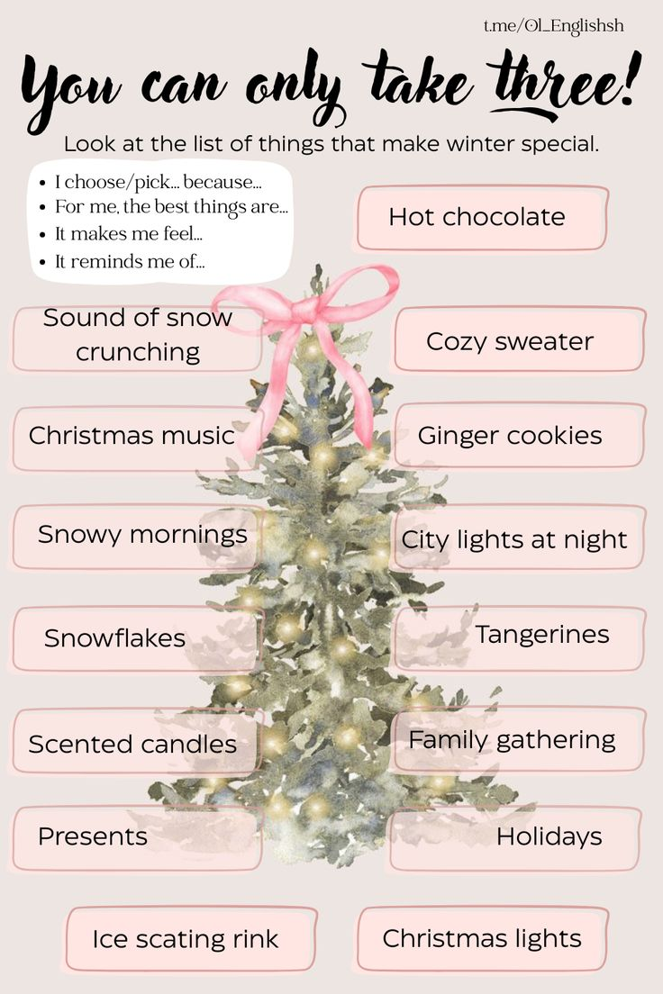

Slide 4
Winter story Part 2

Slide 5
100 verbs
61. spend - spent - spent - тратить, проводить
62. grow - grew - grown - расти, выращивать
63. open - opened - opened - открывать
Modal verbs practice
1. Ты должен потратить на это свои деньги?
2. Дерево может вырасти очень большим.
3. Вам нельзя открывать эти подарки до Рождества.
4. Девочки могли провести на ярмарке много времени.
5. Я бы предпочла расти в уютном доме.
6. Им следует открыть эту книгу прямо сейчас?

Slide 6
BONUS: SONG
Reporter
Homework
Write the answers to Questions 9-17 in the video

