Slide 1
Lesson 29

Slide 2
You better watch out, you better not cry
You better not pout, I'm telling you why
Santa Claus is coming to town
He's making a list and checking it twice
Gonna find out who's naughty or nice
Santa Claus is coming to town
He sees you when you're sleeping
He knows when you're awake
He knows if you've been bad or good
So be good for goodness sake
You better watch out, you better not cry
You better not pout, I'm telling you why
Santa Claus is coming to town
Santa Claus Is Coming to Town
He sees you when you're sleeping
He knows when you're awake
He knows if you've been bad or good
So be good for goodness sake
Oh, you better watch out, you better not cry
Better not pout, I'm telling you why
Santa Claus is coming to town

Slide 3

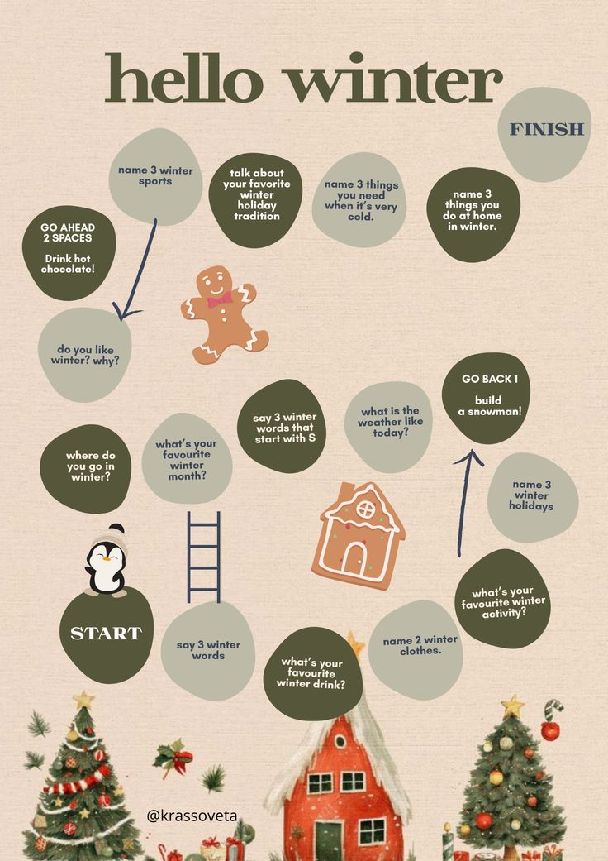


Slide 4
Winter story Part 1

Slide 5
100 verbs
49. create - created - created - творить
50. speak - spoke - spoken - говорить
51. read - read - read - читать
Modal verbs practice
1. Ты можешь сделать (сотворить) красивую рождественскую открытку?
2. Вы должны говорить громко и чётко (loudly and clearly).
3. Мы бы прочитали эту книгу, но её не было в продаже (on sale).
4. Джоан Роулинг смогла придумать огромный интересный мир.
5. Я бы предпочёл говорить с вашими родителями.
6. Можно я возьму эту книгу почитать на выходных?

Slide 6
BONUS: SONG
Reporter
Homework
Write the answers to Questions 1-8 in the video

