Slide 1
Lesson 27

Slide 2
You better watch out, you better not cry
You better not pout, I'm telling you why
Santa Claus is coming to town
He's making a list and checking it twice
Gonna find out who's naughty or nice
Santa Claus is coming to town
He sees you when you're sleeping
He knows when you're awake
He knows if you've been bad or good
So be good for goodness sake
You better watch out, you better not cry
You better not pout, I'm telling you why
Santa Claus is coming to town
Santa Claus Is Coming to Town
He sees you when you're sleeping
He knows when you're awake
He knows if you've been bad or good
So be good for goodness sake
Oh, you better watch out, you better not cry
Better not pout, I'm telling you why
Santa Claus is coming to town

Slide 3
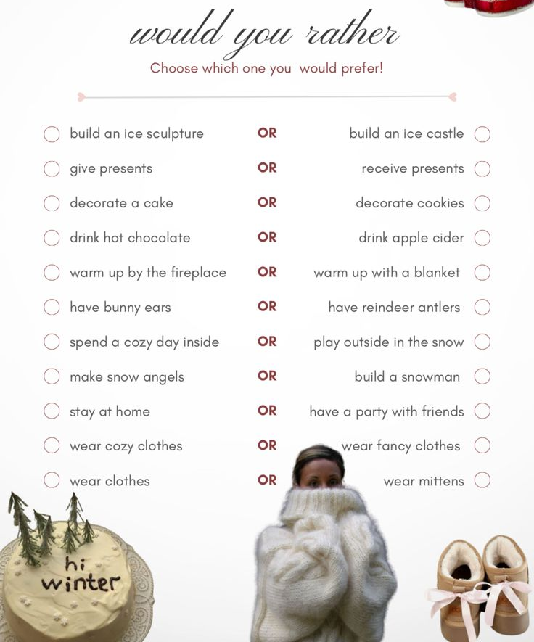
I would
rather...
than...
Lesson 27

Slide 4
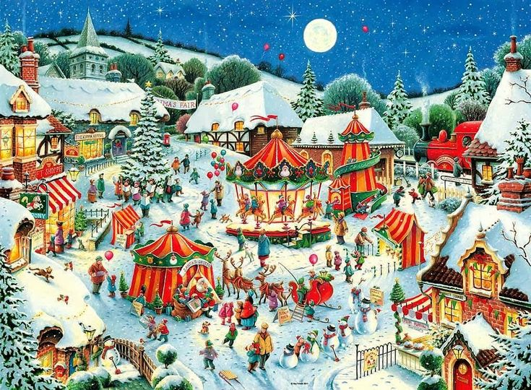
Christmas Fair - рождественская ярмарка
Christmas tree - новогодняя ёлка
a merry-go-round - карусель
a stall - палатка, ларёк с товарами
singing carols - пение рождественских песен
reindeers - олени
sledge - сани
gingerbread - имбирное печенье
cinnamon - корица
a skating rink - каток
presents - подарки
sparkling - сверкающий
handmade jewellery - бижутерия ручной работы
embroidered - вышитый
amazing - потрясающий
live music - живая музыка
delicious - восхитительный (вкусный)

Slide 5
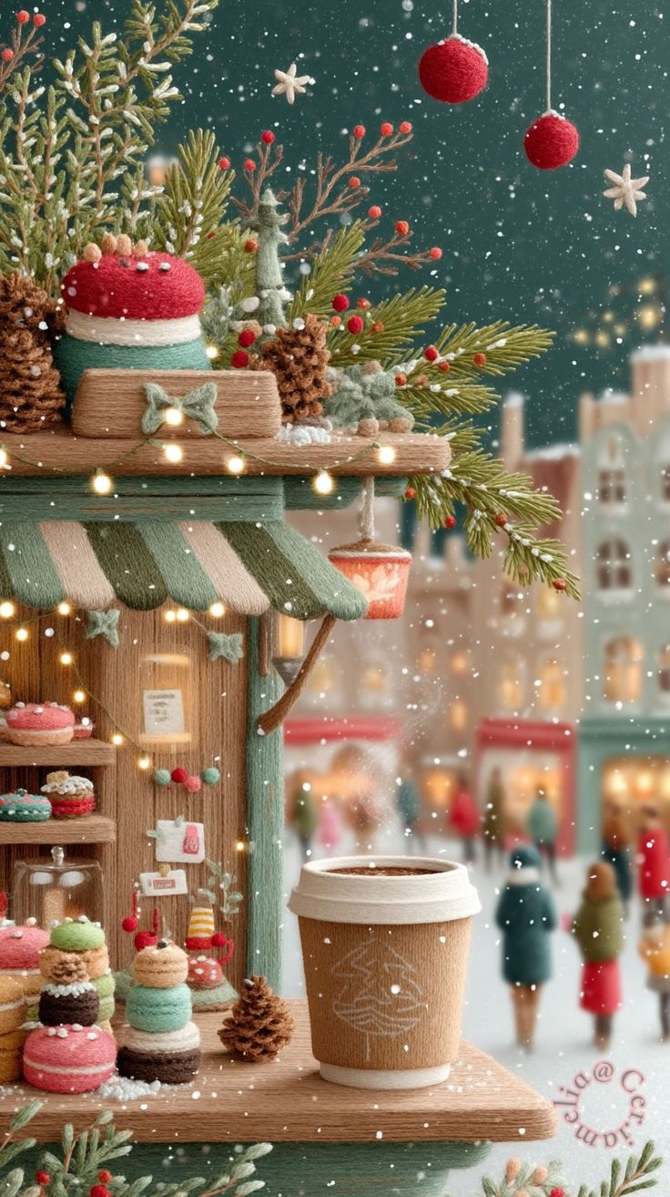
Girls at Christmas Fair
Anna: Look at that huge Christmas tree! It must be ten metres tall! Let's find the hot chocolate stall first – my hands are freezing!
Yasenia: Good idea! I can already smell something delicious... is it cinnamon? Oh, those gingerbread hearts look amazing! Should we buy some to share?
Dasha: Wait, let me take a photo of us with the tree! The lights are so sparkly. Look at this handmade jewellery stall! The snowflake earrings are pretty.
Zlata: I think these wooden toys are the best presents for little children. My mum would love this embroidered star. How much does it cost?
Milana: Can you hear that live music? It's a traditional Christmas song! I really want to try ice skating on the small rink over there.
Sofia: Do you think we can find good presents here for under 300 roubles? I'm saving my money for the big New Year party, but a small souvenir would be nice.
Vasilisa: I already know what to buy for my brother – a cool superhero mug! This is the best day of the winter holidays! Let's try everything!

Slide 6
100 verbs
43. change - changed - changed - (из)менять
44. lead - led - led - вести
45. understand - understood - understood - понимать
Modal verbs practice
1. Тебе следует сменить стиль!
2. Не могли бы вы вести нас?
3. Мы понимали вас раньше.
4. Давайте переоденемся (сменим одежду).
5. Ему придётся нас вести.
6. Ты можешь понять это правило?

Slide 7
Copy the dialogue, translate it and learn your part by heart
BONUS: SONG
Reporter
Homework

