Slide 1
Lesson 26

Slide 2
You better watch out, you better not cry
You better not pout, I'm telling you why
Santa Claus is coming to town
He's making a list and checking it twice
Gonna find out who's naughty or nice
Santa Claus is coming to town
He sees you when you're sleeping
He knows when you're awake
He knows if you've been bad or good
So be good for goodness sake
You better watch out, you better not cry
You better not pout, I'm telling you why
Santa Claus is coming to town
Santa Claus Is Coming to Town
He sees you when you're sleeping
He knows when you're awake
He knows if you've been bad or good
So be good for goodness sake
Oh, you better watch out, you better not cry
Better not pout, I'm telling you why
Santa Claus is coming to town

Slide 3
Make combinations with our verbs
Some (какой-то)
body (тело)
Any (любой)
one (один/кто-то)
place (место)
No (никакой)
thing (вещь)
time (время/раз)
Every (каждый)
where (где-то)

Slide 4
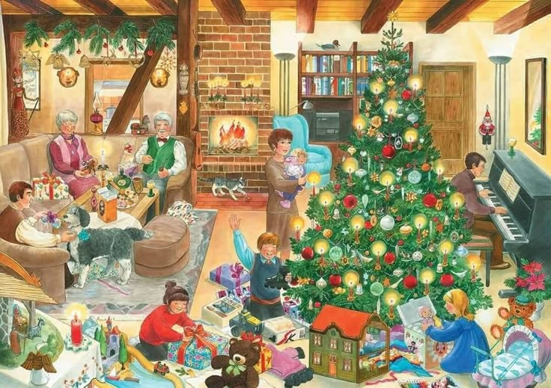
I see
somebody ... (where)
something... (where)
in в
on на
under под
behind позади
next to рядом с
between между

Slide 5
100 verbs
43. continue - continued - continued - продолжать
44. set - set - set - устанавливать
45. learn - learned/learnt - learned/learnt - учить
Modal verbs practice
1. Можно я выйду из комнаты?
2. Нельзя ставить эту вазу на полку, она может упасть.
3. Нам следует выучить модальные глаголы побыстрее.
4. Вы продолжите учить английский в следующем месяце?
5. Мой брат, возможно, установил эту игру на мой телефон.
6. Я не обязана учить это глупое (stupid) правило.

Slide 6
5-10 sentences with combinations from Slide 3
BONUS: SONG
Reporter
Homework

