Slide 1



Lesson 24
Test

Slide 2
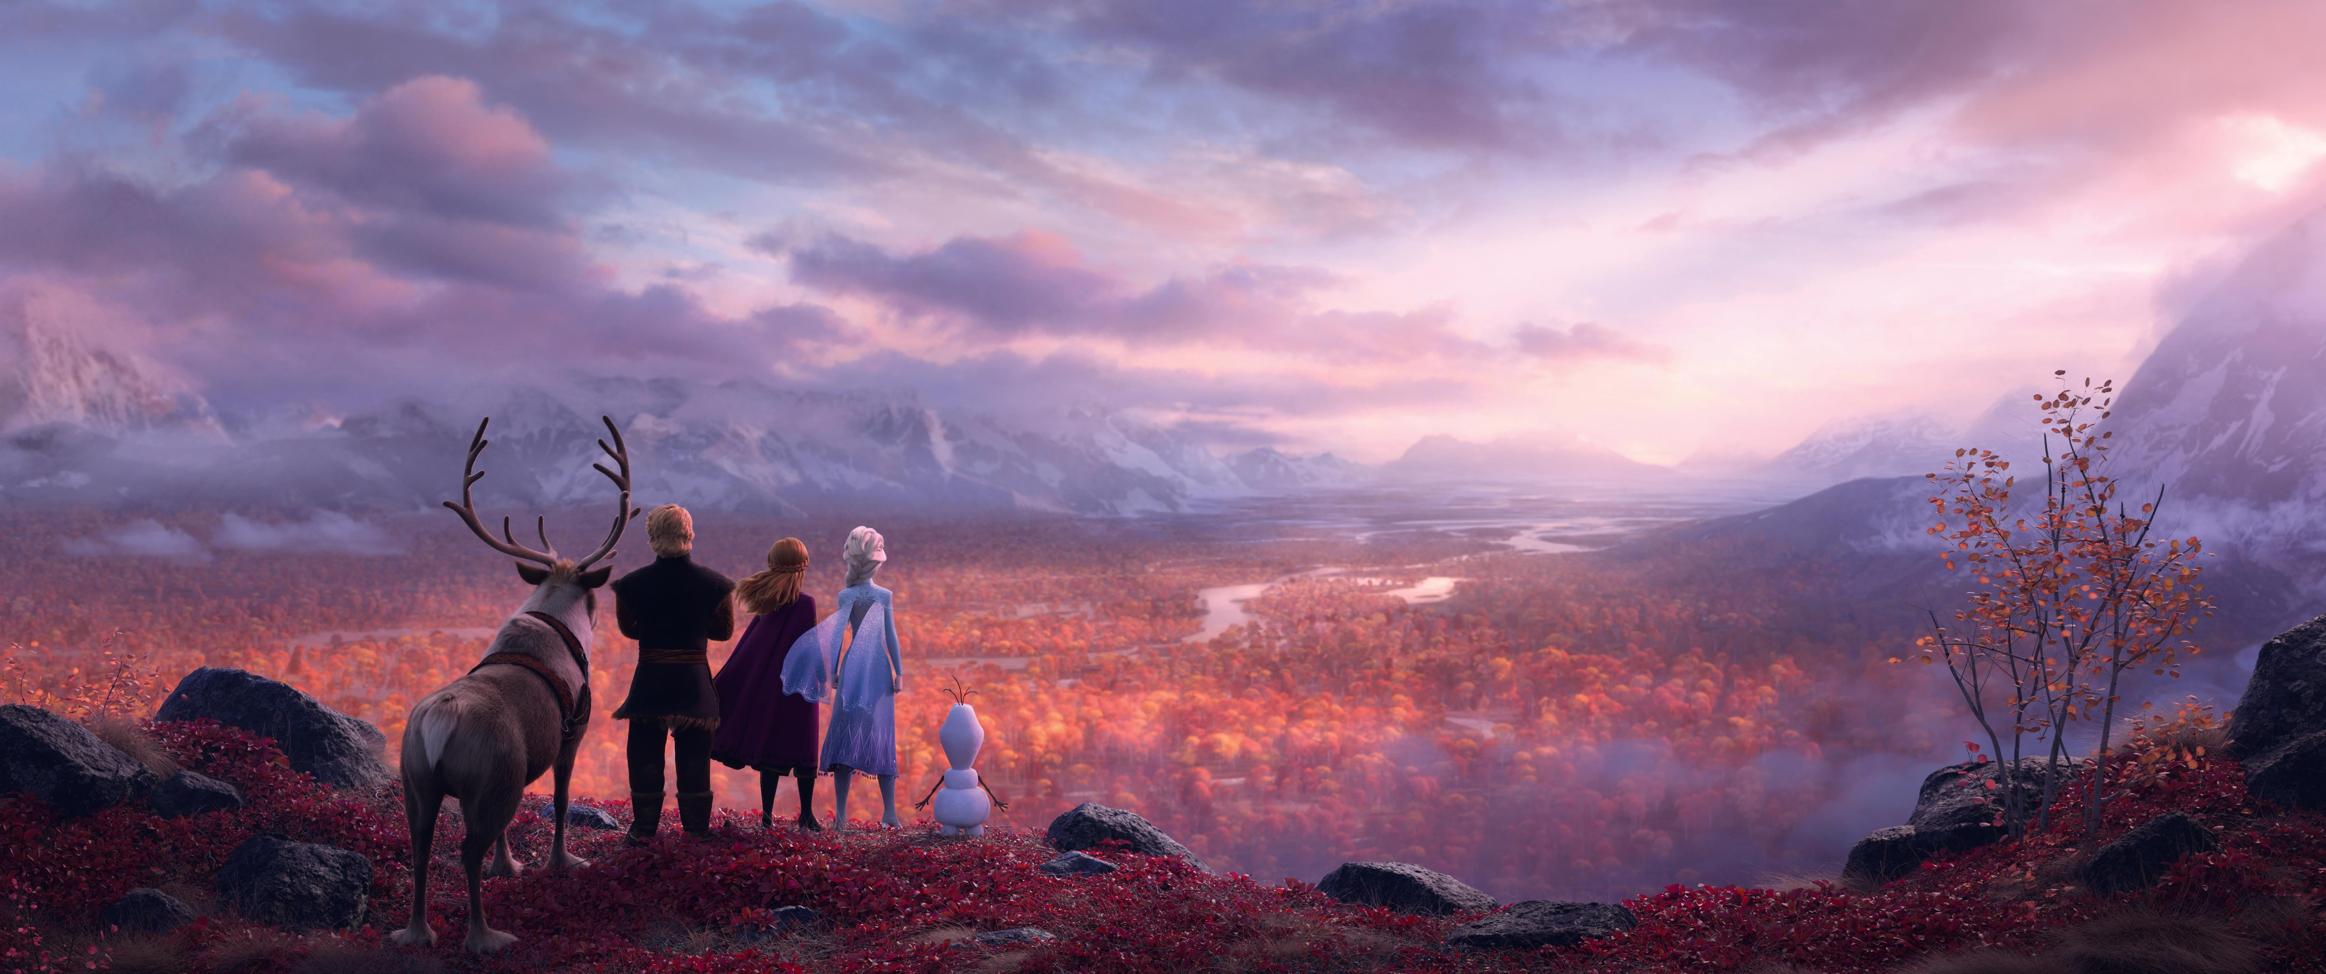
All Is Found
1. Where the north wind meets the sea
There's a river full of memory
Sleep, my darling, safe and sound
For in this river, all is found
3.Yes, she will sing to those who'll hear
And in her song, all magic flows
But can you brave what you most fear?
Can you face what the river knows?
2. In her waters, deep and true
Lie the answers and a path for you
Dive down deep into her sound
But not too far or you'll be drowned
4. Where the north wind meets the sea
There's a mother full of memory
Come, my darling, homeward bound
When all is lost, then all is found

Slide 3
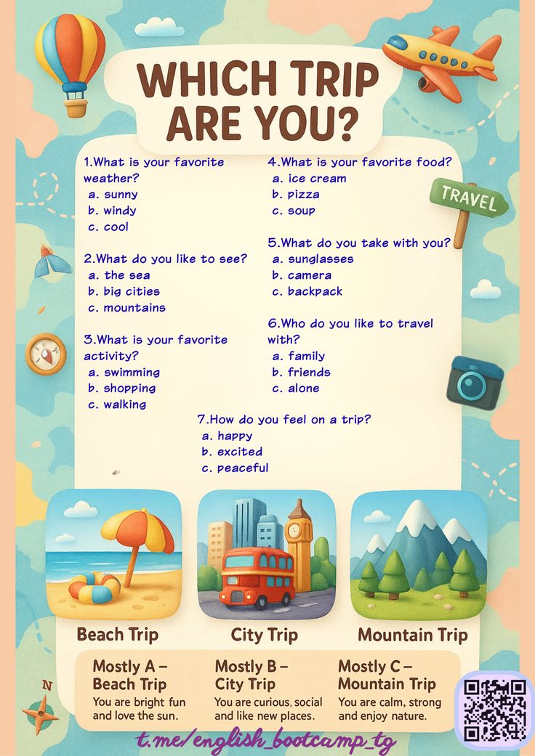
Warm-up

Slide 4
True/False
Linda
1. Linda likes practicing the piano.
2. Linda doesn’t enjoy playing the violin.
3. Linda collects stamps and coins.
4. Linda goes swimming now and again.
Mike
1. Mike lives far from the forest.
2. His favourite music is country.
3. Cooking is Mike’s hobby.
4. Mike enjoys science fiction books.

Slide 5
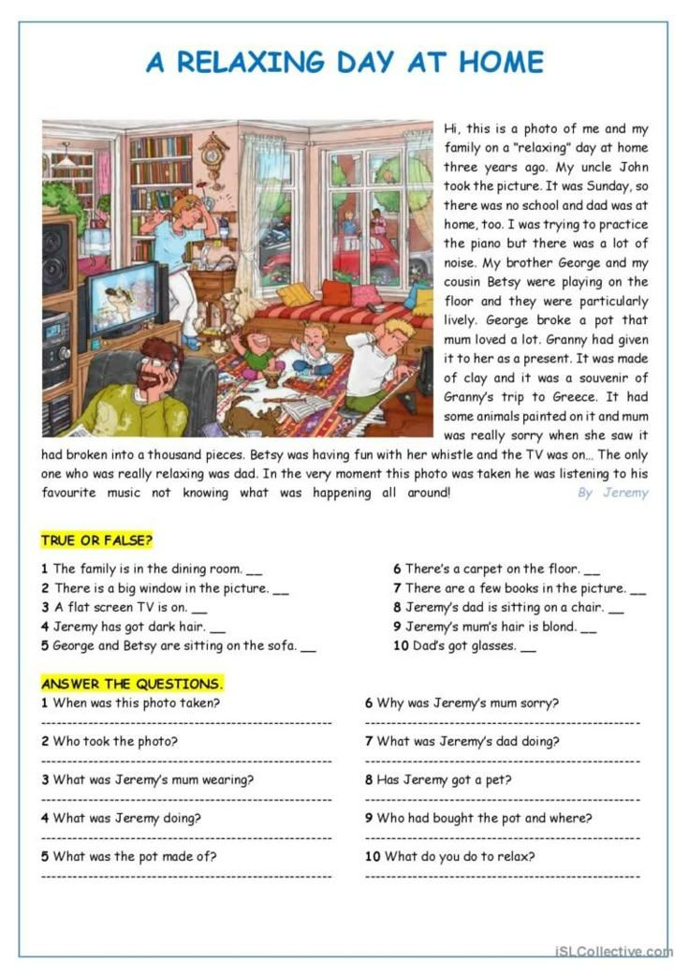
HOMEWORK
Basis: Copy, translate and learn the dialogue by heart
(10 coins)
Extra: sing the song (video) ( 5 coins)

Slide 6
HOMEWORK
Basis: Do the exercises to the text.
(Первое упражнение - только цифра+буква T/F, второе упражнение - ПОЛНЫЙ ответ на вопрос )
(5-10 coins)
Extra: sing the song (video) ( 5 coins)

