Slide 1



Lesson 23
Sweet November

Slide 2
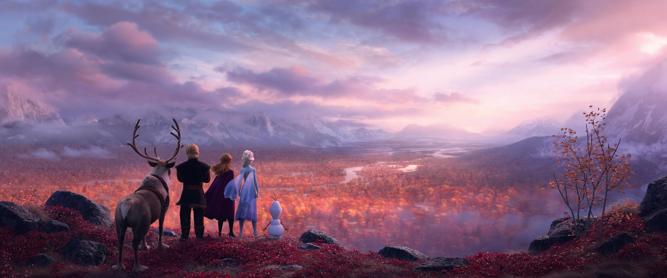
All Is Found
1. Where the north wind meets the sea
There's a river full of memory
Sleep, my darling, safe and sound
For in this river, all is found
3.Yes, she will sing to those who'll hear
And in her song, all magic flows
But can you brave what you most fear?
Can you face what the river knows?
2. In her waters, deep and true
Lie the answers and a path for you
Dive down deep into her sound
But not too far or you'll be drowned
4. Where the north wind meets the sea
There's a mother full of memory
Come, my darling, homeward bound
When all is lost, then all is found

Slide 3
Video Dialogue/Script
Miss Taylor: Hey, Emma! Morning!
E: Morning, Miss Taylor!
Miss Taylor: You look sleepy. Late night?
E: A little bit. I watched a movie.
Miss Taylor: Ooh, what movie?
E: I don’t remember the name, but it was funny.
MT: That’s a good reason.
E: I didn’t want to watch it. My parents made me.
MT: I believe you. Next time go to bed earlier, okay?
E: Deal.
MT: By the way, nice hair today.
E: Thank you! My mom made it for me.
MT: She did a great job. Now take your seat.

Slide 4

as...as...
такой... как...
так же... как и...

Slide 6

100 VERBS
37. sit - sat - sat - сидеть
38. stand - stood - stood - стоять
39. lose - lost - lost - терять, проигрывать
Тренировка 5 основных времён
База: Они теряют ключи/проигрывают.
Они всё время теряют ключи. (Present Simple)
Год назад мой папа потерял этот ключ. (Past Simple)
Вы не потеряете ключи в следующий раз. (Future Simple)
Он проигрывает этот матч, я вижу. (Present Cont.)
Жаль, но вы уже проиграли эту игру. (Present Perfect)

Slide 7
HOMEWORK
Basis: Choose 5-10 questions from Slide 5 and write answers to them.
(5-10 coins)
Extra: sing the song (video) ( 5 coins)

