Slide 1



Lesson 22
Family dialogue 2

Slide 2
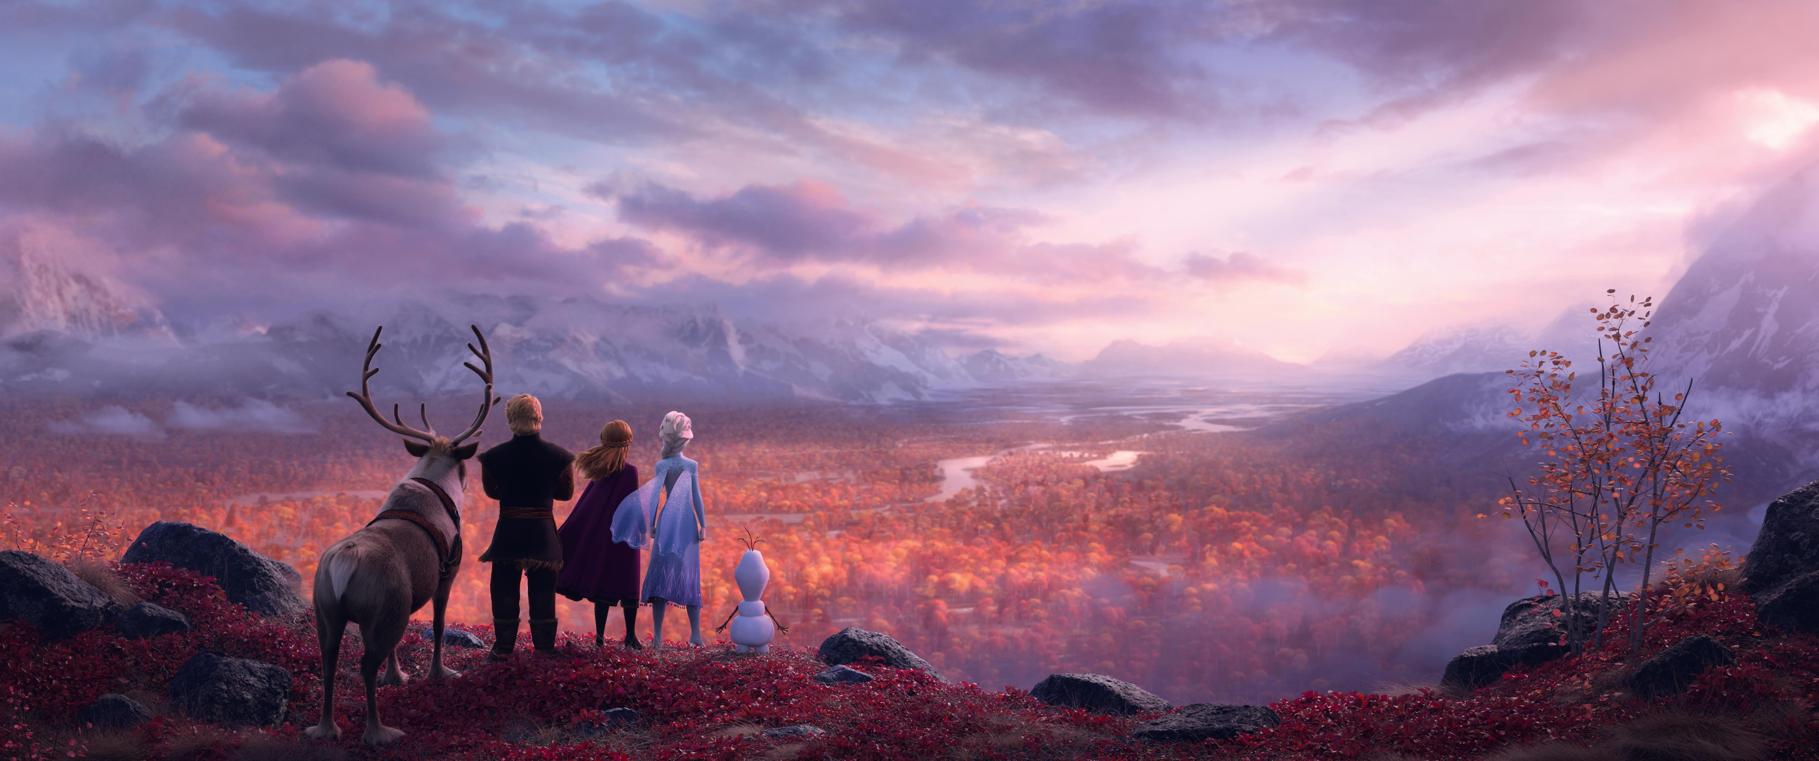
All Is Found
1. Where the north wind meets the sea
There's a river full of memory
Sleep, my darling, safe and sound
For in this river, all is found
3.Yes, she will sing to those who'll hear
And in her song, all magic flows
But can you brave what you most fear?
Can you face what the river knows?
2. In her waters, deep and true
Lie the answers and a path for you
Dive down deep into her sound
But not too far or you'll be drowned
4. Where the north wind meets the sea
There's a mother full of memory
Come, my darling, homeward bound
When all is lost, then all is found

Slide 3
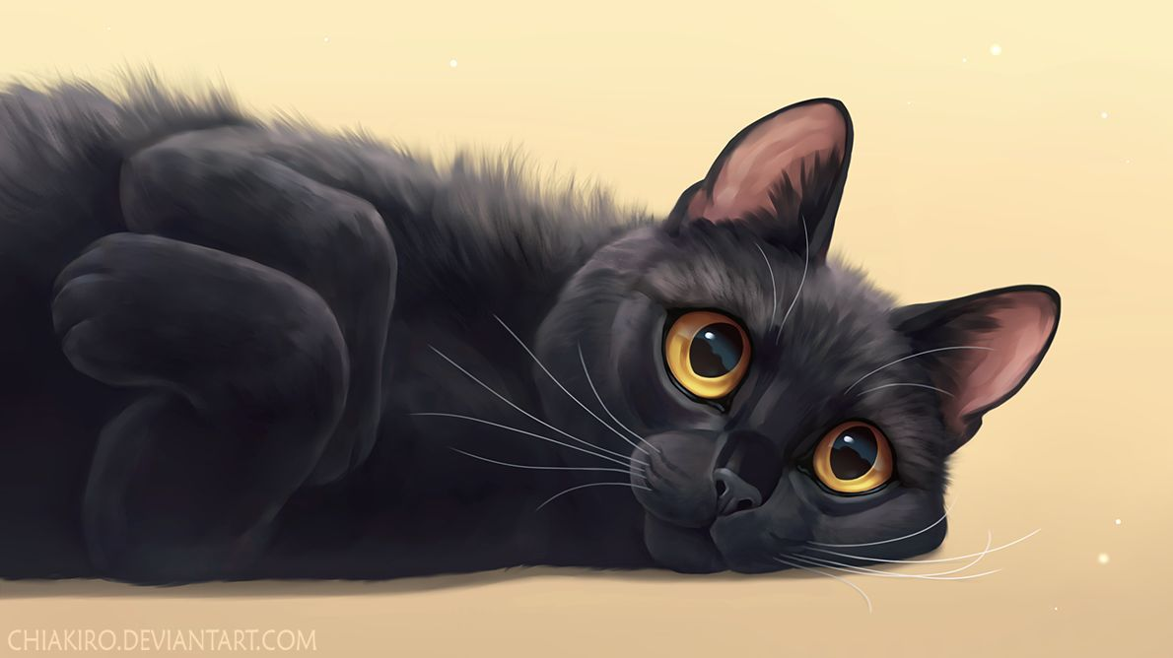
Warm-up
F: Good morning! Is Emma still asleep?
M: Yes, she is. Can you wake her up?
F: Sure! Emma, time to wake up! It’s time for school.
E: Oh, I don’t want to... Can I stay home?
F: No, Emma. Wake up.
E: Okay... I’m getting up.
F: Don’t forget to brush your teeth.
E: Okay...
M: Good morning, Emma! Sit down and eat.
E: What’s for breakfast?
M: Your favourite pancakes.
E: Pancakes? Really?
F: Time to go to school!
M: Don’t forget your backpack!
E: Okay, Mom.
M: Have a good day!

Slide 4
Video Dialogue/Script
Miss Taylor: Hey, Emma! Morning!
E: Morning, Miss Taylor!
Miss Taylor: You look sleepy. Late night?
E: A little bit. I watched a movie.
Miss Taylor: Ooh, what movie?
E: I don’t remember the name, but it was funny.
MT: That’s a good reason.
E: I didn’t want to watch it. My parents made me.
MT: I believe you. Next time go to bed earlier, okay?
E: Deal.
MT: By the way, nice hair today.
E: Thank you! My mom made it for me.
MT: She did a great job. Now take your seat.

Slide 5

100 VERBS
34. bring - brought - brought - приносить
35. happen - happened - happened - случаться, происходить
36. write - wrote - written - писать
Тренировка 5 основных времён
База: Неприятности (Troubles) случаются.
Неприятности иногда случаются. (Present Simple)
Большая неприятность произошла вчера. (Past Simple)
Неприятность случится завтра. (Future Simple)
Неприятность происходит с тобой сейчас. (Present Cont.)
Неприятность уже случилась. (Present Perfect)

Slide 6
HOMEWORK
Basis: Copy, translate and learn the dialogue by heart
(10 coins)
Extra: sing the song (video) ( 5 coins)

