Slide 1



Lesson 20
Why do cats purr?

Slide 2
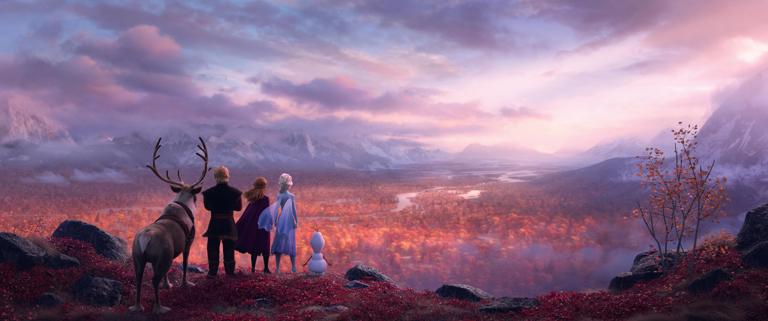
All Is Found
1. Where the north wind meets the sea
There's a river full of memory
Sleep, my darling, safe and sound
For in this river, all is found
3.Yes, she will sing to those who'll hear
And in her song, all magic flows
But can you brave what you most fear?
Can you face what the river knows?
2. In her waters, deep and true
Lie the answers and a path for you
Dive down deep into her sound
But not too far or you'll be drowned
4. Where the north wind meets the sea
There's a mother full of memory
Come, my darling, homeward bound
When all is lost, then all is found

Slide 3


Slide 5

100 VERBS
34. hear - heard - heard - слышать
35. play - played - played - играть
36. run - ran - run - бегать
Тренировка 5 основных времён
База: Ты слышишь эту музыку.
Ты часто слышишь эту музыку.
Ты слышал эту музыку в прошлый раз.
Ты услышишь эту музыку через час.
Ты слышишь эту музыку прямо сейчас.
Ты услышал эту музыку.

Slide 6
HOMEWORK
Basis: Copy the text from the video and translate it
(10 coins)
Extra: sing the 2nd verse of the song (video) ( 5 coins)

