Slide 1


Lesson 16
Trick or treat
Modal verbs
TIME：2025.10.31

Slide 2
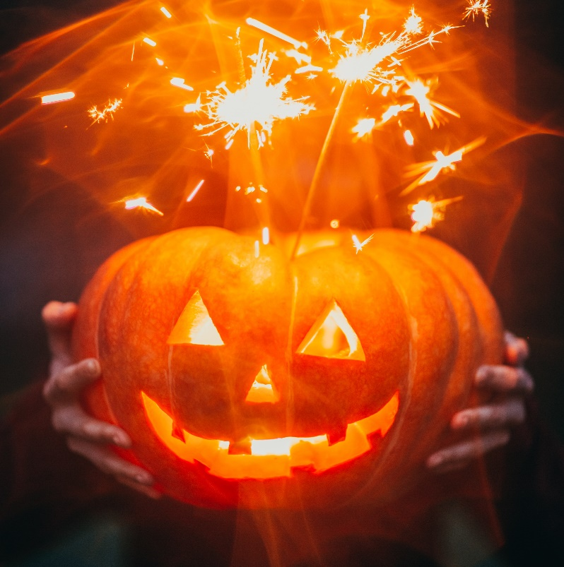
Trick or treat
1. Once a year
When the leaves are brown
October 31st rolls around
Kids come out when the sun goes down
You know they're comin'
When you hear this sound
2. Ghosts and witches, monsters too
Men from space, and bats say boo
Cowboys and fairies what a zoo
Better be ready
They're coming for you
3. Whats that creeping uuuupppp
Your drive is it a zombie ooh
I'm terrified could it be pirates
Now live nearby wait I think
I know! it's only halloween!
Trick or treat
Trick or treat
Give us something good to eat
/1.If you don't, we don't care
We'll put red ants in your hair
/ 2. If you don't hee hee hee
We'll put snails upon your feet
/ 3. If you don't, nevermind
You can sit on a porcupine
Trick or treat
Trick or treat
We love candy oh so sweet
Each and every halloween
We all say trick or treat

Slide 3
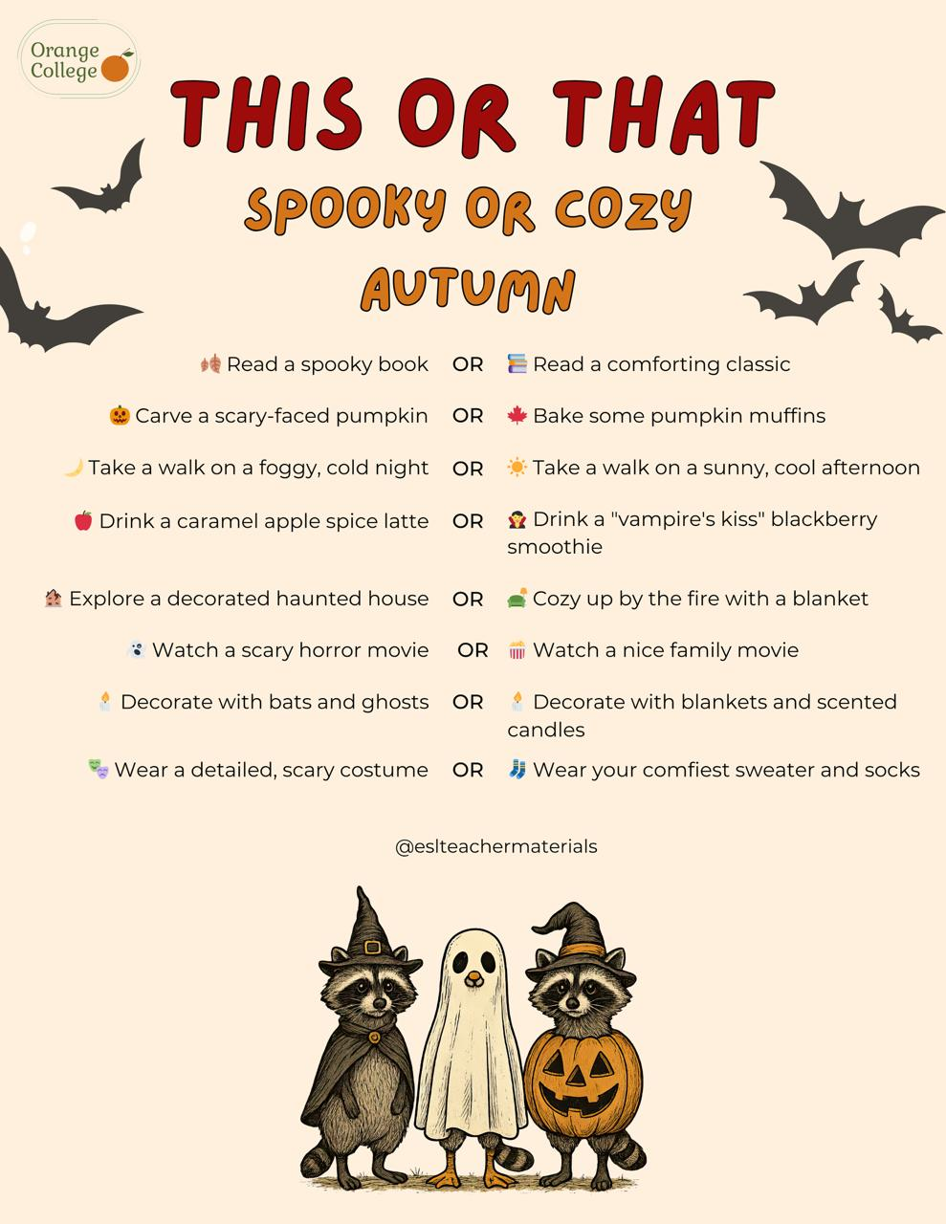
would
бы
I’d rather... than... in autumn
Я бы лучше... чем... осенью

Slide 4
Video on verbs

Slide 5
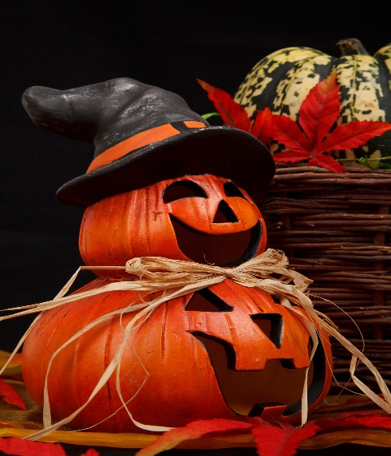
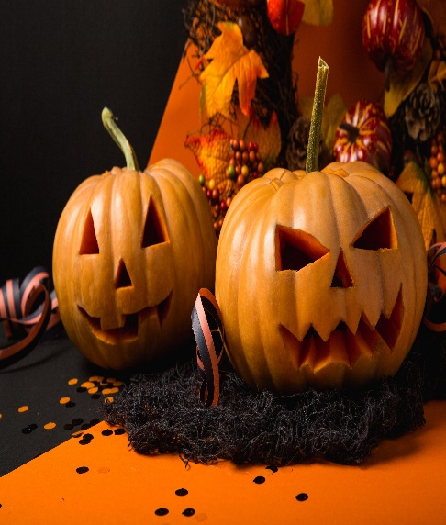
Модальные глаголы -
бывшие глаголы, ставшие отдельными специальными словами (элементами)
НИКАК не изменяются,
САМИ формируют вопросы и отрицания,
после них только СЛОВАРНАЯ форма глагола.
Shall
(I/we)
Should
1. Совет (следует/следовало бы)
You should eat more fruits.
2. Ожидание
The train should arrive at 5 p.m.
3. Мягкое побуждение, требование
We all should follow rules.
1. Предположение, намерение
I shall do my homework later.
2. Предложение
Shall we go for a walk?
отработка со словарными глаголами - кубик

Slide 6
Today’s verbs
25. leave - left - left - оставлять, покидать
26. put - put - put - класть, положить
27. mean - meant - meant - значить, означать, подразумевать, иметь ввиду
100 Verbs

Slide 7
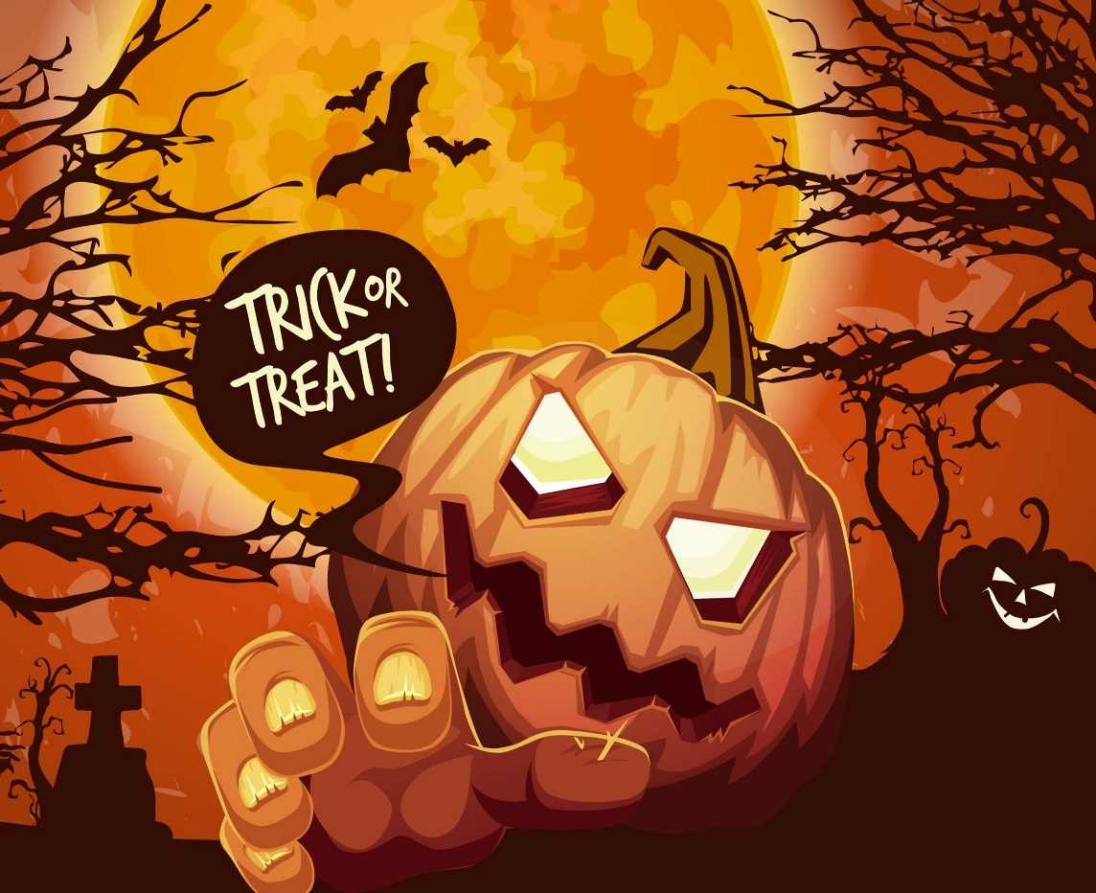

Homework
1. Copy the notes from Slide 4, give your own examples on SHALL / SHOULD
6 -10 + 2 design
* Use our verbs
be, have, do, say, go, get, take, see, come, want, use, find, make, think, know, give, tell, work, call, try, ask, need, feel, become, leave, put, mean

