Slide 1
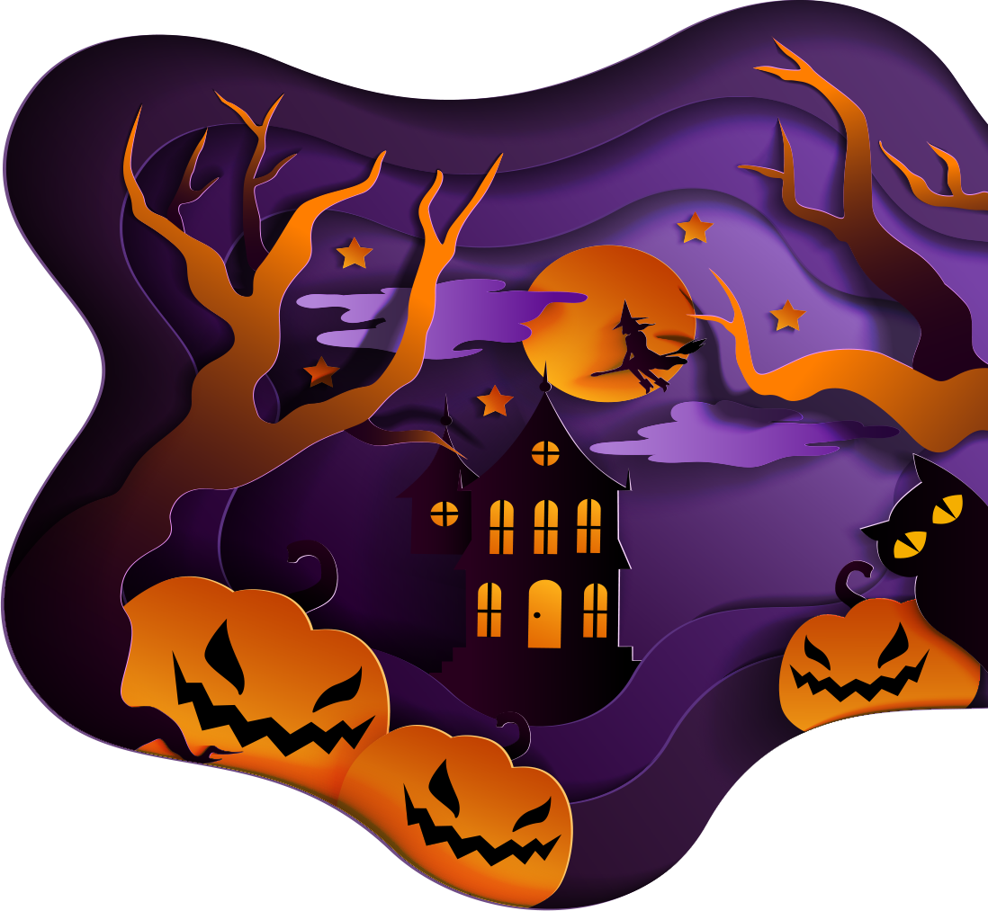

Lesson 15
Trick or treat
Modal verbs
TIME：2025.10.31

Slide 2
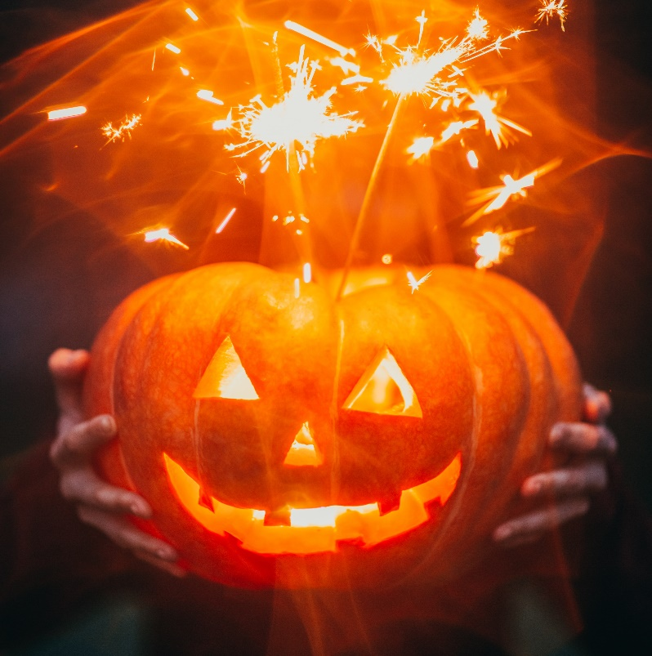
Trick or treat
1. Once a year
When the leaves are brown
October 31st rolls around
Kids come out when the sun goes down
You know they're comin'
When you hear this sound
2. Ghosts and witches, monsters too
Men from space, and bats say boo
Cowboys and fairies what a zoo
Better be ready
They're coming for you
3. Whats that creeping uuuupppp
Your drive is it a zombie ooh
I'm terrified could it be pirates
Now live nearby wait I think
I know! it's only halloween!
Trick or treat
Trick or treat
Give us something good to eat
/1.If you don't, we don't care
We'll put red ants in your hair
/ 2. If you don't hee hee hee
We'll put snails upon your feet
/ 3. If you don't, nevermind
You can sit on a porcupine
Trick or treat
Trick or treat
We love candy oh so sweet
Each and every halloween
We all say trick or treat

Slide 3
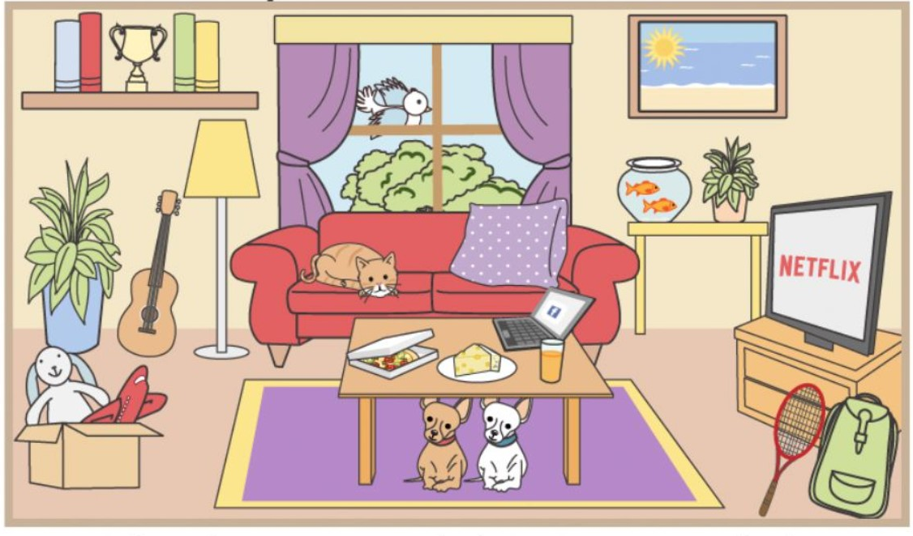
Where is / are the...?
video
I’m not sure...It / they might be...
in on under
in front of
behind
next to
between
near
over
above

Slide 4
Video on verbs

Slide 5
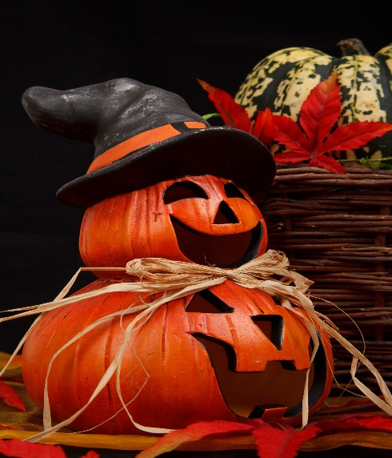
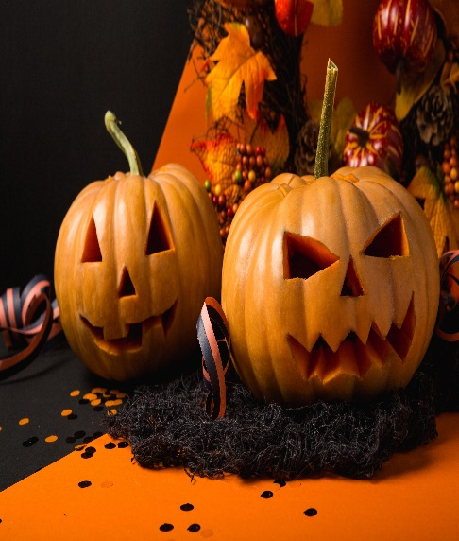
Модальные глаголы -
бывшие глаголы, ставшие отдельными специальными словами (элементами)
НИКАК не изменяются,
САМИ формируют вопросы и отрицания,
после них только СЛОВАРНАЯ форма глагола.
Will
Would
1. Будущее, определённость
The dog will bite if you approach.
2. Приглашение, просьба
Will you come with me?
3. Желание, обещание
I will do my best in exam.
1. Вежливое предложение
Would you like a cup of tea?
2. Условность (бы)
I would travel the world.
3. Привычка в прошлом
My mother would make pancakes on weekends.
отработка со словарными глаголами - кубик

Slide 6
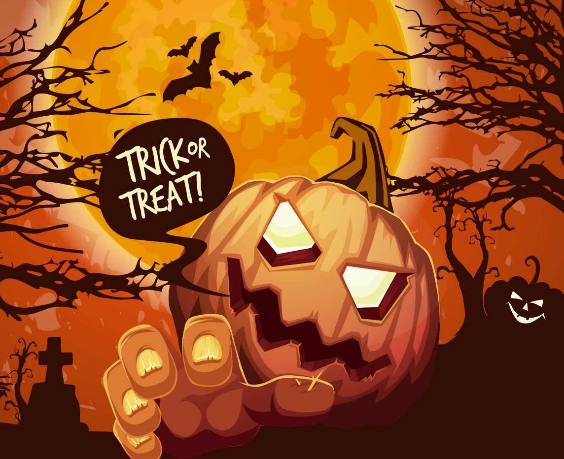

Homework
1. Copy the notes from Slide 4, give your own examples on MAY / MIGHT
6 -10 + 2 design
* Use our verbs
be, have, do, say, go, get, take, see, come, want, use, find, make, think, know, give, tell, work, call, try, ask, need, feel, become

