Slide 1


Lesson 14
Trick or treat
Modal verbs
TIME：2025.10.31

Slide 2
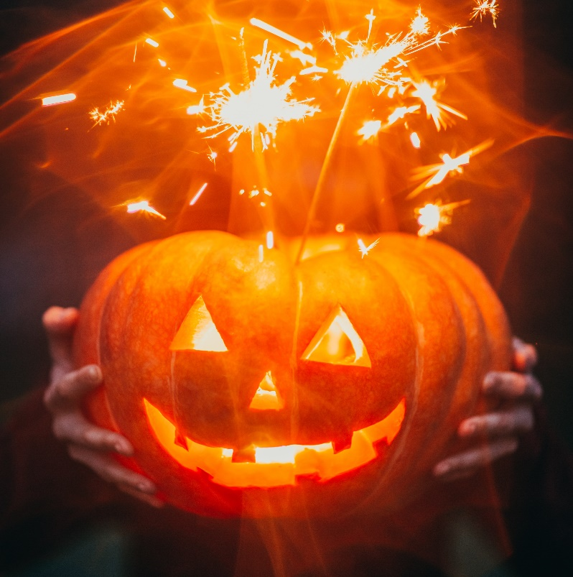
Trick or treat
1. Once a year
When the leaves are brown
October 31st rolls around
Kids come out when the sun goes down
You know they're comin'
When you hear this sound
2. Ghosts and witches, monsters too
Men from space, and bats say boo
Cowboys and fairies what a zoo
Better be ready
They're coming for you
3. Whats that creeping uuuupppp
Your drive is it a zombie ooh
I'm terrified could it be pirates
Now live nearby wait I think
I know! it's only halloween!
Trick or treat
Trick or treat
Give us something good to eat
/1.If you don't, we don't care
We'll put red ants in your hair
/ 2. If you don't hee hee hee
We'll put snails upon your feet
/ 3. If you don't, nevermind
You can sit on a porcupine
Trick or treat
Trick or treat
We love candy oh so sweet
Each and every halloween
We all say trick or treat

Slide 3
Warm-up: Could you... please? - With pleasure (С удовольствием)
I’m afraid I can’t (Боюсь, не смогу)
(be, have, do, say, go, get, take, see, come, want, use, find, make, think, know, give, tell, work)
Video on tenses

Slide 4
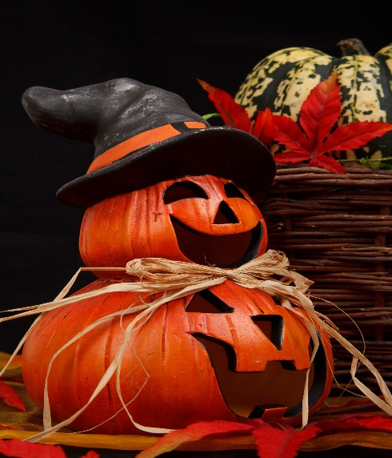
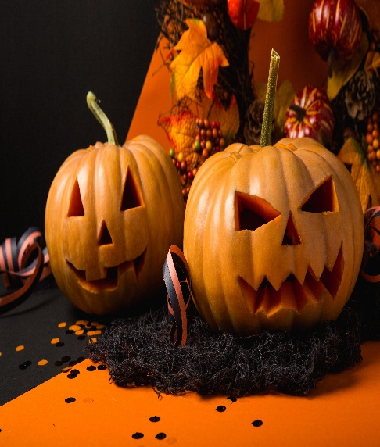
Модальные глаголы -
бывшие глаголы, ставшие отдельными специальными словами (элементами)
НИКАК не изменяются,
САМИ формируют вопросы и отрицания,
после них только СЛОВАРНАЯ форма глагола.
May
Might
1. Возможность, вероятность (возможно, может)
The dog may bite.
2. Разрешение (можно?)
May I open the window?
1. Слабая вероятность (под сомнением) - возможно, может
I’m not sure, she might be at home.
2. Неувернная просьба (Позволите ли?.. А можно?..)
Might I trouble you for a glass of water?
отработка со словарными глаголами - кубик

Slide 5
Today’s verbs
19. call - called - called -звать, звонить, называть(ся)
20. try - tried - tried - пытаться, стараться, пробовать
21. ask- asked - asked - работать
100 Verbs

Slide 6
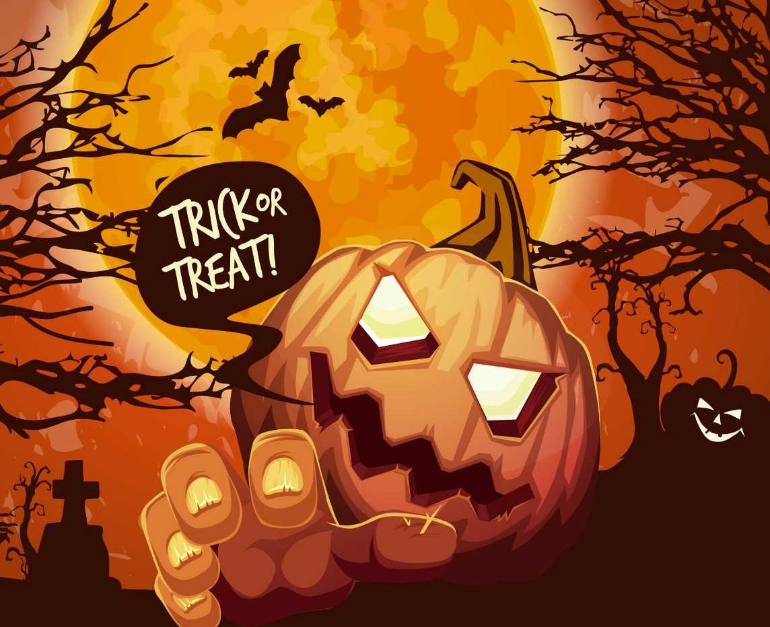

Homework
1. Copy the notes from Slide 4, give your own examples on MAY / MIGHT
4 -10 + 2 design
* Use our verbs
be, have, do, say, go, get, take, see, come, want, use, find, make, think, know, give, tell, work, call, try, ask

Slide 7

1. Did Harry believe that he was a wizard?
2.Did the Dursleys know that Harry was a wizard?
3. What did Aunt Petunia think about her sister?

