Slide 1


Lesson 13
Trick or treat
Modal verbs
TIME：2025.10.31

Slide 2
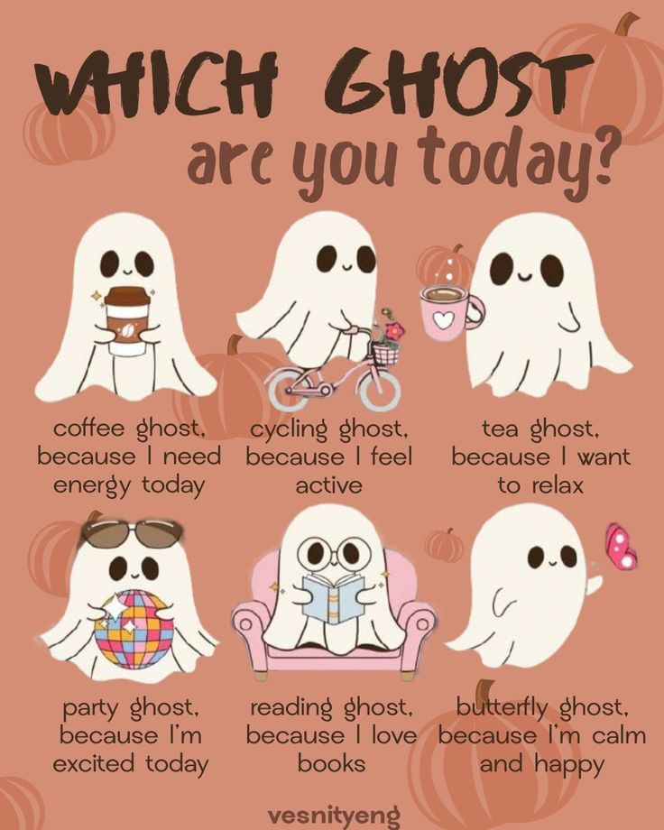

CONTENTS
01. Subtitle
02. Subtitle
03. Subtitle
04. Subtitle
Trick or treat

Slide 3
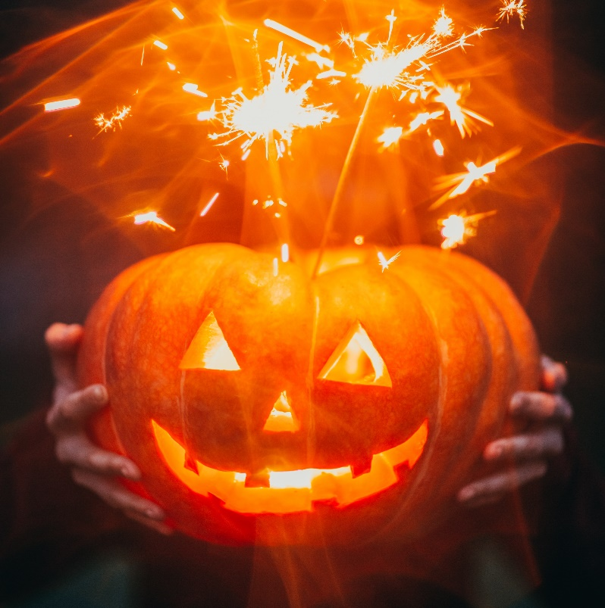
Trick or treat
1. Once a year
When the leaves are brown
October 31st rolls around
Kids come out when the sun goes down
You know they're comin'
When you hear this sound
2. Ghosts and witches, monsters too
Men from space, and bats say boo
Cowboys and fairies what a zoo
Better be ready
They're coming for you
3. Whats that creeping uuuupppp
Your drive is it a zombie ooh
I'm terrified could it be pirates
Now live nearby wait I think
I know! it's only halloween!
Trick or treat
Trick or treat
Give us something good to eat
/1.If you don't, we don't care
We'll put red ants in your hair
/ 2. If you don't hee hee hee
We'll put snails upon your feet
/ 3. If you don't, nevermind
You can sit on a porcupine
Trick or treat
Trick or treat
We love candy oh so sweet
Each and every halloween
We all say trick or treat

Slide 4
Video on tenses

Slide 5
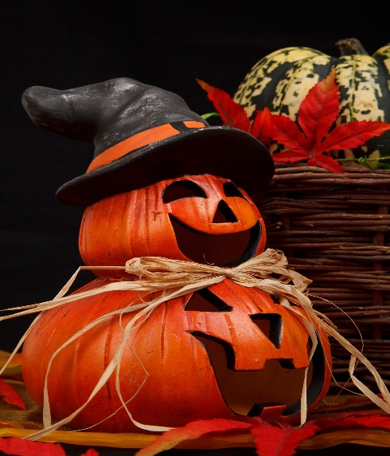
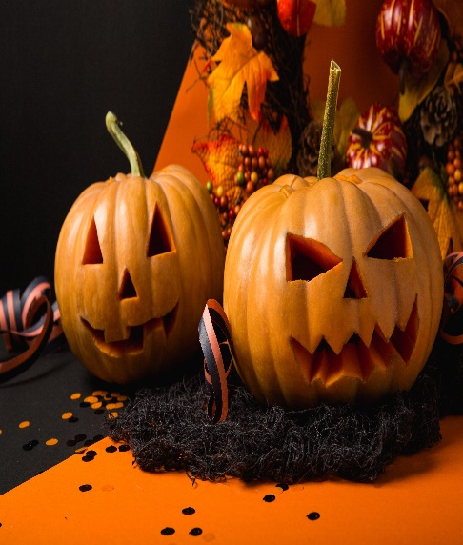
Модальные глаголы -
бывшие глаголы, ставшие отдельными специальными словами (элементами)
НИКАК не изменяются,
САМИ формируют вопросы и отрицания,
после них только СЛОВАРНАЯ форма глагола.
Can
Could
1. Физическая способность (могу, умею)
I can bake yummy apple pies.
2. Разрешение (можно?)
Can I open the window?
3. Возможное событие (наверное, скорее всего).
It can rain today.
1. Физическая способность в прошлом (мог, умел)
He could sing well.
2. Вежливая просьба (Не могли бы вы...?)
Could you give us a hand with this?
3. Совет (вам бы...)
You could rest.
4. (+ have + V3) - сожаление о несбывшемся (мог бы...)
This could have helped.
отработка со словарными глаголами - кубик

Slide 6
Today’s verbs
16. give - gave - given -давать, дарить
17. tell - told - told - рассказывать
18. work- worked - worked - работать
100 Verbs

Slide 7
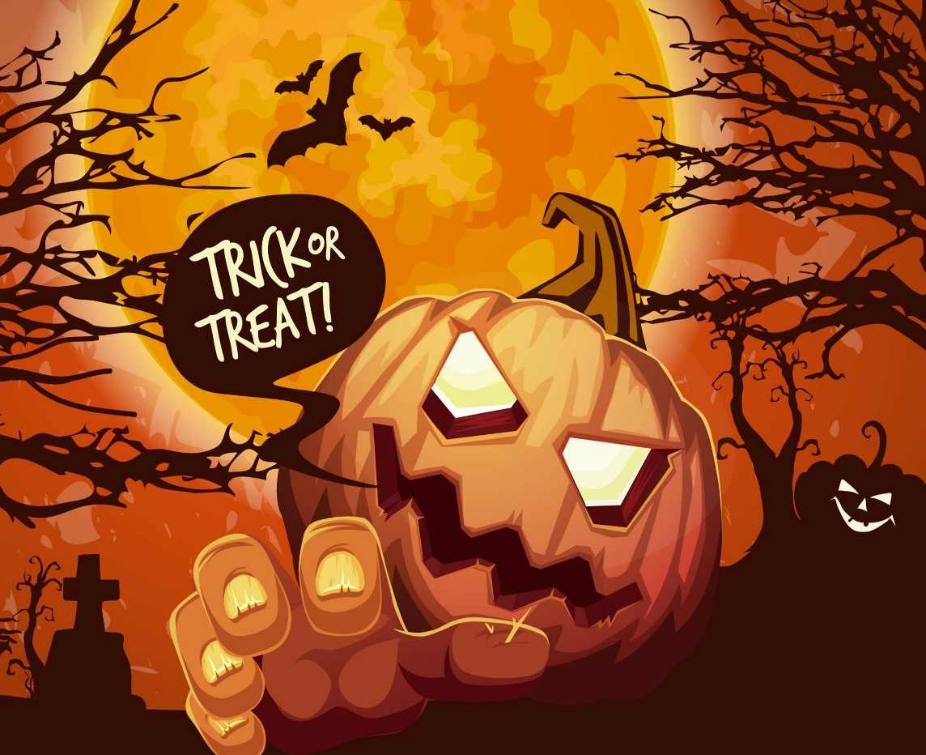
Homework
1. Copy the notes from Slide 4, give your own examples on CAN / COULD
7-10 + 2 design
* Use our verbs
be, have, do, say, go, get, take, see, come, want, use, find, make, think, know, give, tell, work

Slide 8

1. Did Harry believe that he was a wizard?
2.Did the Dursleys know that Harry was a wizard?
3. What did Aunt Petunia think about her sister?

