Slide 1


A piece song
RU
Мир тебе в набегающей волне,
Мир тебе в дуновении ветров,
Мир тебе в ярком росчерке звезды,
В теплом сне и дыхании земли.
Deep peace of the running wave to you,
Deep peace of the flowing air to you,
Deep peace of the shining stars to you,
Deep peace of the quiet earth to you.
EN

Slide 2











Middle School
English
Tenses
Revision
LESSON 12

Slide 3
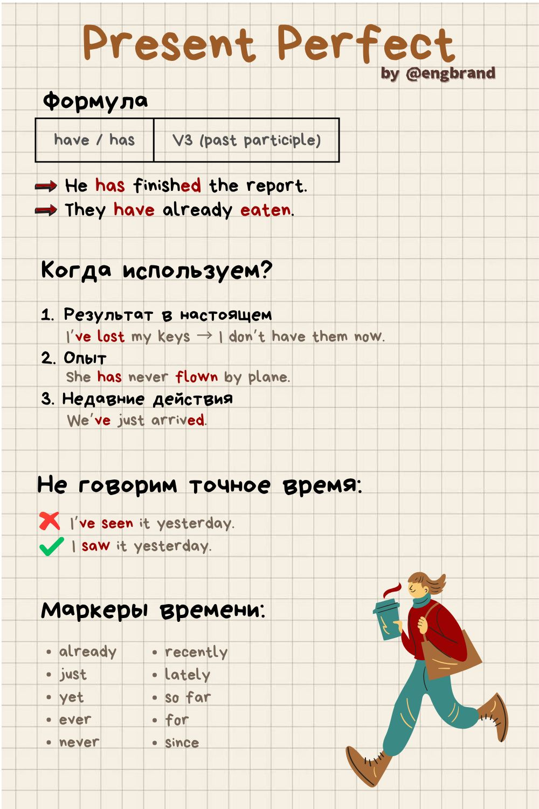
Copy to your Grammar book!
I’ve made it! - Я это Сделал! (имею Сделанным это)
I’ve had enough (of it) - С меня хватит! (Я ПОимел достаточно)
It’s been a while. - Давно это было.../ не виделись.
He has been to Australia. - Он ПОбывал в Австралии.
What’s happened? - Что Случилось?

Slide 4
Test
Раскройте скобки, употребляя глаголы в Present Perfect
6. I (to eat) my breakfast.
a) eated
b) have eaten
c) ate
7. John (to do) this exercise.
a) has done
b) done
c) did
8. They (to leave) Astana.
a) have left
b) leaved
c) left
9. We (to buy) a car.
a) have bought
b) bought
c) has bought
10. You (not to find) the book.
a) You have not found the book
b) You has not found the book
c) You did not find the book
Выберите предложение, в котором сказуемое выражено глаголом в Present Perfect.
1. a) Tom watched TV yesterday.
b) We have a dog.
c) The have already been abroad.
2. a) My granny did not buy a table.
b) His sister has not read a book.
c) She is not a student.
3. a) Kate has given me three books already.
b) He has a big house.
c) I lost my ball yesterday.
4. a) They were planting trees
b) We were at work yesterday
c) I have visited this museum already.
5. a) Has your brother been to Paris?
b) Did you clean the window yesterday?
c) Were they happy together?

Slide 5
HomeTest
Раскройте скобки, употребляя глаголы в Present Perfect
6. I (to see) this film.
a) saw
b) have seen
c) seen
7. She (to make) a cake.
a) maked
b) has made
c) made
8. They (to go) to London.
a) have gone
b) went
c) go
9. He (not to do) his homework.
a) He did not do his homework
b) He has not done his homework
c) He does not do his homework
10. We (to take) the books from the library.
a) took
b) have taken
c) taken
Выберите предложение, в котором сказуемое выражено глаголом в Present Perfect.
1. a) She made a beautiful drawing last week.
b) He has seen this film three times already.
c) They go to the park every Sunday.
2. a) I want to learn Spanish next year.
b) We have known each other since childhood.
c) She took my pen yesterday.
3. a) He is getting ready for school now.
b) They have already done their homework.
c) I use a computer for my projects.
4. a) She came home early yesterday.
b) We have thought about this problem a lot.
c) He says interesting things in class.
5. a) Have you found your keys yet?
b) Did you get my message yesterday?
c) Do you come here often?

Slide 6
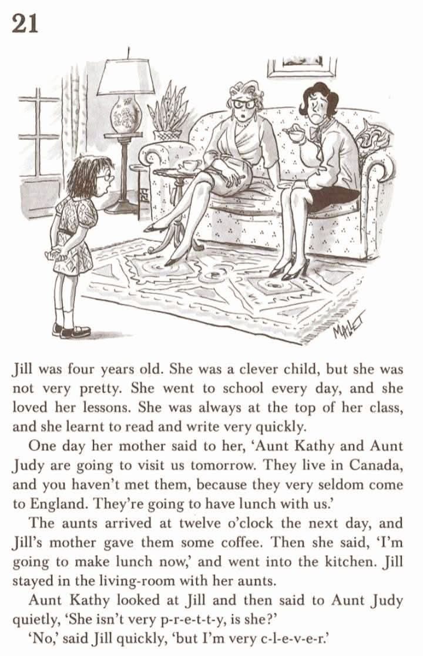
Reading test
Выберите, выпишите и переведите предложение, в котором сказуемое выражено глаголом в Present Perfect.
Найдите в тексте выражение «Быть лучшим в чём-либо» и составьте своё предложение с ним.

Slide 7






Homework
Make a Hometest on slide 5-6. Every correct answer - 1
Copy the rule on slide 3 into your Grammar book
+ Beautiful design - 2
Bonus - EPOCH SONG (video) - 3

