Slide 1


A piece song
RU
Мир тебе в набегающей волне,
Мир тебе в дуновении ветров,
Мир тебе в ярком росчерке звезды,
В теплом сне и дыхании земли.
Deep peace of the running wave to you,
Deep peace of the flowing air to you,
Deep peace of the shining stars to you,
Deep peace of the quiet earth to you.
EN

Slide 2











Middle School
English
Tenses
Revision
LESSON 12

Slide 3
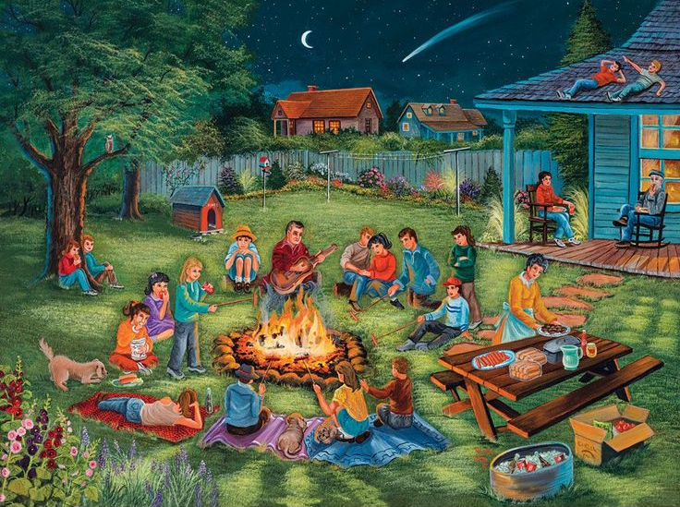
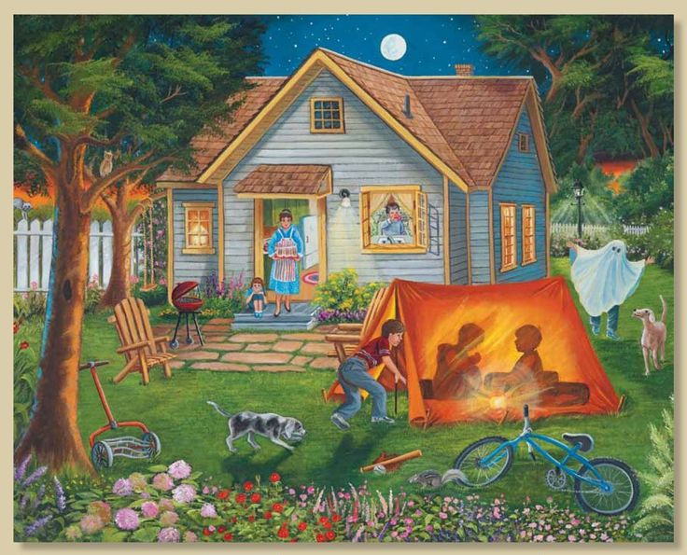
Autumn evenings
Autumn is here! In the USA, we say “The Fall” and that is because the leaves are falling from the trees! The autumn months are September, October and November. In the UK, celebrations during autumn include Halloween on October 31’st and Bonfire Night (Guy Fawkes Night) on November, 5th. There are also Harvest Festival celebrations and many villages have scarecrow competitions.

Slide 4
Main tenses in English (video)

Slide 5
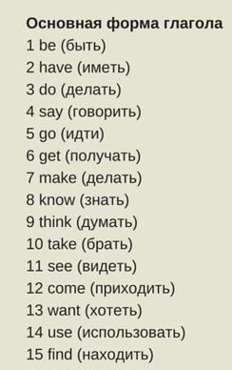
1. Hermione will be at the library tomorrow.
2. Zlata had a great time at the autumn picnic.
3. You have done all the tasks in Charms correctly.
4. He is seeing Professor Dumbledor after class.
5. My sister comes to art classes with me.
6. Alex has made great progress in English.
7. We will want to see our test results.
8. Milana took nice photos of autumn leaves.
9. She is using her phone to record the lesson.
10. I have known my best friend since kindergarten.
11. Harry is getting ready to go to Hogwarts.
12. We went to the autumn fair last weekend.
13. Sophie thought about her future profession.
14. I will find information about autumn traditions.
15. Teachers often say that practice is important.
Прочитать, перевести, определить время, сделать отрицанием и вопросом

Slide 6
Today’s verbs
V1
V2
V3
16. give gave given давать
17. tell told told рассказывать
18. work worked worked работать
100 Verbs

Slide 7






Homework
Make 5-10 sentences with the verbs from slide 5. Use all the main tenses (Present Simple, Past Simple, Future Simple, Present Continuous,Present Perfect) +5-10
+ Beautiful design - 2
Bonus - EPOCH SONG (video) - 3

Slide 8
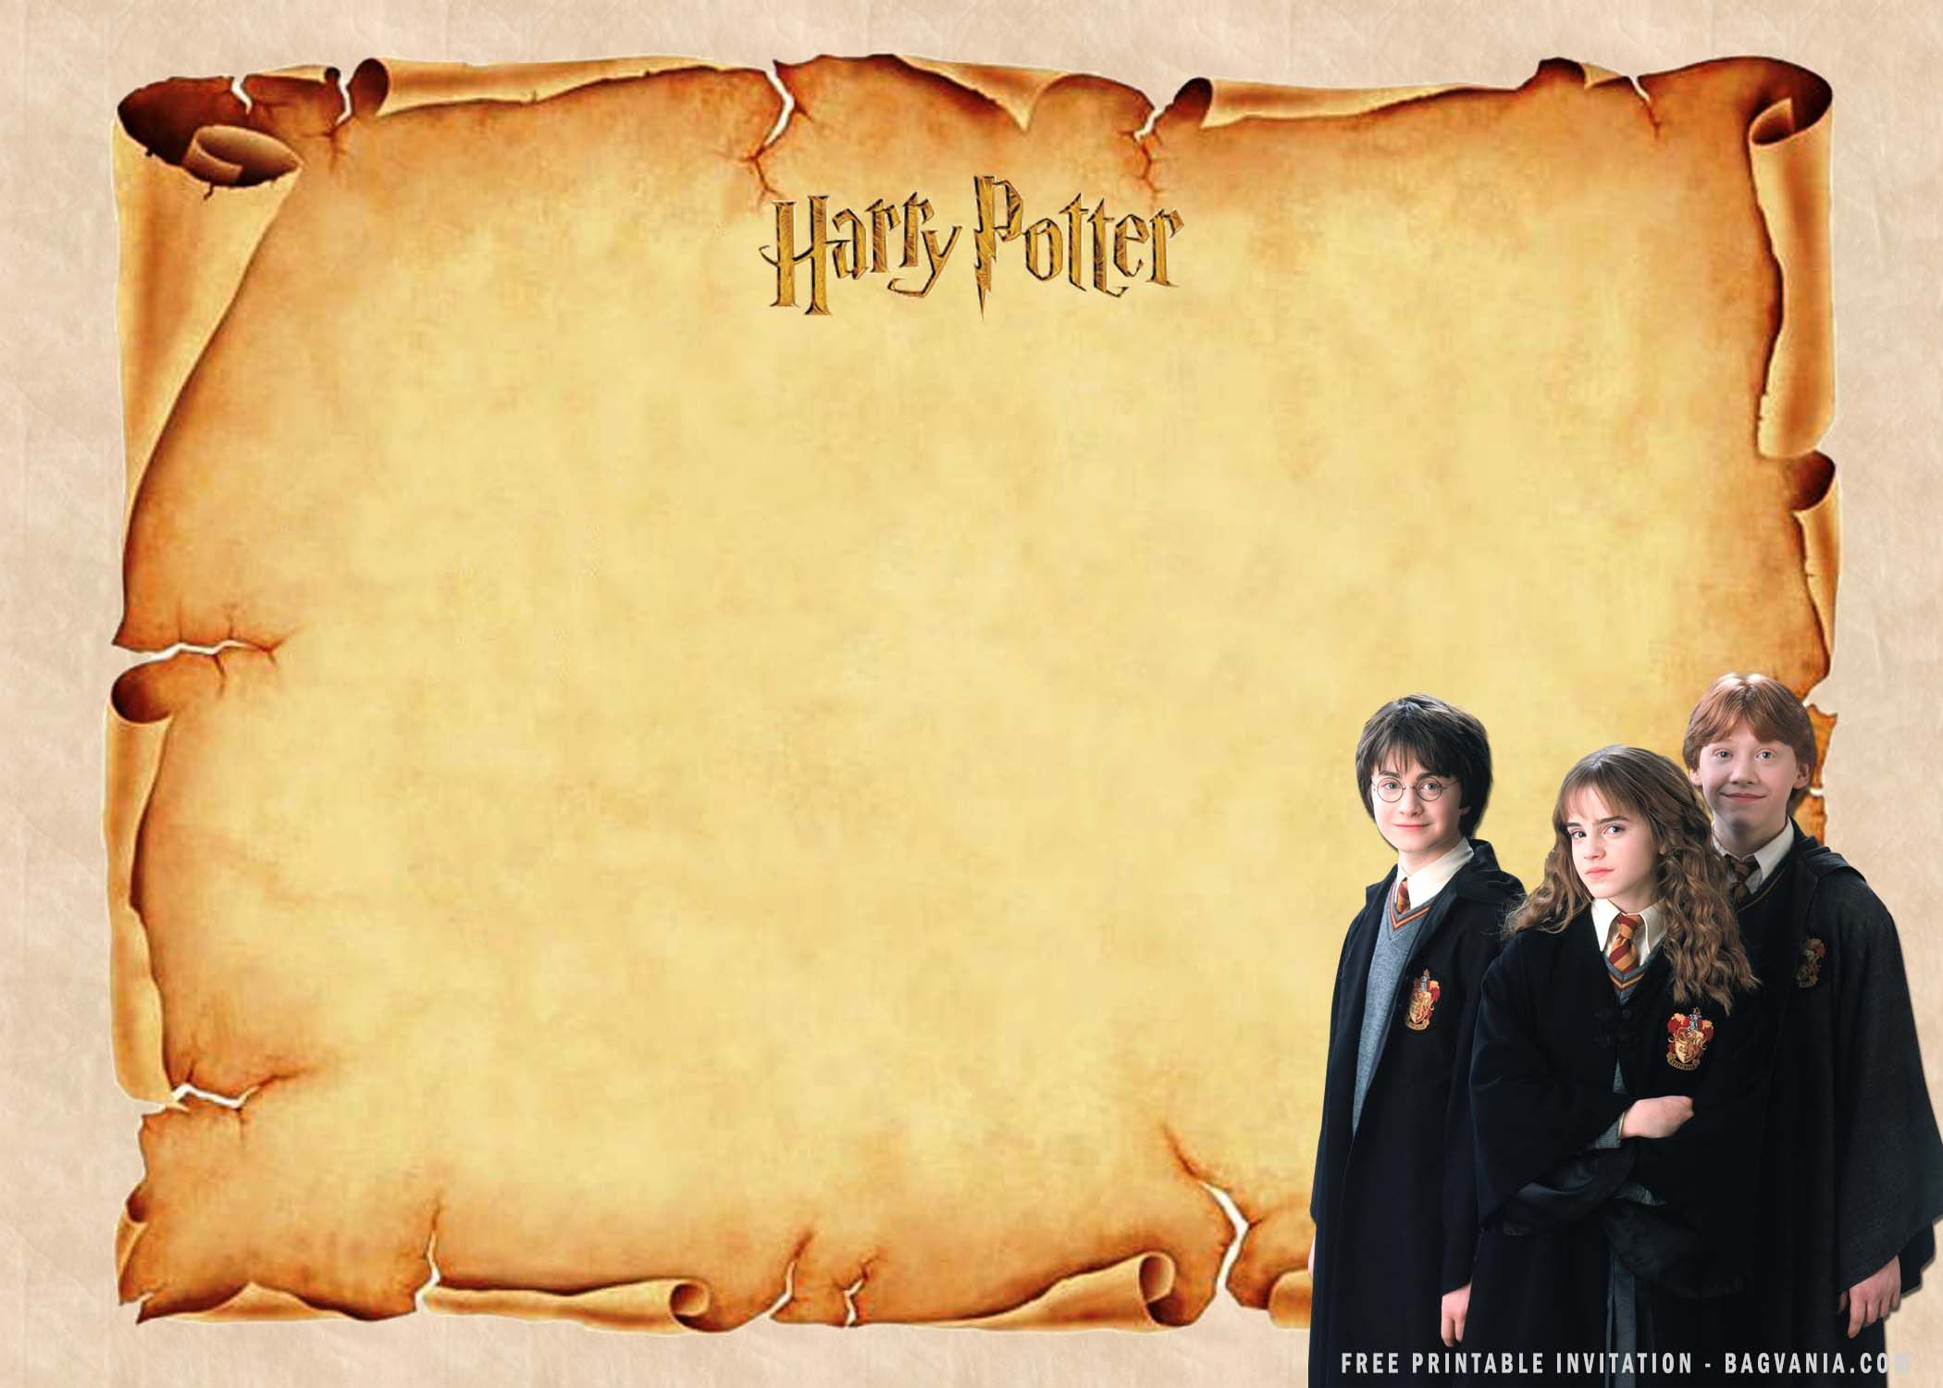
1. Did Harry believe that he was a wizard? 2.Did the Dursleys know that Harry was a wizard? 3. What did Aunt Petunia think about her sister?
Part 4

