Slide 1
Welcome back!
Lesson 6
English sentence
Test

Slide 2

Touch the sky
When cold winds are calling And the sky is clear and bright, Misty mountains sing and beckon, Lead me out into the light.
I will ride, I will fly, Chase the wind and touch the sky, I will fly, Chase the wind and touch the sky.
Where dark woods hide secrets, And mountains are fierce and bold, Deep waters hold reflections, Of times lost long ago.
I will hear their every story, Take hold of my own dream, Be as strong as the seas are stormy, And proud as an eagle’s scream.

Slide 3
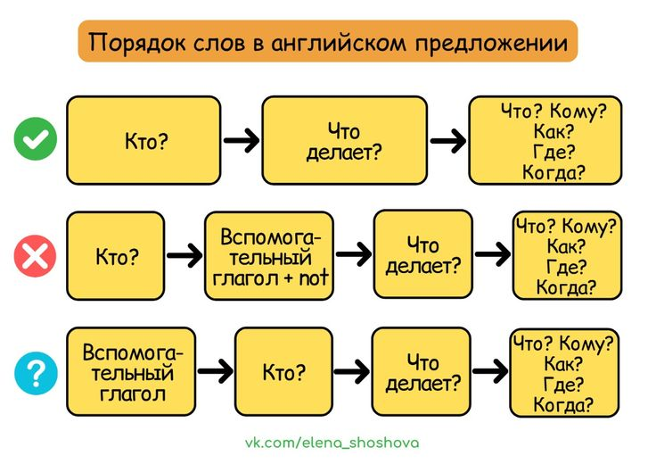

Slide 4
Восстановите правильный порядок слов в предложении
1. not, did, her homework, she, do
a) She did not do her homework.
b) Not she did do her homework.
c) Did she not do her homework?
2. read, do, book, this, you?
a) This book you do read?
b) Read you this do book?
c) Do you read this book?
3. he, be, is, to, going, a pilot.
a) Is he going to be a pilot.
b) To be going a pilot he is.
c) He is going to be a pilot.
4. often, do, how, you, to, go, the, park?
a) How do you often go to the park?
b) How often do you go to the park?
c) Do you how often go to the park?
5. not, like, I, do, carrots.
a) I do not like carrots.
b) Do I not like carrots?
c) I not do like carrots.
6. last, did, buy, what, she , month?
a) Did she buy what last month?
b) Buy did she last month what?
c) What did she buy last month?
7. always, at 6 o’clock, she, wakes, up
a) She always wakes up at 6 o’clock.
b) Always at 6 o’clock she wakes up.
c) She wakes up always at 6 o’clock.
8. yesterday, what, you, did, for, breakfast, have?
a) What did you have for breakfast yesterday?
b) What you did have for breakfast yesterday?
c) Did you have what for breakfast yesterday

Slide 5
Выберите общий вопрос к предложению
1. They can play the piano.
a) Can they play the piano?
b) Do they can play the piano?
c) Play they can the piano?
2. My sister will go to London.
a) Will my sister go to London?
b) Do my sister will go to London?
c) My sister will go to London?
3. My parents bought a new car.
a) What did my parents buy?
b) Did my parents buy a new car?
c) Who bought a new car?
Выберите специальный вопрос к подчёркнутому слову
1. He went to Italy last summer.
a) Where did he go last summer?
b) When did he go to Italy?
c) Who went to Italy last summer?
2. Tom usually plays football on Sundays.
a) When does Tom usually play football?
b) Who usually plays football on Sundays?
c) What does Tom usually do on Sundays?
3. The leaves became yellow because of the cold weather.
a) When did the leaves become yellow?
b) Why did the leaves become yellow?
c) What became yellow because of the cold weather?

Slide 6
Выберите альтернативный вопрос к предложению
1. We are reading a book.
a) Are we reading a book or a magazine?
b) What are we reading?
c) Do we read a book?
2. My family usually collects mushrooms in the forest in September.
a) Where does your family usually collect mushrooms in September?
b) When does your family usually collect mushrooms in the forest?
c) Does your family usually collect mushrooms or berries in the forest in September?
Выберите эквивалент для следующего предложения:
1. Мой друг не был в школе вчера.
a) My friend be not at school tomorrow
b) My friend not was at school tomorrow
c) My friend was not at school yesterday
2. Маша будет рада видеть его завтра.
a) Masha will be glad to see him tomorrow.
b) Masha was glad to see him yesterday
c) Masha were glad to see him yesterday

Slide 7
Homework test
1. Восстановите правильный порядок слов в предложении
every day, exercises, morning, does, she
a) She does morning exercises every day.
b) Every day she does morning exercises.
c) She does exercises morning every day.
2.Выберите общий вопрос к предложению
The children usually play with leaves in the park in autumn.
a) Do the children usually play with leaves in the park in autumn?
b) Does the children usually play with leaves in the park in autumn?
c) Are the children usually play with fallen leaves in the park in autumn?

Slide 8
Homework test
3. Выберите специальный вопрос к подчёркнутому слову
My little brother usually collects yellow leaves in the park.
a) Who usually collects yellow leaves in the park?
b) What does your little brother usually collect in the park?
c) Where does your little brother usually collect yellow leaves?
4. Выберите альтернативный вопрос к предложению
Students usually read books in the library in autumn.
a) Do students usually read books in the library or in the classroom?
b) What do students usually read in the library?
c) When do students usually read books in the library?

Slide 9
Homework test
5. Выберите эквивалент для следующего предложения
По выходным мы с друзьями обычно ходим в кино.
a) My friends and I don’t often go to the cinema on weekends.
b) On weekends my friends and I usually go to the cinema.
c) We with friends usually go to the cinema on weekends.
6. Какое предложение составлено правильно?
a) The wind always blows strongly in October.
b) Always the wind blows strongly in October.
c) The wind blows always strongly in October.

Slide 10

Homework
Test
1. В тетрадь по грамматике (Grammar book) перерисуйте схему порядка слов в английском предложении со слайда 3. Фото прислать мне, если есть возможность - дополнительно распечатайте этот слайд и повесьте/положите на видном месте, где учитесь.
2. Выполните тест на слайдах 7-9. Каждый правильный ответ -
Example:
1. - а, 2. - с, 3 - b и т. д. Ответы присылайте мне в личку.
Засчитываются только правильные предложения
Дополнительный бонус за красоту -

