Slide 1











English
Middle School
Tenses
Present Perfect Tense
LESSON 10

Slide 2


A piece song
RU
Мир тебе в набегающей волне,
Мир тебе в дуновении ветров,
Мир тебе в ярком росчерке звезды,
В теплом сне и дыхании земли.
Deep peace of the running wave to you,
Deep peace of the flowing air to you,
Deep peace of the shining stars to you,
Deep peace of the quiet earth to you.
EN

Slide 3









Past Present Future
Факт Процесс Результат
Simple
V1/ V2 /will +V1
Continuous
to be + Ving
Perfect
have/has/ had +V3
-/?- do/does/did
Always
Usually
Every day
Yesterday
Tomorrow
Often
Sometimes
next week
last summer
Now
at this moment
at that time
still
already
just
yet
ever
never

Slide 4







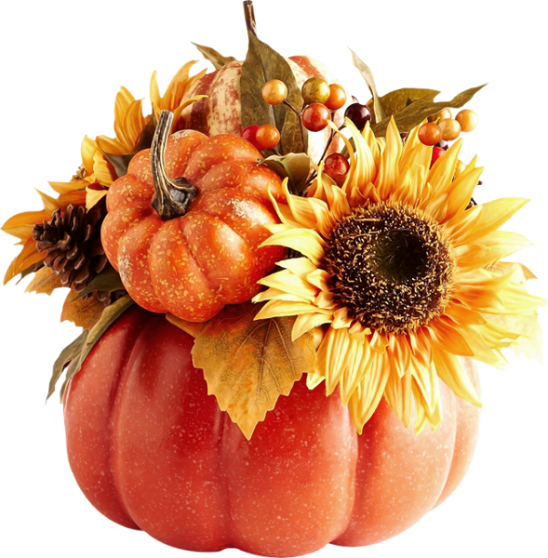

Have you... this autumn?
collected mushrooms/leaves
tried a seasonal drink
HAD a cold
BOUGHT something new
GONE to a new place
cooked or DRANK something with pumpkin
celebrated someone’s birthday
walked in the park
TOOK up a new hobby
SAT by a fire
GONE to a concert
complained about the weather
READ a new book or watched a new series
GOT wet in the autumn rain
stayed home for the whole day
MET an old friend

Slide 5
Today’s verbs
V1
V2
V3
7. take took taken брать, взять
8. see saw seen видеть
9. come came come приходить
100 Verbs

Slide 6
Homework
Make your own cosy story about this autumn using Present Perfect
! use all forms ()
up to 10
?
+ Beautiful design - 2
Bonus - EPOCH SONG (video) - 3

